Slide 1
Tractable Combinations of Global Constraints
CP 2013, pp 230—246
Authors: Cohen, Jeavons, Thornstensen, Zivny
Presented by Robert Woodward
Disclaimer:
Some slides and images borrowed from the authors own slides at CP 2013

Slide 2
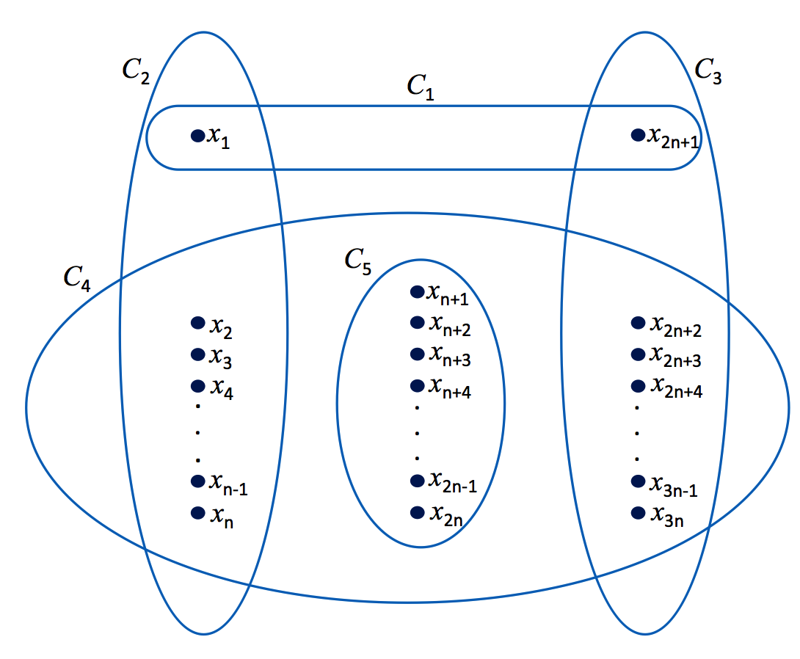
Main Contributions
Addresses tractability (of intersection) of global constraints
Identifies tractability conditions for arbitrary constraints
Polynomial size of assignments of constraints intersections
Bounded sizes of constraints
Shows that property holds for constraints of
Extended Global Cardinality (EGC) of bounded domains
Positive Tables
Negative Tables

Slide 3
Overview
Motivating Example
Restricted Classes of CSPs
Acyclic hypergraph
Treewidth & constraint catalogue
Further Constraint Restrictions
Extensional equivalence
Operations on sets of global constraints
Cooperating constraint catalogues
Polynomial-Time Reductions
Take the dual of the dual
Tractability results
Conclusion
Notes:
Note: I will not give full rigorous proofs for all the details covered in the paper; I do not have time for that! Instead, I will introduce the needed terminology / sketches of proofs so you can go and read the technical details (if you choose)

Slide 4
Motivating Example
Boolean vars: {x₁,x₂,…,x_{3n}}
5 constraints:
C₁: (x₁∨ x_{2n+1})
C₂: Exactly one literal is true
C₃: Exactly one literal is true
C₄: Exactly n+1 literals are true
C₅: (¬x_{n+1}∨ ¬x_{n+2}∨···∨ ¬x_{2n})
Notes:
Family of problems not included in any previously known tractable class, but will be shown to be tractable using the results here

Slide 5
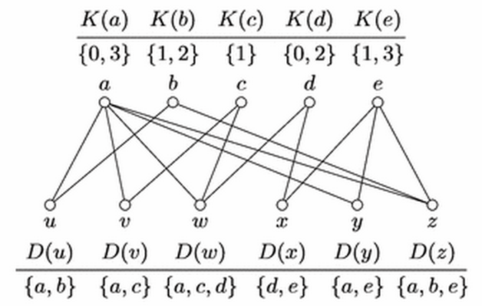
Extended Global Cardinality Constraint
For every domain element a
K(a) a finite set of natural numbers
Cardinality set of a
Requires number of variables assigned to a to be in the set K(a)
Example: Timetabling
6 workers {u,v,w,x,y,z}
5 tasks {a,b,c,d,e}
Restrictions on how many people have to work on a task
Example from [Samer+ Constraints 11]

Slide 6
Motivating Example
All constraints are instances of Extended Global Cardinality (EGC) constraints
C₁: (x₁∨ x_{2n+1})
K(1)={1,2}, K(0)={0,1}
C₂: Exactly one literal is true
K(1)={1}, K(0)={n-1}
C₃: Exactly one literal is true
K(1)={1}, K(0)={n-1}
C₄: Exactly n+1 literals are true
K(1)={n+1}, K(0)={2n-3}
C₅: (¬x_{n+1}∨ ¬x_{n+2}∨···∨ ¬x_{2n})
K(1)={0,1,…,n-1}, K(0)={1,2,…,n}
Notes:
Family of problems not included in any previously known tractable class, but will be shown to be tractable using the results here

Slide 7
Restricted Classes of CSPs
C₁
Structural restrictions (e.g., treewidth)
Hypergraph is acyclic when
Repeatedly removing
all hyperedges contained in other hyperedges, and
all vertices contained in only a single hyperedge
Eventually deletes all vertices
Acyclic hypergraph
Tractable for table constraints
Alert
Hypergraph of a global constraint has a single edge, is acyclic
However, not every global constraint is tractable
Two examples: An EGC constraint with unbounded & bounded domains
C₂
C₃
Acyclic
Non-acyclic

Slide 8
Example (I): EGC constraint with unbounded domain
EGC constraint with unbounded domain is NP-complete
Reduction from SAT
Example: (x₁∨x₂)∧(x̅₁∨x₂)
Full proof in [Quimper+ CP04]
Variables
Values
EGC K(a)
C_{1,1}
C₁
{0,1}
C_{1,1} C_{1,2} C_{2,1} C_{2,2}
C_{1,2}
C₂
{0,1}
Consider assignment:
x₁ = false
x₂ = true
C_{2,1}
x₁
{0,2}
C_{2,2}
x̅₁
{0,2}
x₁
x₂
{0,3}
x₂
x̅₂
{0,1}

Slide 9
Example (II): EGC constraint with bounded domain
EGC constraint with bounded domain is NP-complete
Reduction from 3-coloring G=(V,E)
CSP:
V set of variables
Domains {r,g,b}
For every edge create EGC constraint
K(r)=K(g)=K(b)={0,1}
Make hypergraph acyclic
EGC constraint with scope V and
K’(r)=K’(g)=K’(b)={0,…,|V|}
G
{r,g,b}
{r,g,b}
{r,g,b}

Slide 10
Review of Acyclic Hypergraphs
Guarantee tractability for table constraints
Do not guarantee tractability for global constraints
Structural restrictions alone do not guarantee tractability in general!
Need hybrid restrictions that restrict both
structure &
nature of the constraints

Slide 11
Tree Decomposition
A tree decomposition:〈T, 𝝌, 𝜓〉
T: a tree of clusters
𝝌: maps variables to clusters
𝜓: maps constraints to clusters
Conditions
Each constraint appears in at least one cluster with all the variables in the constraint’s scope
For every variable, the clusters where the variable appears induce a connected subtree
D
𝝌(C1)
R₄
R₅
C₁
𝜓(C1)
G
R₃
{A,B,C,E} , {R₂,R₃}
A
C
B
C₂
C₃
{A,E,F},{R₁}
{A,B,D},{R₃,R₅}
F
R₁
R₂
C₄
E
{A,D,G},{R₄}
Hypergraph
Tree decomposition

Slide 12
Treewidth
Width of a tree decomposition
max({|𝝌(t)|-1 | t node of T})
Treewidth tw(G) of a hypergraph G
minimum width over all its tree decompositions
C₁
{A,B,C,E} , {R₂,R₃}
Great, but we are not interested in individual hypergraphs
ℋ = class of hypergraphs
tw(ℋ) = maximum treewidth over the hypergraphs in ℋ
If tw(ℋ) is unbounded, tw(ℋ)=∞
Otherwise tw(ℋ)<∞
C₂
C₃
{A,E,F},{R₁}
{A,B,D},{R₃,R₅}
C₄
{A,D,G},{R₄}
Width of tree decomposition: 3
Recall, I said we wanted to restrict both structure & constraints

Slide 13
Constraint Catalogue
Constraint catalogue 𝒞 is a set of global constraints
CSP instance is over a constraint catalog if every constraint in the instance is in the catalog
Restricted CSP class
𝒞 a constraint catalog
ℋ be a class of hypergraphs
CSP(ℋ,𝒞) the class of CSP instances over 𝒞 whose hypergraphs are in ℋ
CSP(ℋ,𝒞) is tractable if tw(ℋ)<∞
Does not help us with our example
tw(ℋ)=∞

Slide 14
Overview
Motivating Example
Restricted Classes of CSPs
Acyclic hypergraph
Treewidth & constraint catalogue
Further Constraint Restrictions
Extensional equivalence
Operations on sets of global constraints
Cooperating constraint catalogues
Polynomial-Time Reductions
Take the dual of the dual
Tractability results
Conclusion
Notes:
Note: I will not give full rigorous proofs for all the details covered in the paper; I do not have time for that! Instead, I will introduce the needed terminology / sketches of proofs so you can go and read the technical details (if you choose)

Slide 15
Extension Equivalence
Global constraint e[δ] to X⊆vars(δ)
ext(μ ,e[δ]) [Selection & Projection]
Set of assignments of vars(δ)-X that extend μ to a satisfying assignment for e[δ]
Two assignments θ₁, θ₂ to X
are extension equivalent on X w.r.t. e[δ]
if ext(θ₁,e[δ])=ext(θ₂,e[δ])
Denoted equiv[e[δ],X]
A | B | C
0 | 0 | 0 | 0
0 | 0 | 1 | 1
0 | 1 | 0 | 1
0 | 1 | 1 | 1
1 | 0 | 0 | 1
1 | 0 | 1 | 1
… | … | … | …
X
(A ∨ B ∨ C)
ext(A=0,B=1)
ext(A=1,B=0)
(A=0,B=1)&(A=1,B=0) are equivalent

Slide 16
Example: Extension Equivalence
For any clause e[δ] & non-empty X⊆vars(δ)
Any assignment to X will either
Satisfies at least one
Any extension will satisfy the clause
All such assignments are extension equivalent
Falsifies all of them
An extension will satisfy the clause iff it satisfies one of the other literals
equiv[e[δ],X] has 2 equivalence classes
A | B | C
0 | 0 | 0 | 0
0 | 0 | 1 | 1
0 | 1 | 0 | 1
0 | 1 | 1 | 1
1 | 0 | 0 | 1
1 | 0 | 1 | 1
… | … | … | …
X
ext(A=0,B=0)
(A ∨ B ∨ C)
ext(A=0,B=1)
ext(A=1,B=0)

Slide 17
Operations on Sets of Global Constraints
S a set of global constraints
iv(S) = ⋂_{c∈S} vars(c)
Intersection of scopes of the constraints in S
join(S) = a global constraint e’[δ’]
Operates as you imagine a join should
Notes:
First, some terminology / notation
join(S) = a global constraint e’[δ’]
with vars(δ’) = ⋃_{c∈S} vars(c)
such that for every assignment θ to vars(δ’)
we have θ∈e’[δ’] iff
for every e[δ]∈S, θ|_{vars(δ)}∈e[δ]

Slide 18
Cooperating Constraint Catalogues
(A∨B∨C)∧(A̅∨B∨D)
Constraint catalogue 𝒞 is cooperating if
For any finite set of global constraints S⊆𝒞
We can compute a set of assignments of the variables iv(S)
Containing at least one representative of each equivalence class of equiv[join(S),iv(S)]
In polynomial time in
the size of iv(S) and
the total size of the constraints in S
iv(S)
A | B | C | D
0 | 0 | 1 | 0 | 1
0 | 0 | 1 | 1 | 1
0 | 1 | 0 | 0 | 1
0 | 1 | 0 | 1 | 1
0 | 1 | 1 | 0 | 1
0 | 1 | 1 | 1 | 1
1 | 0 | 0 | 1 | 1
1 | 0 | 1 | 1 | 1
1 | 1 | 0 | 0 | 1
1 | 1 | 0 | 1 | 1
1 | 1 | 1 | 0 | 1
1 | 1 | 1 | 1 | 1
ext(A=0,B=1)
ext(A=1,B=1)
Notes:
Care about cooperating constraint catalogues because we want to exploit the polynomial nature later

Slide 19
Example: Cooperating Constraint Catalogue
(A∨B∨C)∧(A̅∨B∨D)
Constraint catalogue consisting entirely of clauses
equiv[join(S),iv(S)] has at most |S|+1 classes
Similar argument to equiv[e[δ],X] has 2 equivalent classes
All other assignments that satisfy at least one literal in each clause (at most 1)
Single assignment of variables in iv(S) that falsify (at most |S|)
Equivalence classes in equiv[join(S),iv(S)] increases linearly with S
iv(S)
A | B | C | D
0 | 0 | 1 | 0 | 1
0 | 0 | 1 | 1 | 1
0 | 1 | 0 | 0 | 1
0 | 1 | 0 | 1 | 1
0 | 1 | 1 | 0 | 1
0 | 1 | 1 | 1 | 1
1 | 0 | 0 | 1 | 1
1 | 0 | 1 | 1 | 1
1 | 1 | 0 | 0 | 1
1 | 1 | 0 | 1 | 1
1 | 1 | 1 | 0 | 1
1 | 1 | 1 | 1 | 1
ext(A=0,B=0)
ext(A=0,B=1)
ext(A=1,B=0)
ext(A=1,B=1)
Notes:
Care about cooperating constraint catalogues because we want to exploit the polynomial nature later

Slide 20
Are EGC Constraints Cooperating?
In general, no
Theorem
Any constraint catalogue that contains only
counting constraints with bounded domain size,
table constraints, and
negative constraints,
is a cooperating catalogue
An EGC constraint is a counting constraint
Thus, it is tractable when it has bounded domain size
Proof of theorem is not presented for lack of time
Notes:
Counting function: Let X be a set of variables with domain D=… A counting function for X is any function K: D \rightarrow \mathbb{N} such that \sum_{a \in D} K(a) = |X|. Every assignment θ to X defines a corresponding counting function K_θ given by K_θ(a) = |{x \in X | θ(x) = a}| for every a \in D
Counting Constraints: Global constraint e[δ] is called a counting constraint if, for any two assignments θ1, θ2 or vars(δ) which have the same counting function, either θ1, θ2 \in e[δ] or θ1, θ2 \notin e[δ]

Slide 21
Overview
Motivating Example
Restricted Classes of CSPs
Acyclic hypergraph
Treewidth & constraint catalogue
Further Constraint Restrictions
Extensional equivalence
Operations on sets of global constraints
Cooperating constraint catalogues
Polynomial-Time Reductions
Take the dual of the dual
Tractability results
Conclusion
Notes:
Note: I will not give full rigorous proofs for all the details covered in the paper; I do not have time for that! Instead, I will introduce the needed terminology / sketches of proofs so you can go and read the technical details (if you choose)

Slide 22
Polynomial-Time Reductions
Goal is to show for any constraint problem over a cooperating catalogue, give a polynomial-time reduction to a smaller problem
Consider a set of variables that all occur in exactly the same set of constraint scopes
Replace them by a single new variable with an appropriate domain
How? Using the dual of a hypergraph

Slide 23
Dual of a Hypergraph
G=(V,H) a hypergraph
The dual of G, G* is a hypergraph with
Vertex set: H
For every v∈V, a hyperedge {h∈H|v∈h}
For a class of hypergraphs ℋ, ℋ*={G*|G∈ℋ}

Slide 24
The Dual, in Pictures
Note: The dual of the dual of a hypergraph is not necessarily the original hypergraph
Notes:
Gives us a “merging” of the variables

Slide 25
The Dual and Treewidth
twDD: Treewidth of the dual of the dual of G
twDD(G)=tw(G**)
For class of hypergraphs ℋ, twDD(ℋ)=tw(ℋ**)
For our example
twDD(ℋ)=3

Slide 26
Tractability Result
Constraint catalogue 𝒞 and class of hypergraphs ℋ
CSP(ℋ,𝒞) is tractable if 𝒞 is a cooperating catalogue and twDD(ℋ)<∞
I can sketch the definitions/ideas for the proof
The proof gives justification for why we can take the dual of the dual
See the paper for the full rigorous proof
Notes:
Before we go into the technical details (and you get have the potential to get lost…), here is the major result!

Slide 27
Conclusions
Cannot achieve tractability by structural restrictions alone
Introduce cooperating constraint catalogue
Sufficiently restricted to ensure that an individual constraint is always tractable
Not all structures are tractable even with cooperating constraint catalogue (twDD(ℋ)=∞ NP-Complete)
However, twDD(ℋ)<∞ is tractable

Slide 28
Thank You
Any Questions?
Don’t ask me… I didn’t write the paper
Contact the authors ☺
Just kidding… I’ll try to answer them!

Slide 29
Quotient of a CSP Instance
P
Let P=(V,C) be a CSP instance
X⊆V non-empty subset of variables
all occur in the scope of the same set S of constraints
The quotient of P w.r.t. X, P^{X}, defined:
Variables of P^{X} are given by V^{X}=(V-X)∪{v_{X}}
v_{X} is a fresh variable
Domain of v_{X} is equiv[join(S),X]
Constraints of P^{X} are unchanged, except
each constraint e[δ]∈S is replaced by a new constraint e^{X}[δ^{X}]
vars(δ^{X})=(vars(δ)-X)∪{v_{X}}
assignment θ true iff the equiv[join(S),X] is true
X
P^{X}
v_{X}
Notes:
Goal: Replace a set of variables with a single variable
Constraints of P^{X} are unchanged, except
each constraint e[δ]∈S is replaced by a new constraint e^{X}[δ^{X}]
vars(δ^{X})=(vars(δ)-X)∪{v_{X}}
for any assignment θ of vars(δ^{X}), define e^{X}[δ^{X}](θ) to be 1 iff θ|vars(δ)-X⊕μ∈e[δ], where μ is a representative of the equivalence class θ(v_{X})

Slide 30
Using the Dual of the Dual
CSP P can be converted to P’
With hyp(P’)=hyp(P)**
Such that P’ has a solution iff P does
If P is over a cooperating catalogue, this conversion can be done in polynomial time
CSP(ℋ,𝒞) is tractable if 𝒞 is a cooperating catalogue and twDD(ℋ)<∞

