Slide 1
Exploiting Automatically Inferred Constraint-Models for Building Identification in Satellite Imagery
Martin Michalowski, Craig A. Knoblock
University of Southern California Information Sciences Institute
Research funded by the AFSOR,
grant numbers FA9550-04-1-0105 and FA9550-07-1-0416.
Kenneth M. Bayer, Berthe Y. Choueiry
University of Nebraska-Lincoln Constraint Systems Lab
Research funded by NSF CAREER Award No. IIS-0324955.

Slide 2
Problem Statement
Goal: Annotating satellite imagery with addresses
Addresses can be assigned by exploiting sets of addressing “rules”
Many traditional and non-traditional data sources available online
How can we combine our knowledge of addressing with the available data?

Slide 3
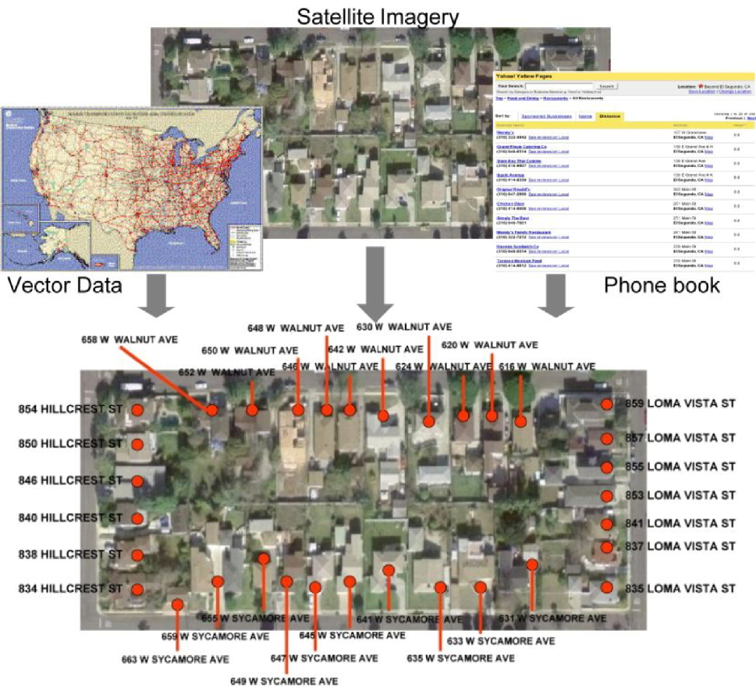
Building Identification Process
Non-traditional Sources
Traditional Sources
Notes:
Explain the process of using traditional + non-traditional sources to identify buildings in satellite imagery
Leveraging address characteristics found in the real world
Mention Pickering report to provide additional motivation

Slide 4
Challenges
Integrating heterogeneous data
Modeling data and addressing characteristics
Supporting various addressing schemes
One model tailored & stored per area ← BAD
Non-homogenous addressing within one area
Efficiently solving the constructed problem

Slide 5
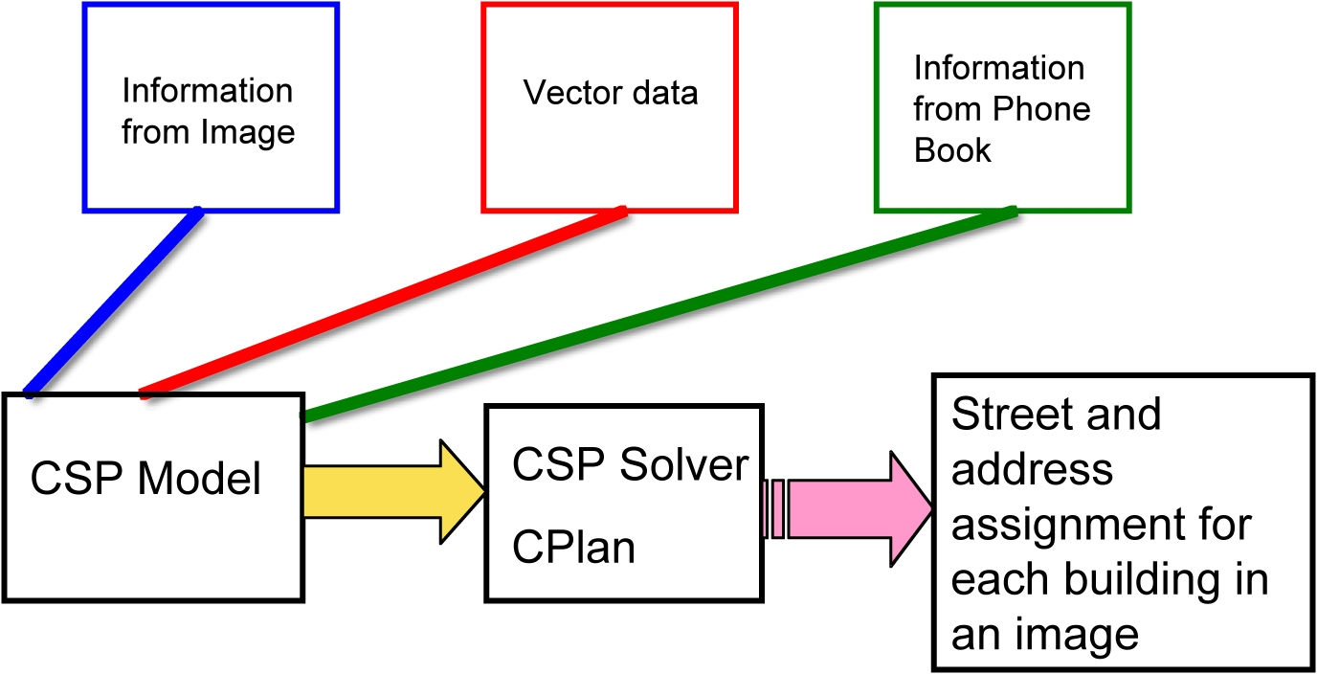
Initial Approach [Michalowski & Knoblock, 2005]

Slide 6
Building Identification as a CSP [Michalowski+, 2005]
Constraint Satisfaction Problem
Variables: Buildings
Variable Domains: Potential street addresses
Constraints: Global addressing characteristics (parity, ascending direction, etc.)
Demonstrated the feasibility of modeling data integration for building identification as a CSP
Limitations
Relied on a ‘single-model’ approach
Limited to small homogeneous areas
Did not scale

Slide 7
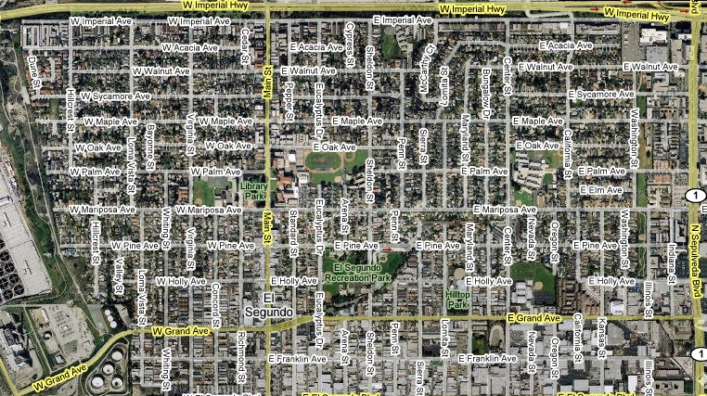
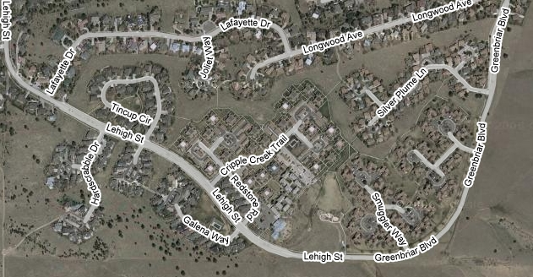
Why a Single Model Doesn’t Work
Block Numbering
Constraints apply in different contexts
YES
1
2
NO
Addresses increase West
Addresses increase East

Slide 8
Our Solution

Slide 9
Constraint Inference
Problem Instance
Constraint Library
User-defined (& learned) constraints
C_{L} = {C_{l1},C_{l2},…,C_{lz}}
Input information
F = {F₁,F₂,…,F_{n}}
Generic model
C_{B} = { C₁,C₂,…,C_{i}}
Inference Engine
Inference rules R_{t} = {R₁,R₂,…,R_{z}}
R_{k}: F_{i} ∈ F → C_{I} ∈ C_{L}
Refined model: C_{new} = C_{B} ∪ C_{I}
Notes:
Careful: At the bottom, it is C_I and NOT C_L

Slide 10
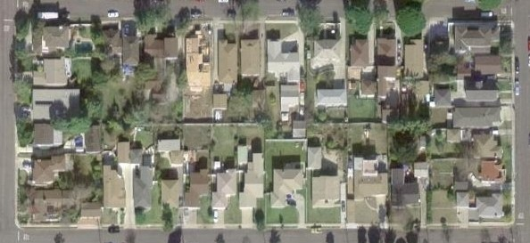
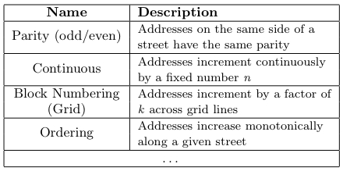
Example
Data points
Landmark points that describes a particular instance
Obtained from any online point repository (e.g. gazetteers)
Features: Address Number, Street Name, Lat, Lon…
852 Hillcrest St
859 Loma Vista St.
834 Hillcrest St
Constraints
Context (El Segundo)
1
2

Slide 11
Inferring Constraints
Inference rules are evaluated using data points
Supports (+,-) provided for the constraints
Constraints are partitioned based on support level
Status: Applicable, Unknown, Non-applicable
Applicable constraints added to generic model
Constraint Library
Applicable
Unknown
Non-applicable
Status:
Support:
Positive
Null
Negative
Notes:
Define support level
Support level of 1 initially used
Support levels studied as future work

Slide 12
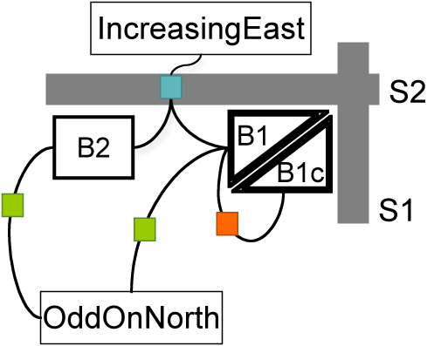
Model Generation
Generates constraint model from variables and inferred constraints
Model improvements over previous work
Reduces total number of variables and constraints’ arity
Reflects topology: Constraints can be declared locally & in restricted ‘contexts’
B1
B2
B3
B4
B5

Slide 13
Constraint Solver
Backtrack-search with nFC3 and conflict-directed back-jumping
Exploits structure of problem (backdoor variables)
Implements domains as (possibly infinite) intervals
Incorporates new reformulations that increase the scalability by large factors
Details available in [Bayer+, 2007]

Slide 14
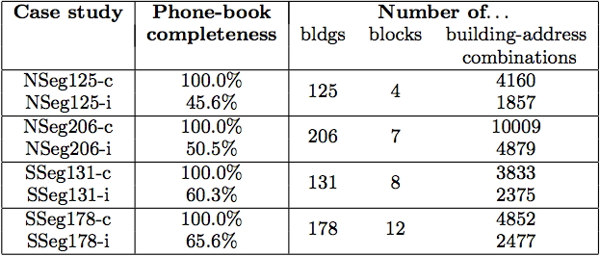
Case Studies
All cases are beyond what our initial work could solve

Slide 15
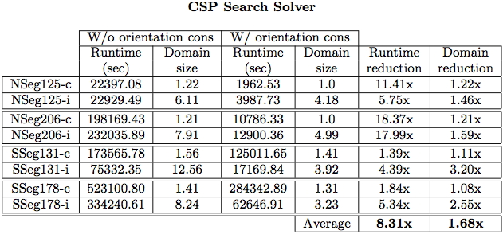
Experimental Results
26 points used to infer correct model (inference time < 2 secs)
Inferred model greatly reduces runtime
Domain reduction leads to higher precision by a significant factor
Additional results show an even greater improvement (see paper)

Slide 16
Observations
Constraint inference provides framework for data integration
Inferred models lead to more precise results
Ability to solve more complex instances
Dynamic modeling makes global coverage possible and easier

Slide 17
Related Work
Geospatial
Geocoding
[Bakshi+, 2004]
Computer Vision
[Agouris+, 1996; Doucette+, 1999]
Modeling
Learning constraint networks from data
[Coletta+, 2003; Bessière+, 2005]

Slide 18
Current Work
Eliminating incorrect constraint inference
Support levels associate confidence with inferences
Dealing with a lack of expressiveness in data points
Iterative algorithm with constraint propagation
Generalizing context-inference mechanism
Classification in the feature space using SVMs
Learning constraints to populate library
Agglomerative clustering combined with set covering

Slide 19
Thank you!!!

Slide 20
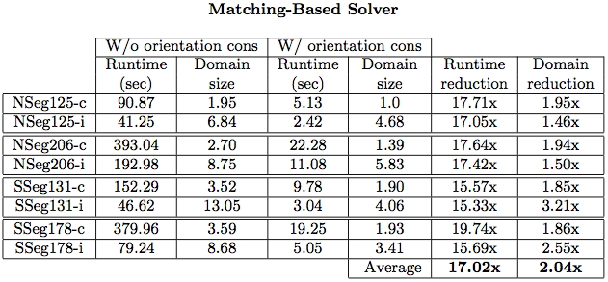
Experimental Results

