Slide 1
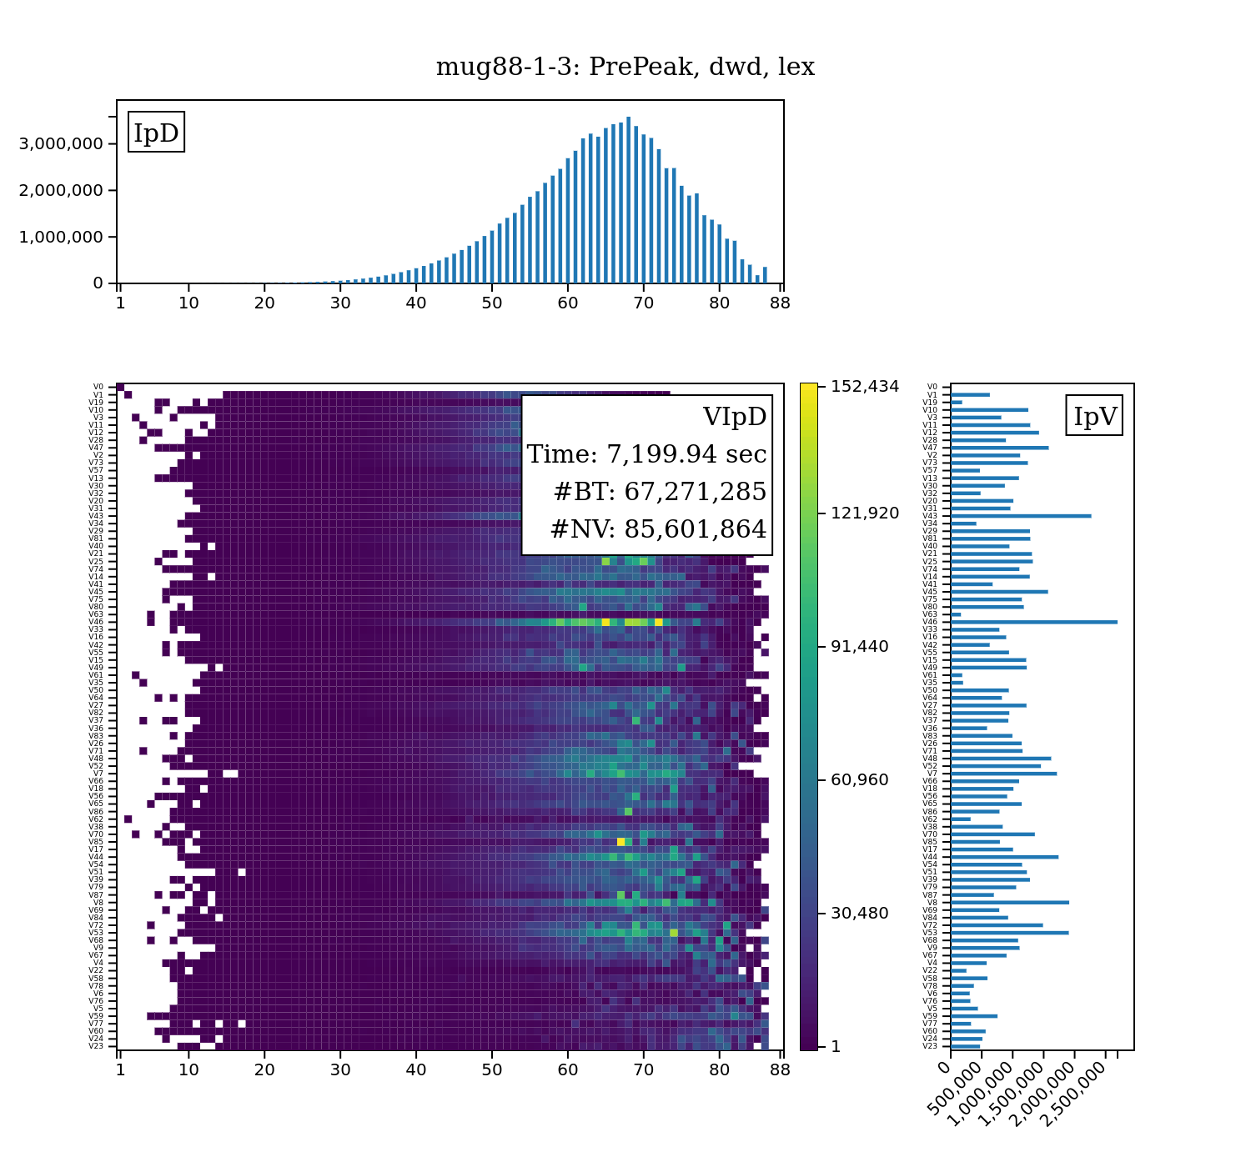
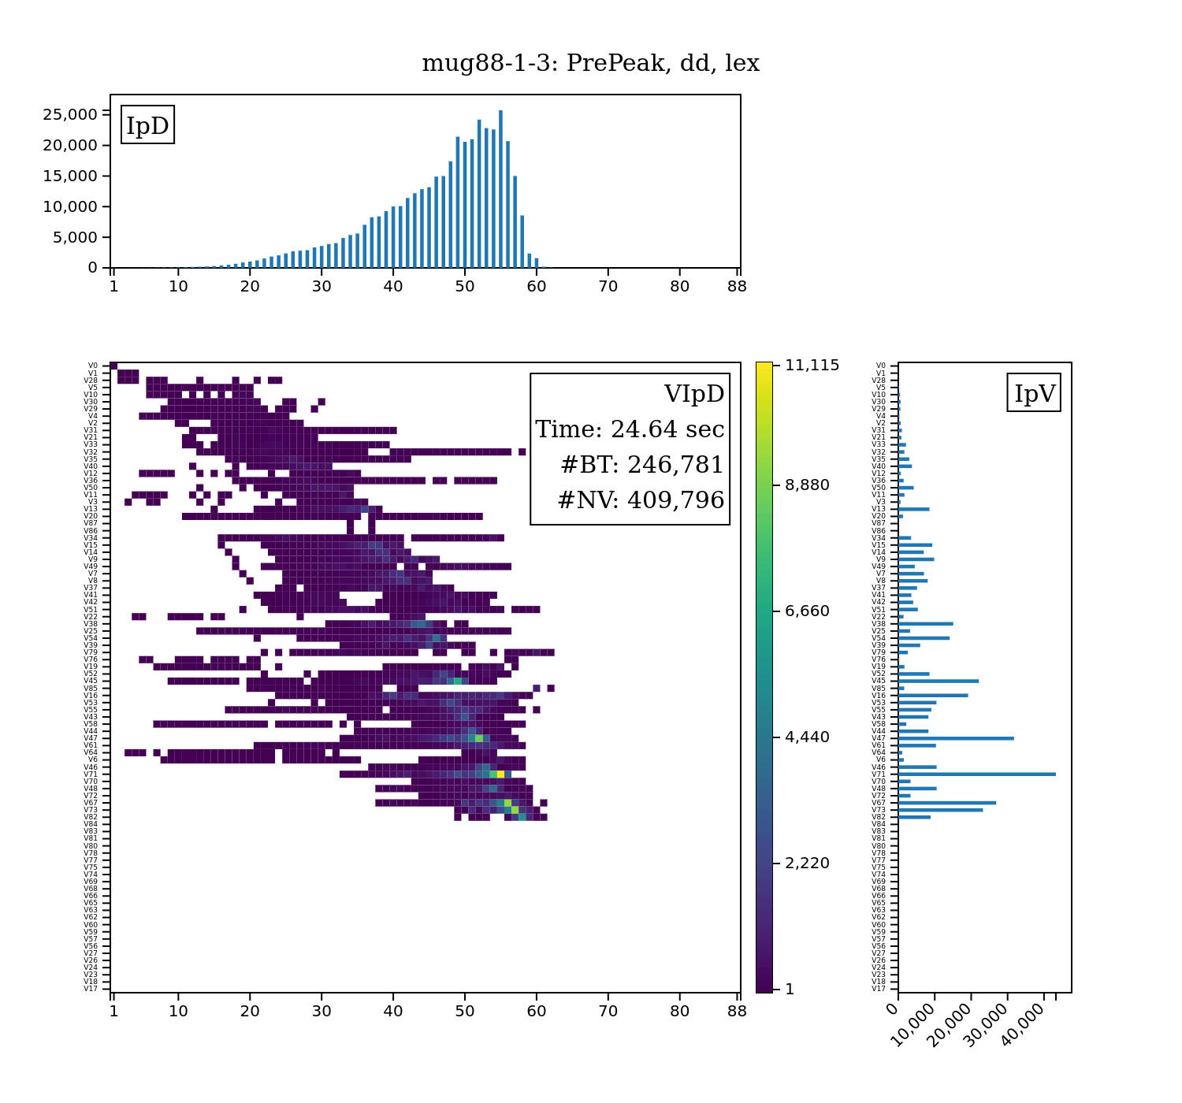
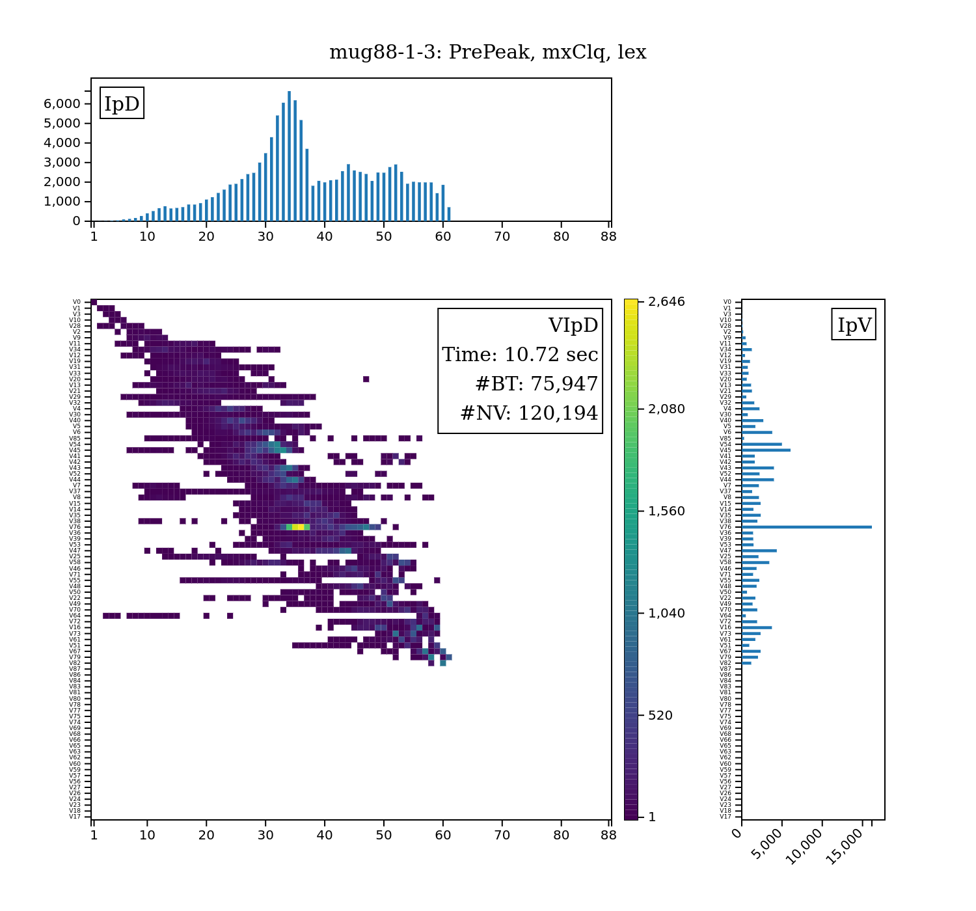


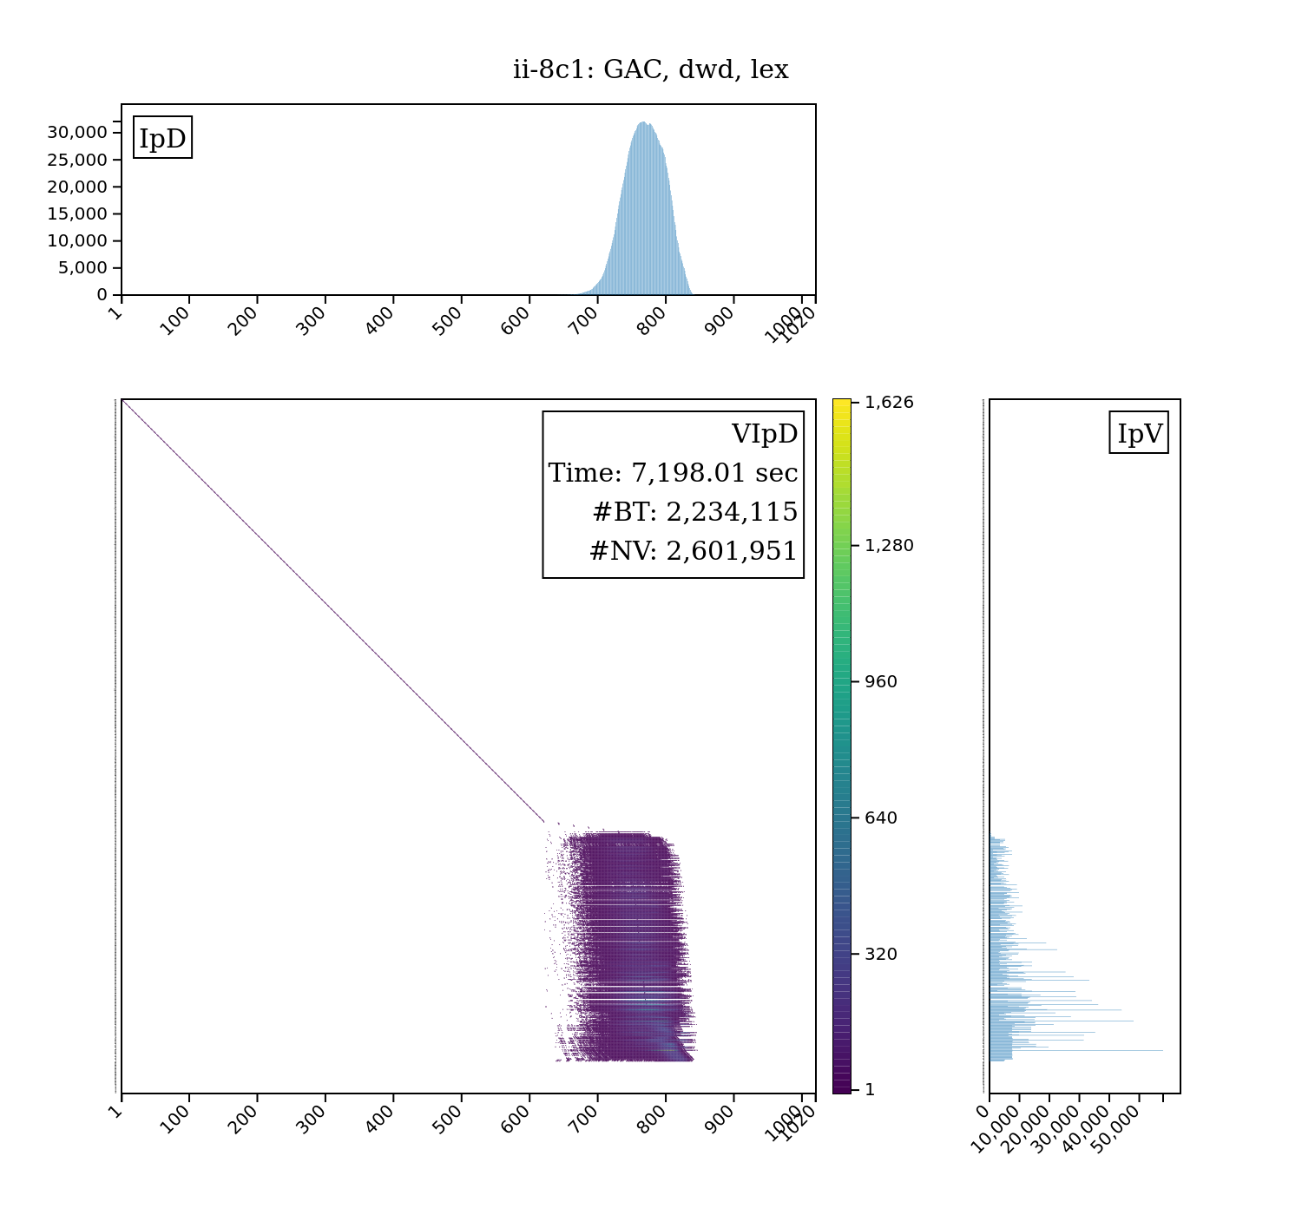
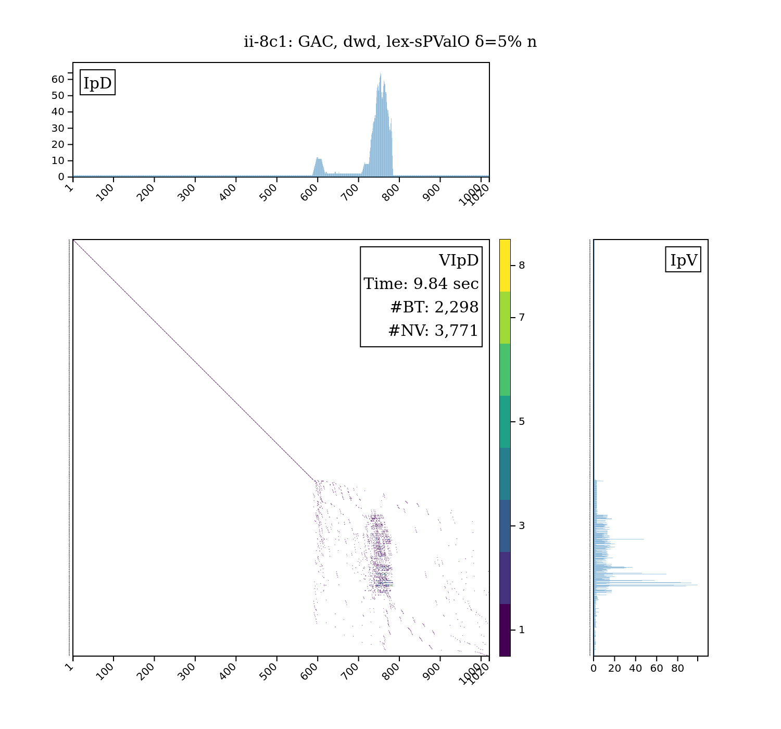
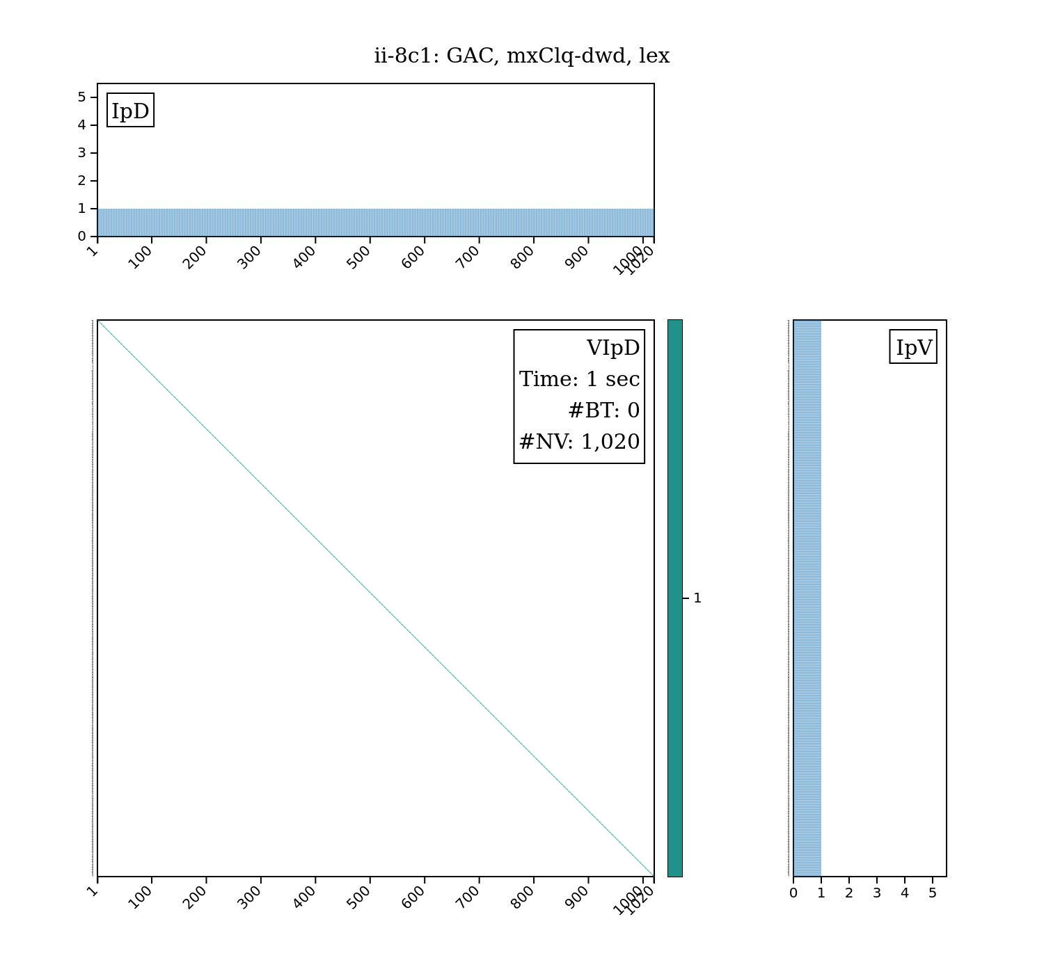
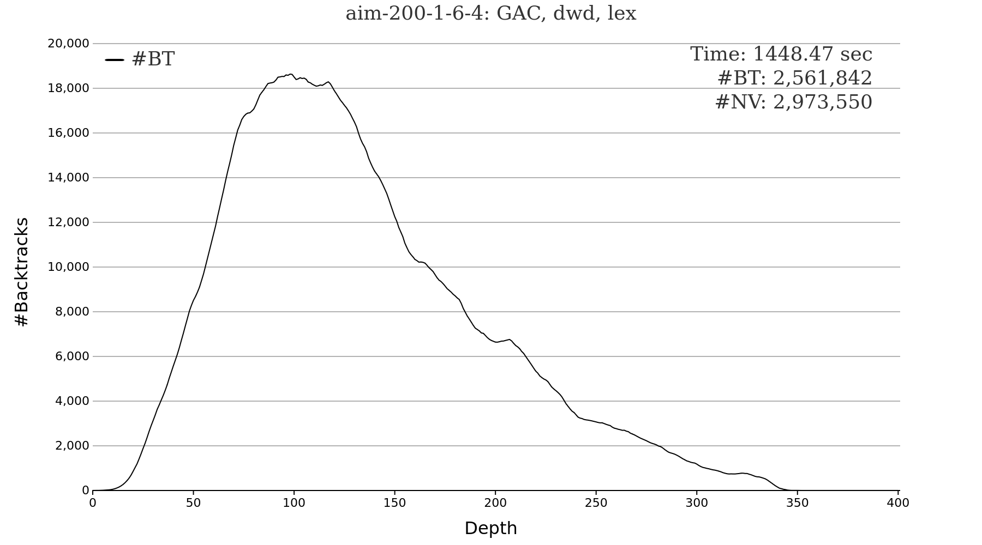
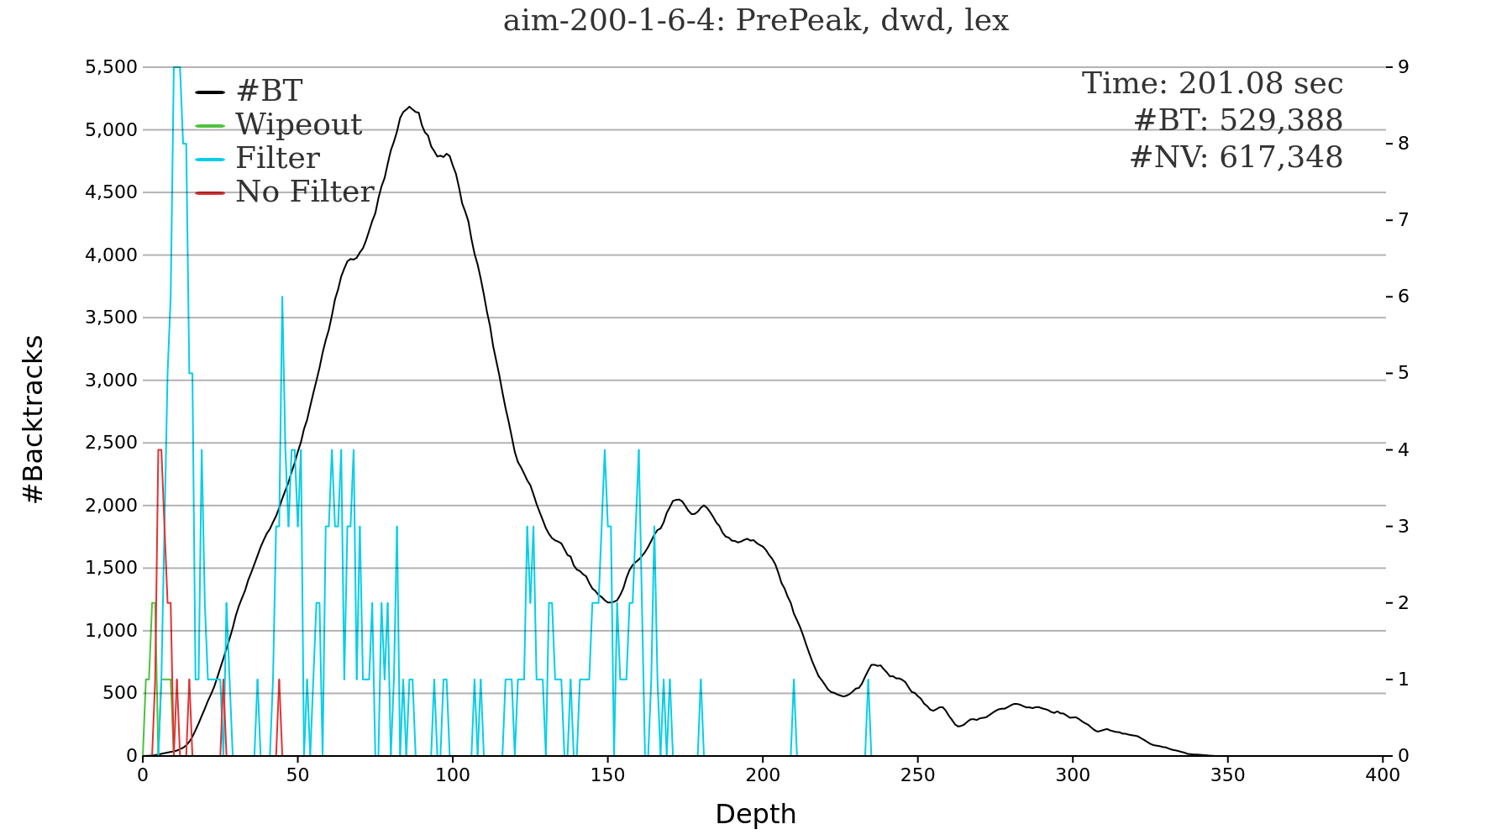

Visualizations to Explain Algorithm Performance
Carston Wiebe, Andrew Kula, Simon Schoenbeck, and Berthe Y. Choueiry
Constraint Systems Laboratory • School of Computing
Context and Contributions
Context: Constraint Programming (CP) is powerful paradigm for modeling and solving complex decision problems in management and engineering, including resource allocation, scheduling, product configuration, and design. These problems are represented as Constraint Satisfaction Problems (CSPs), which are NP-complete, making their solving cost difficult to predict. Contributions: We design visualizations that summarize the behavior of the CP solver to Explain the cost of the solver Allow the users to design new algorithms and heuristics
Parameters and Visualizations
Cost of search Number of variable instantiations: #NV Number of backtracks: #BT Number of calls to a consistency algorithm CPU time Visualizations BpD: Number of backtracks per depth VIpD: Number of variable instantiations per depth CpD: Number of calls to a consistency algorithm per depth #Wipeouts: Consistency prunes the entire subtree (super effective) #Filter: Consistency reduces size of subtree (beneficial) #No-filter: Consistency does not affect subtree (wasted efforts)
Ordering Heuristics
mug88-1-3 (UNSAT)
dwd, currently the leading dynamic variable ord. heuristic, is sometime erratic | dd, an older dynamic variable ord. heuristic, is sometimes more stable than dwd | MaxClique, our static variable ord. heuristic, exploits the problem’s structure and performs best
ii-8c1 (SAT)
dwd, again, is erratic: search does not terminate within two hours | Reactively applying PValO [Geelen 92],a costly value ord. heuristic, terminates in less than 10 seconds | MaxClique, our static variable ord. heuristic, exploits the structure of the CSP and solves this instance backtrack-free!
Solving CSPs with Search
Constraint Satisfaction Problem: Given A set of decisions (variables), options for each decision (values), and A set of constraints restricting the allowed combinations of options to decisions (combinations of values to variables), Determine if the problem has a solution that satisfies all constraints Example: a Sudoku puzzle Algorithms Backtrack search: Enumerates all combinations of values for variables Ordering heuristics: Choose which variable to instantiate first Consistency algorithms: Prune inconsistent combinations
High-Level Consistency
root
Solving aim-200-1-6-4
GAC, the basic consistency algorithm, takes more than 24 min
POAC, a high-level consistency applied reactively because it is expensive, takes less than 4 min
V₁
a₁
a₂
a_{i}
V₂
a₁
a₂
a_{i}
V_{n}
a₁
a₂
a_{i}
a₁
a₂
a_{i}
Consistency | Basic GAC | HLC, reactively POAC
CPU time | 1,448.5 sec | 201.08 sec
#BT | 2,561,842 | 529,.388
#NV | 2,973,550 | 617,348
max #BT | 18,632 | 5,185
root
Consistency pruning
Basic (GAC)
High level (HLC)
Future Work
Visualize the constraint graph Coordinate various visualizations Generate animations of significant search regimes
#Calls to (expensive) HLC
Wipeouts: super effective
Filter: beneficial
No filter: wasted efforts
n
Acknowledgments: Supported by UCARE; experiments run on HCC April 7, 2026

