Slide 1
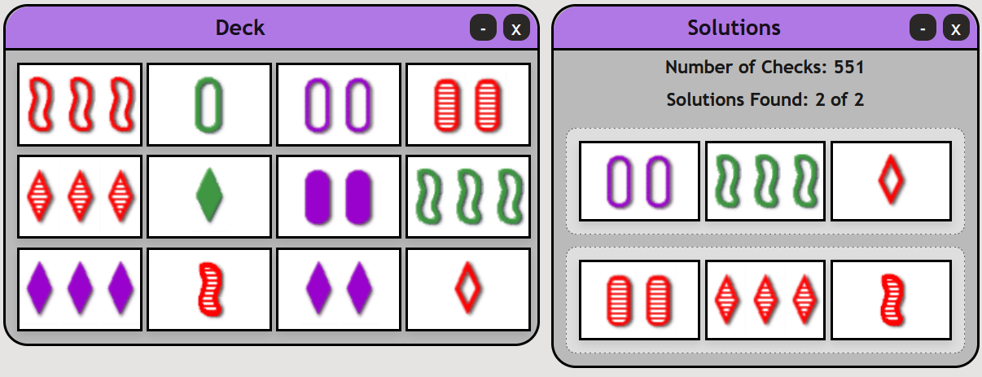
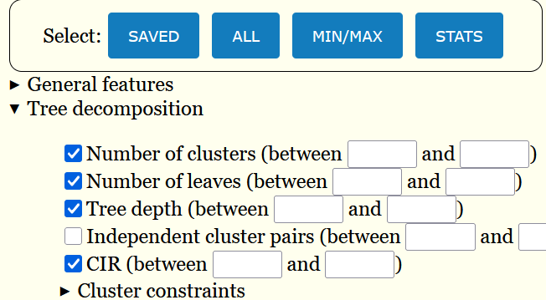
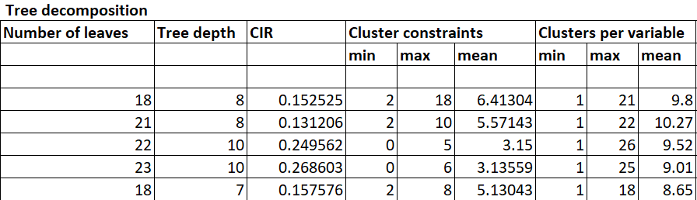

Interactive Graphical Interfaces for Constraint Programming
Sofia Sharif and Berthe Y. Choueiry
Constraint Systems Laboratory • School of Computing
Game of SET
Benchmark DB: Advanced Query
The CP benchmark Database stores a large number of constraint networks used for empirical studies in the Constraint Systems Laboratory. The DB maintains information about the characteristics and attributes of the benchmark instances that are used in evaluating new algorithms developed in the Laboratory. As such, it is a critical resource for our research.
A popular card game of visual perception designed in 1974 by geneticist Marsha Falco.
Task: Identify three cards in a set of 12 (out of 81) where each feature (color, shape, number and shading) is identical or all different.
Goal: Explore visualizations to teach children to play and reason about the game
Contributions: Built an interactive online interface to play the Game of SET and to find all solutions in a deck.
Data structure representing the deck
Database
Attribute​ | c₁​ | c₂​ | c₃​ | c₄​ | c₅​ | c₆​ | c₇​ | c₈​ | c₉​ | c₁₀​ | c₁₁​ | c₁₂​
Number​ | 3​ | 1​ | 2​ | 2​ | 3​ | 1​ | 2​ | ​3 | 3 | 1 | 2​ | 1​
Color​ | r | g | p​ | r​ | r​ | g | p​ | ​g | p | r | p​ | r​
Filling​ | e | e​ | e | s​ | s​ | f | f | ​e | f | s | f​ | e
Shape​ | s | o​ | o​ | o​ | d​ | d​ | o​ | ​s | d | s | d​ | d
Attribute | Values | Constraint
Card id | 1, 2,.. , 81 | id≠
Number | 1, 2, 3 | N⁼ ⊕ N≠
Color | r, g, p | C⁼ ⊕ C≠
Filling | e, f, s | F⁼ ⊕ F≠
Shape | d, o, s | S⁼ ⊕ S≠
id≠
Constraint model
c₁, c₂,…, c₁₂
S⁼ ⊕ S≠
c₁, c₂,…, c₁₂
C⁼ ⊕ C≠
N⁼ ⊕ N≠
c₁, c₂,…, c₁₂
F⁼ ⊕ F≠
Contributions
Added several attributes to the DB to support current research activities
Enhanced the query functionalities to support repeated queries
Enhanced output into Excel files ready for analysis of large experiments
Next steps: Build interactive visualizations of a decomposition algorithm for solving the game without enumerating combinations [Swearngin+ 2011].
Acknowledgment: Supported by UCARE April 7, 2026

