Slide 1
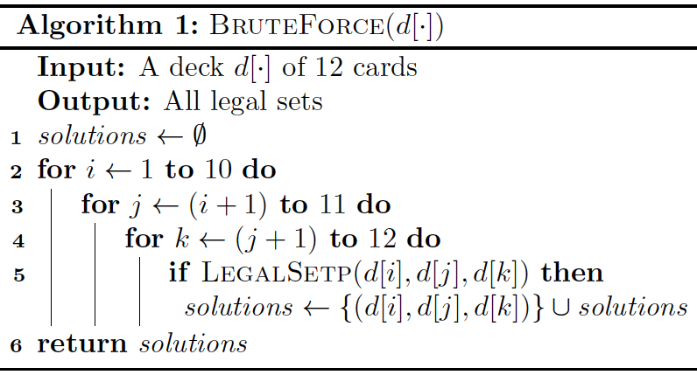
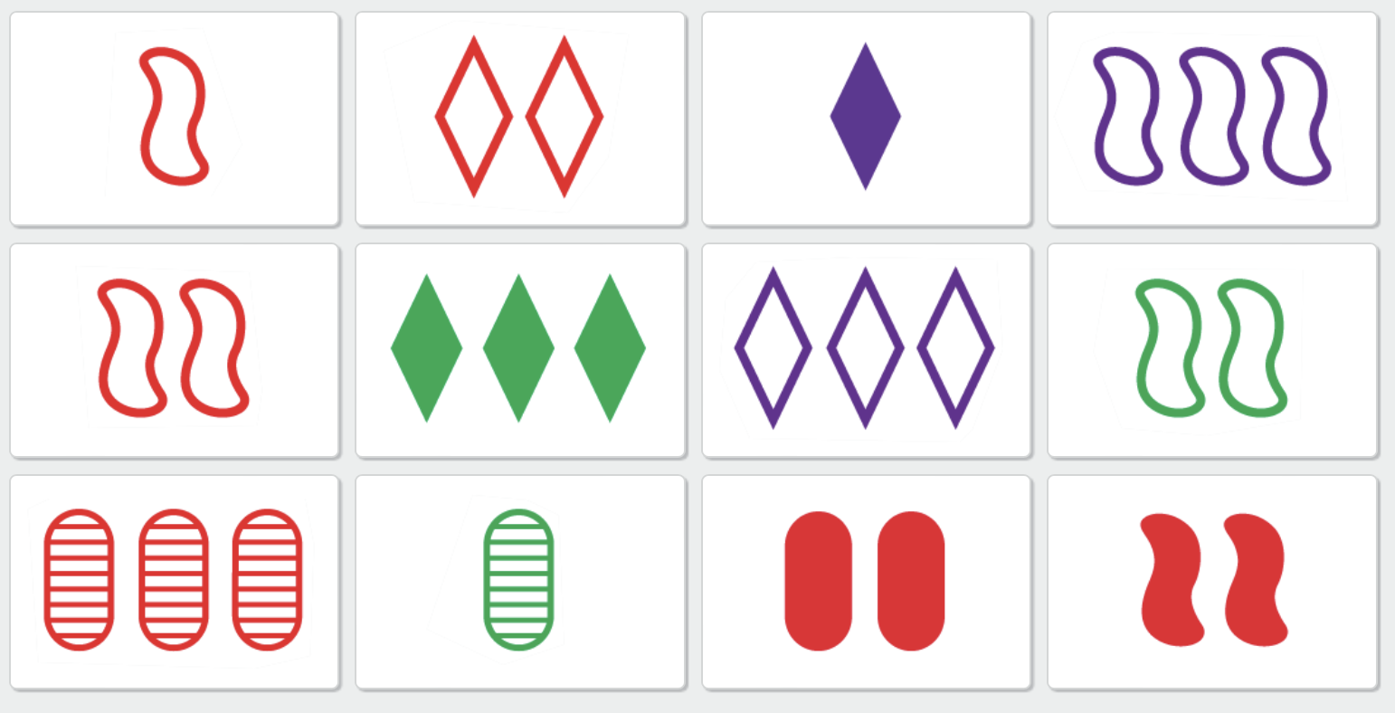
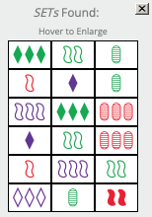
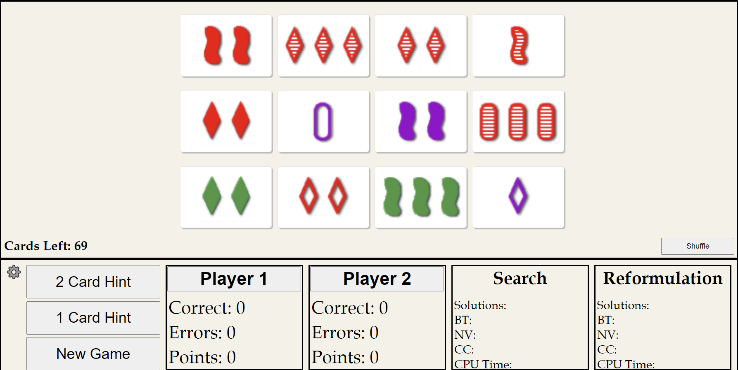

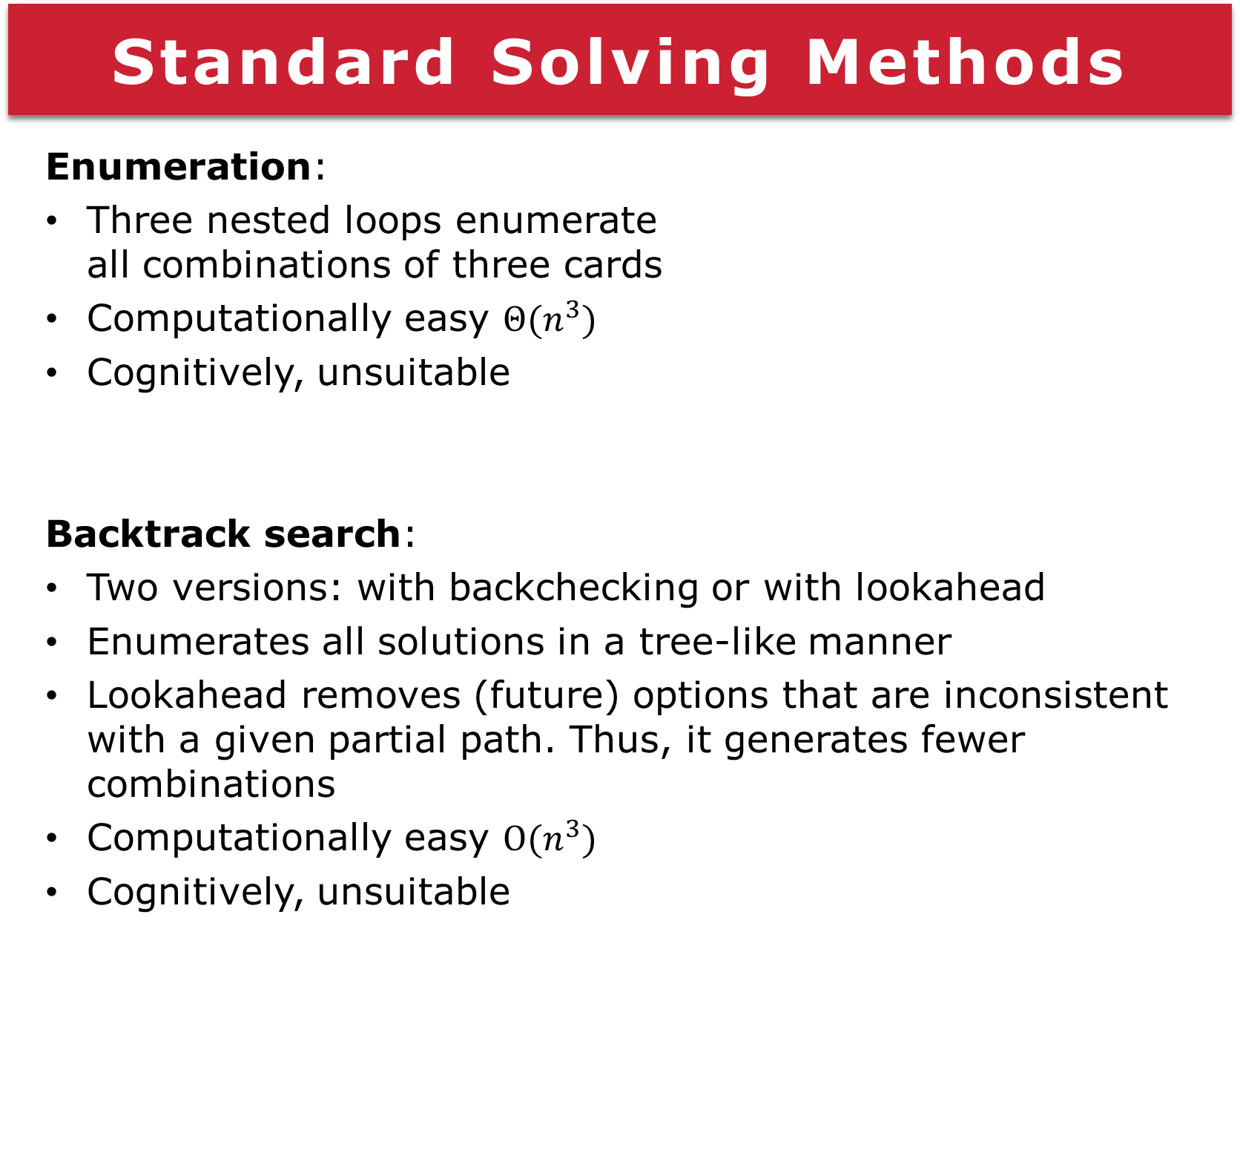
Game of Set: Reasoning Supports Explanation
Michael West and Berthe Y. Choueiry
Constraint Systems Laboratory • School of Computing
Summary
Game of Set: A popular card game of visual perception designed in 1974 by Marsha Falco, a geneticist, out of a coding scheme she developed in her research. Task: Identify three cards in a set of 12 (out of 81) where each feature (color, shape, number and shading) is identical or all different. Goal: Explore how to support reasoning and explanation Contributions: Built an interactive online interface to play the game. Implemented and compared three algorithms to find all solutions Enumeration Backtrack search (two types) Reformulation technique
Standard Solving Methods
Enumeration: Three nested loops enumerate all combinations of three cards Computationally easy $Θ(n^{3})$ Cognitively, unsuitable Backtrack search: Two versions: with backchecking or with lookahead Enumerates all solutions in a tree-like manner Lookahead removes (future) options that are inconsistent with a given partial path. Thus, it generates fewer combinations Computationally easy $O(n^{3})$ Cognitively, unsuitable
Reformulation
The idea is to focus on one feature (e.g., color) at a time, ignoring all others. We decompose the problem for the various values of the chosen feature. The problems become smaller and easier to handle mentally. Then repeat for another feature, etc. This decomposition strategy makes identifies where subproblems that are easier to solve or prove unsolvable and makes it easier to fund and explain solutions. The choice of the feature is key to this strategy. We developed heuristics to assess the ‘least diverse’ feature, which will reduce the number of subproblems generated.
https://www.setgame.com
GUI and Constraint Model
The online interface allows a user to play the game by clicking on cards to validate the selected cards as a set The constraint model has three variables and five constraints The challenge is not the computational complexity but solving the problem in a way that a human player can understand and replicate.
Motivating Example
Below we show how decomposing the set of 6 red cards on the feature ‘number’ helps uncovering all solutions.
Future Work
Build a visualization of the reformulation strategy Generate explanations of each operation step Evaluate the usefulness of the strategy and explanations to human players
Acknowledgment: Supported by UCARE
March 17, 2024

