Slide 1
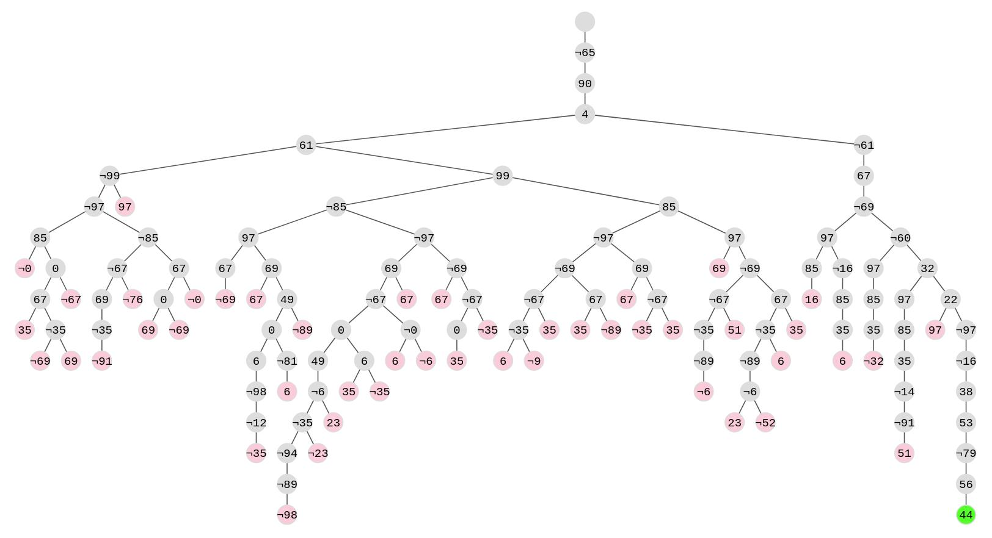
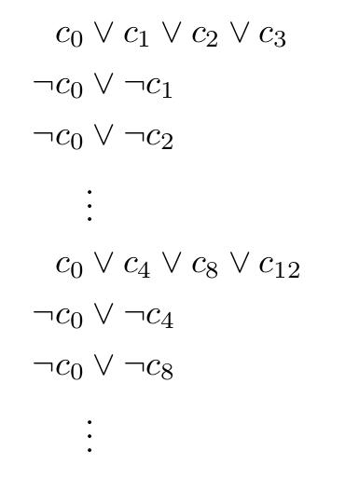
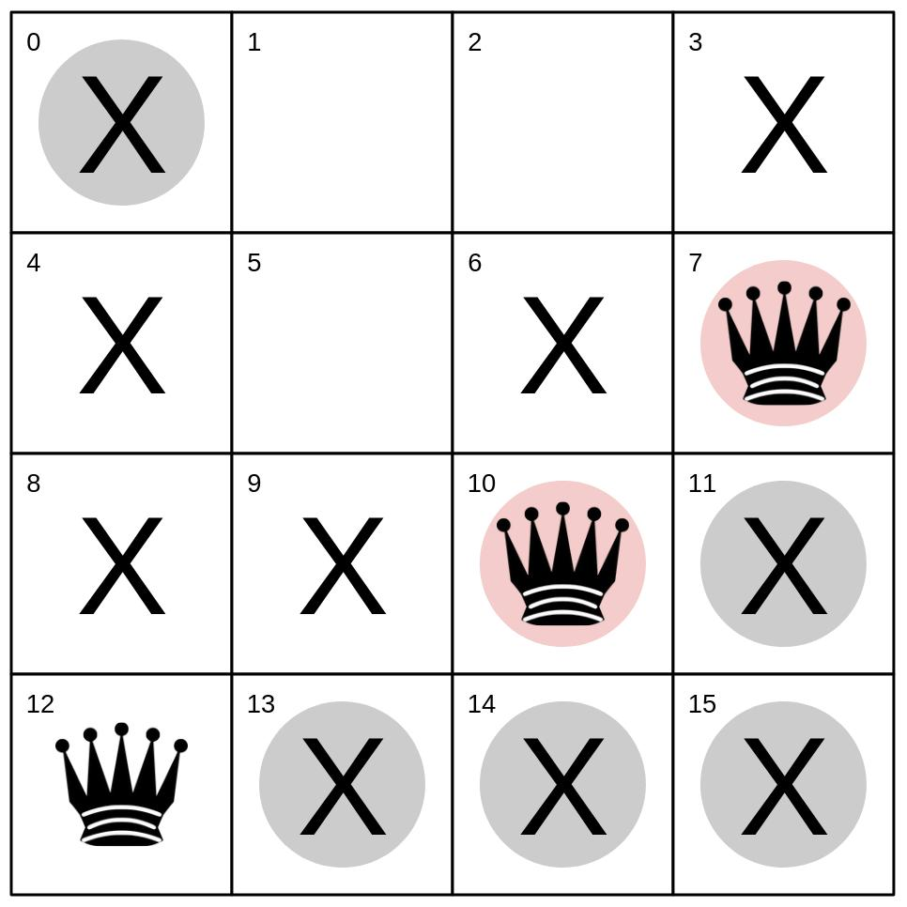
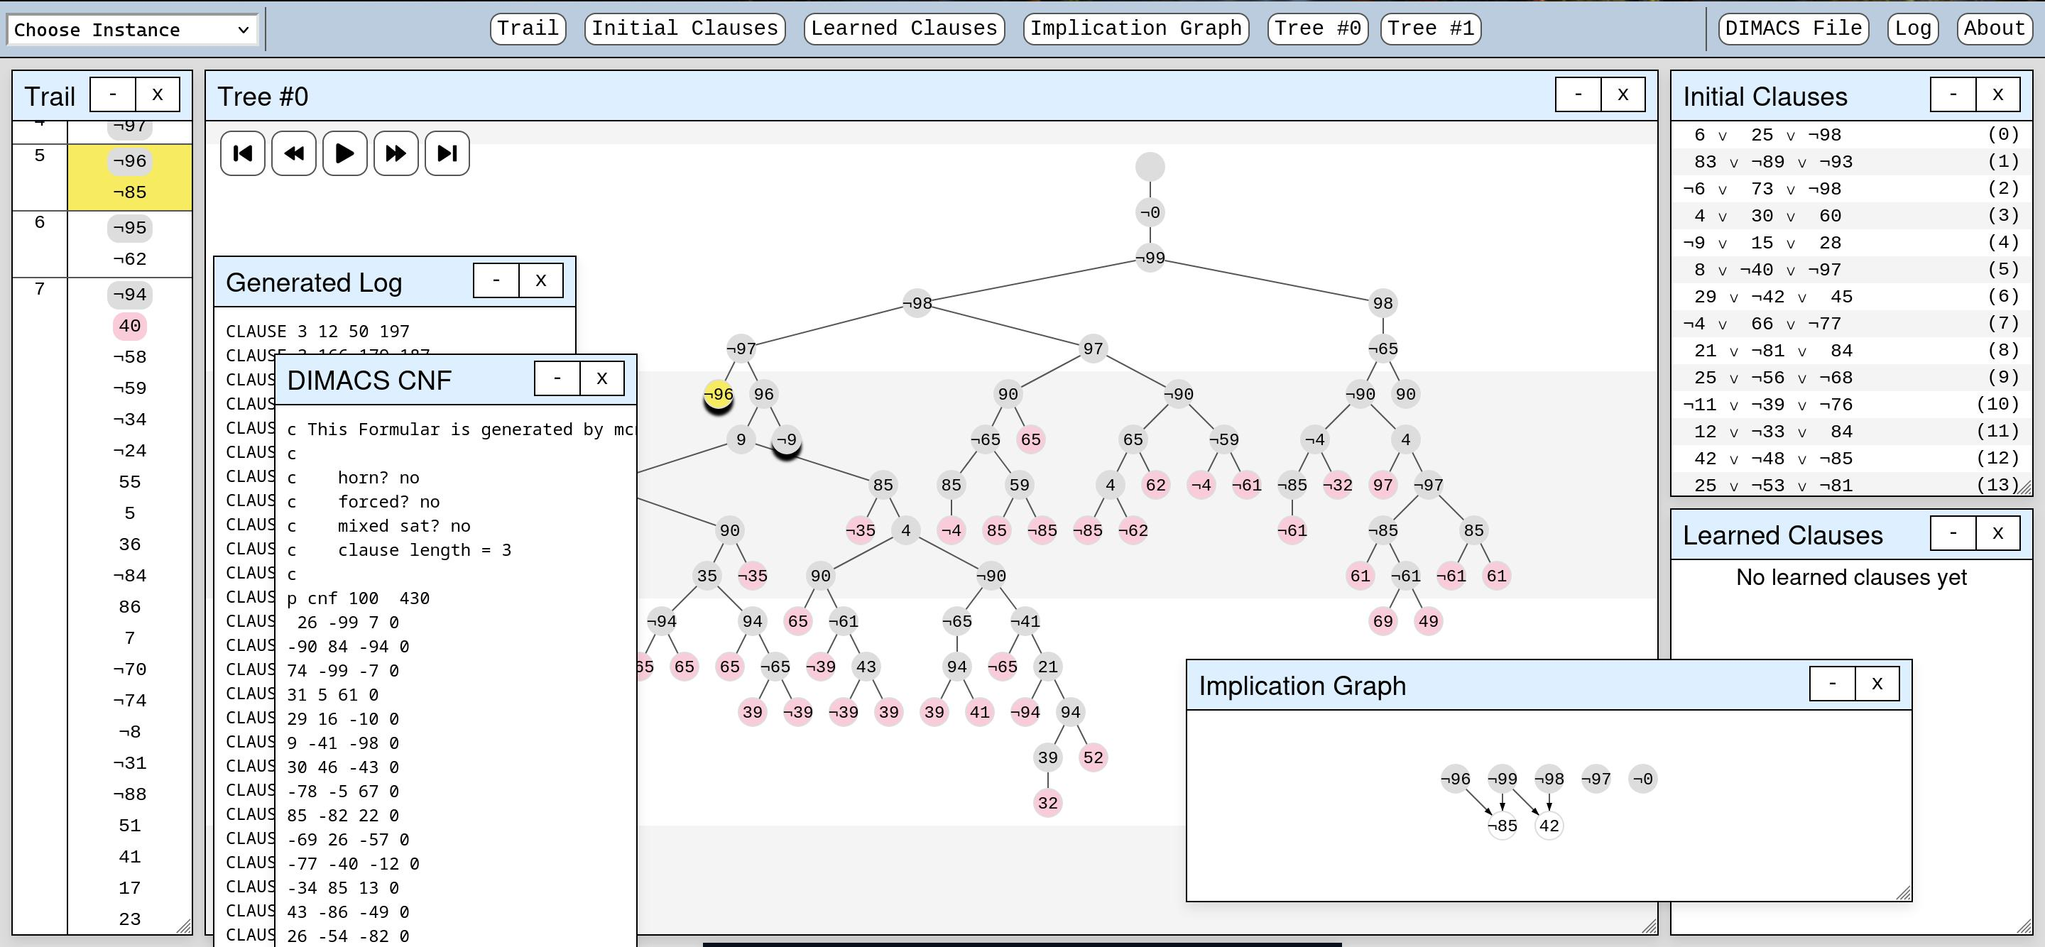
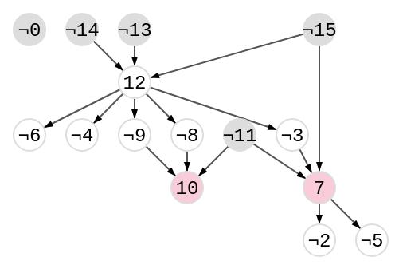
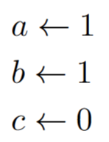
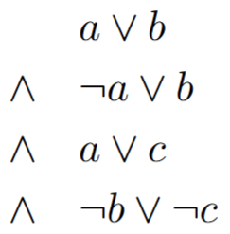
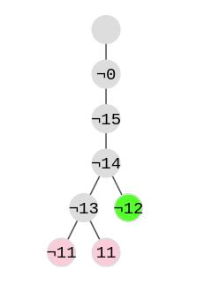
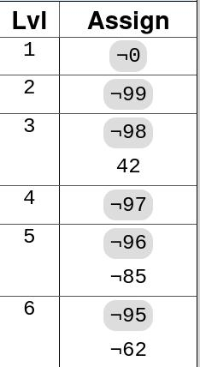
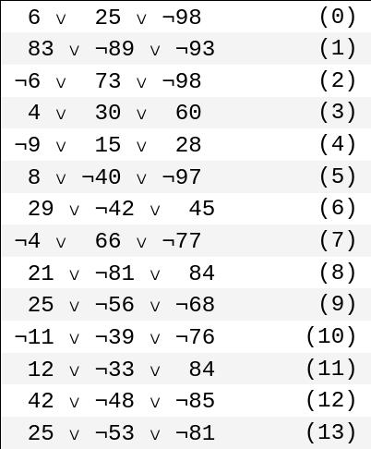
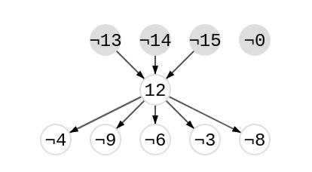
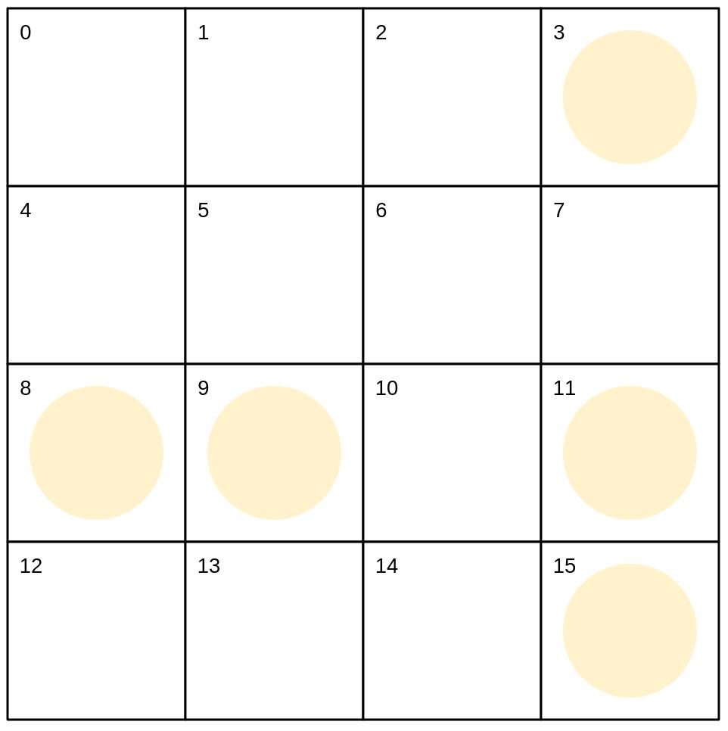
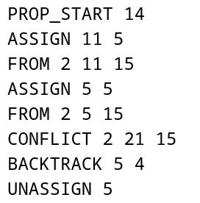
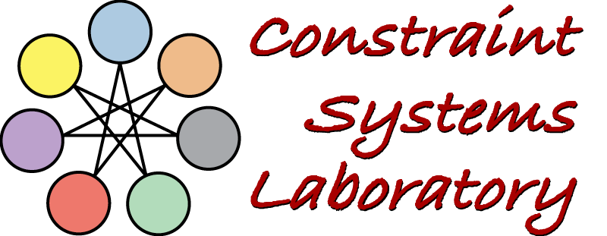
Visualization for Explanations in Decision Support
Carston Wiebe, Raegan Scheet, and Berthe Y. Choueiry
Constraint Systems Laboratory • School of Computing
Summary
We built a website that visualizes the internal workings of the SAT Solver MiniSAT so as to better understand the foundational concepts of computer science that it utilizes. Task: Instrument MiniSAT to record its decision process and model the results in a human-digestible format. Contributions: Built an online tool to visualize how MiniSAT determines whether a SAT Problem is satisfiable.
Results
Motivating Example
The 4 Queens problem aims to see if it is possible to place 4 Queens on a 4x4 grid such that no queen opposes another.
Search Tree
It can be modeled in CNF where each space on the board is a variable (0-15) where "True" means a queen is present on the space.
By viewing the instance on SATVIZ, we can view the path MiniSAT takes to solve it:
Sample of the CNF theory.
Board for the first conflict.
Trail
Initial/Learned Clauses
Implication Graphs
Implication graph for the first conflict.
Method
MiniSAT was instrumented by placing "hooks" into its source code that log information about its decision-making process. Whenever this modified MiniSAT runs, it generates a full log containing its entire "thought process".
...
Sample of the trail.
The search tree.
Learned clause for the first conflict.
MiniSAT Overview
The Boolean Satisfiability Problem (aka SAT) is about proving whether a Boolean formula has a solution SAT Solvers are relied on in many fields such as air-traffic control, circuit design (EDA), and complex scheduling MiniSAT, created by Niklas Eén and Niklas Sörensson in 2003, is a highly efficient and lightweight SAT Solver
Future Work
Create additional graphs to display various instance statistics such as propagations and satisfied clauses per decision made. Create instance specific visualization tools, such as a chess or sudoku board.
The website parses this log into two primary data structures: A linear trail, and a binary "search tree".
These two structures are then navigated through and manipulated to produce our visualizations.
Acknowledgment: Supported by UCARE
April 9, 2025

