Slide 1
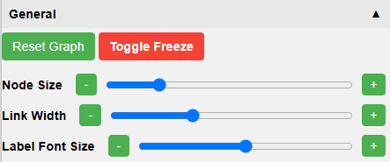
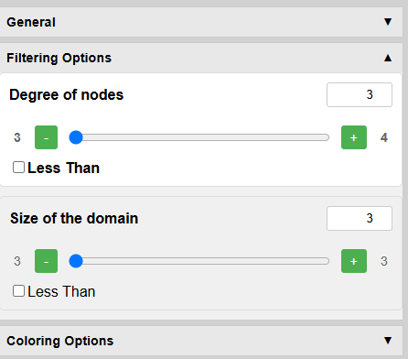
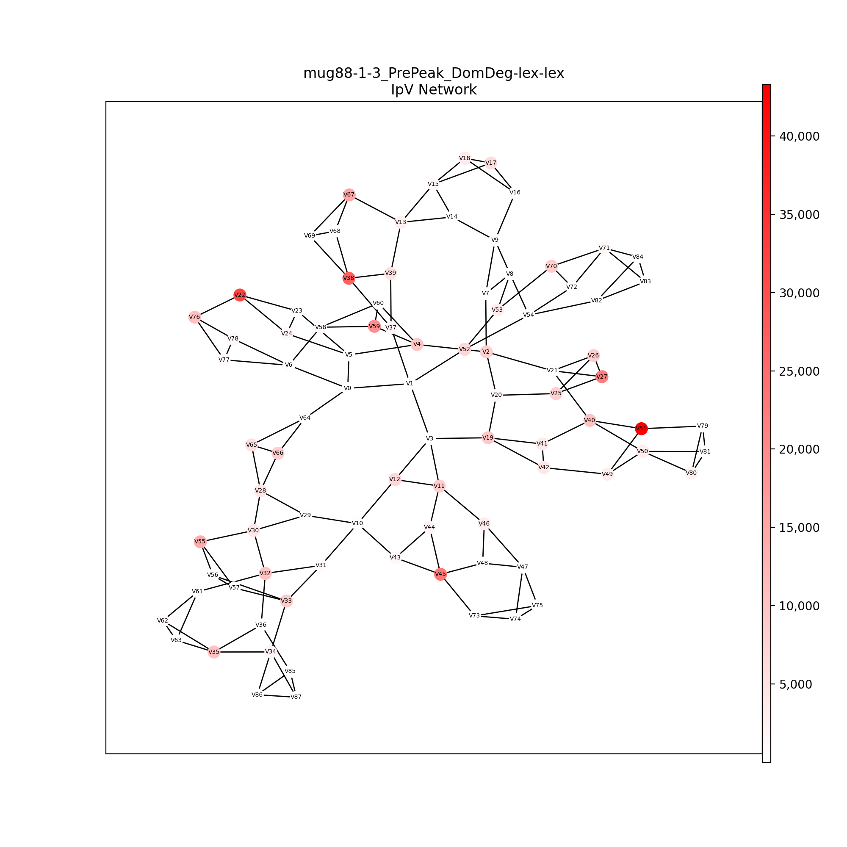
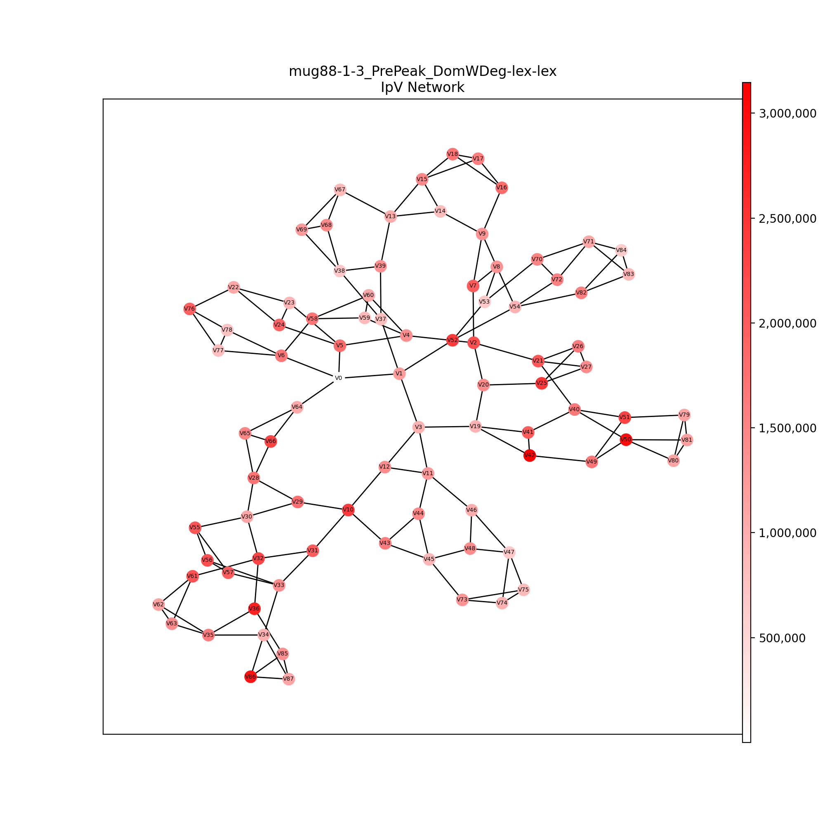
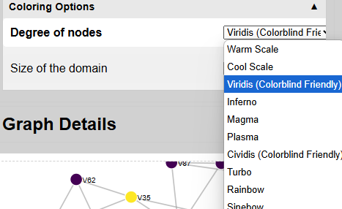
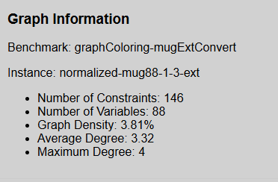
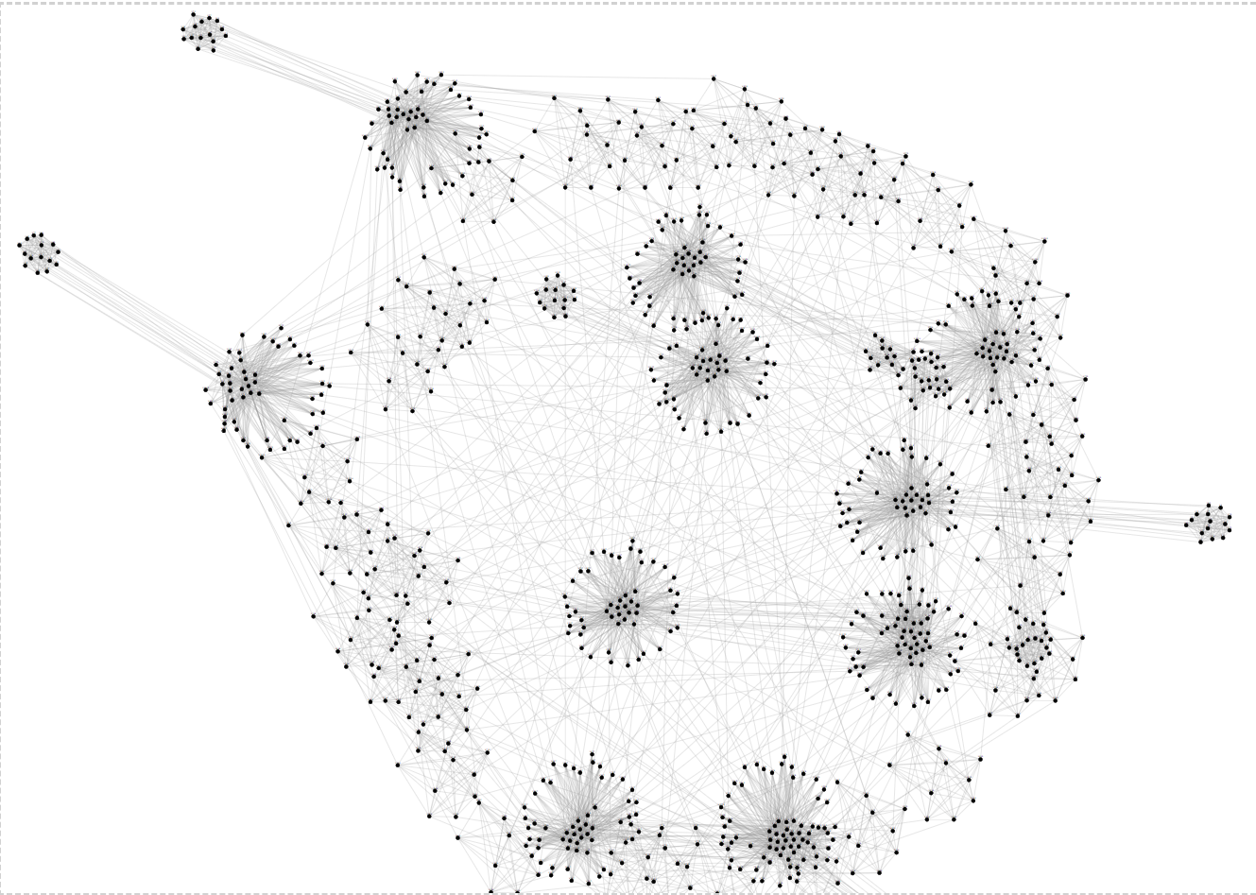
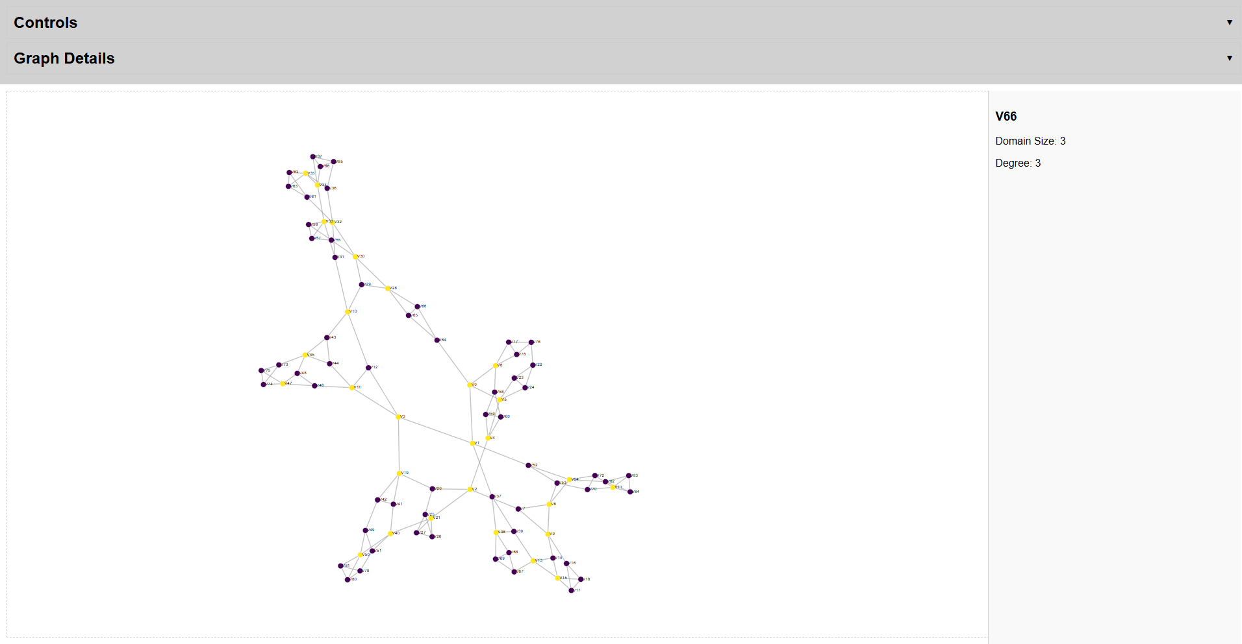
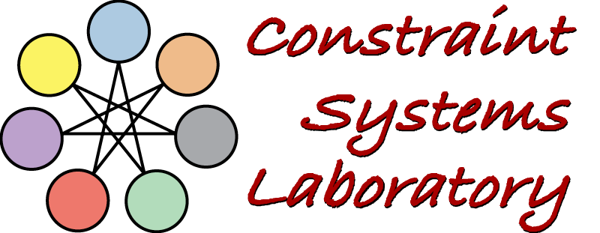
General data about considered instance
Visualization for Explanations in Decision Support
Avery Penn, Simon Schoenbeck and Berthe Y. Choueiry
Constraint Systems Laboratory • School of Computing
Summary
Goal: Support reasoning and explanation in intelligent decision making, and foster creativity. Task: Design visualizations that summarize the behavior of problem-solving algorithms, strategies, and heuristics in the context of solving combinatorial decision problems using Constraint Processing. Contributions: We Developed a web interface to retrieve information about problem instances and generate various visualizations reflecting problem-solving performance on these instances. Visualization are linked to experiment-specific metrics, allowing the tool and visualizations to evolve with ongoing research. Our work allowed the development of a new heuristic, MaxClique, which demonstrated superior preliminary performance.
Controlling Visualizations
Revealing Bad Performance
DomWDeg is the facto standard for variable ordering, but it sometimes degenerates. Displaying the activity of DomWDeg and DomDeg on the vertices the constraint network reveals how DomWDeg loses time while DomDeg focuses on ‘key’ vertices.
General viewing options, and freeze nodes to stop force simulation.
Filtering options relative to the instance and metrics data provided.
MaxClique Heuristic
We designed MaxClique as a pre-filter to DomWDeg. It significantly improving performance by prioritizing vertices that appear in the largest number of maximal cliques of the constraint network.
Color options derived from provided metrics data, with support for accessibility.
Motivation
Our web interface displays large graphs revealing their structure and connectivity. Overlaying the operations of an algorithm on the graph structure reveals bottlenecks and inspires new solving techniques, strategies, and heuristics.
General data about considered instance.
Future Work
Develop ‘fisheye’ views on the constraint network Develop tools to view and animate search performance along time (e.g., history of regimes [1]). [1] I.S. Howell, B.Y. Choueiry, and H. Yu “Visualizations to Summarize Search Behavior,” Proc. CP 2000, pp. 392—409.
pseudo-iiExtConvert_8e1
Displays metrics available per node
Acknowledgment: Supported by UCARE
April 8, 2025

