Slide 1
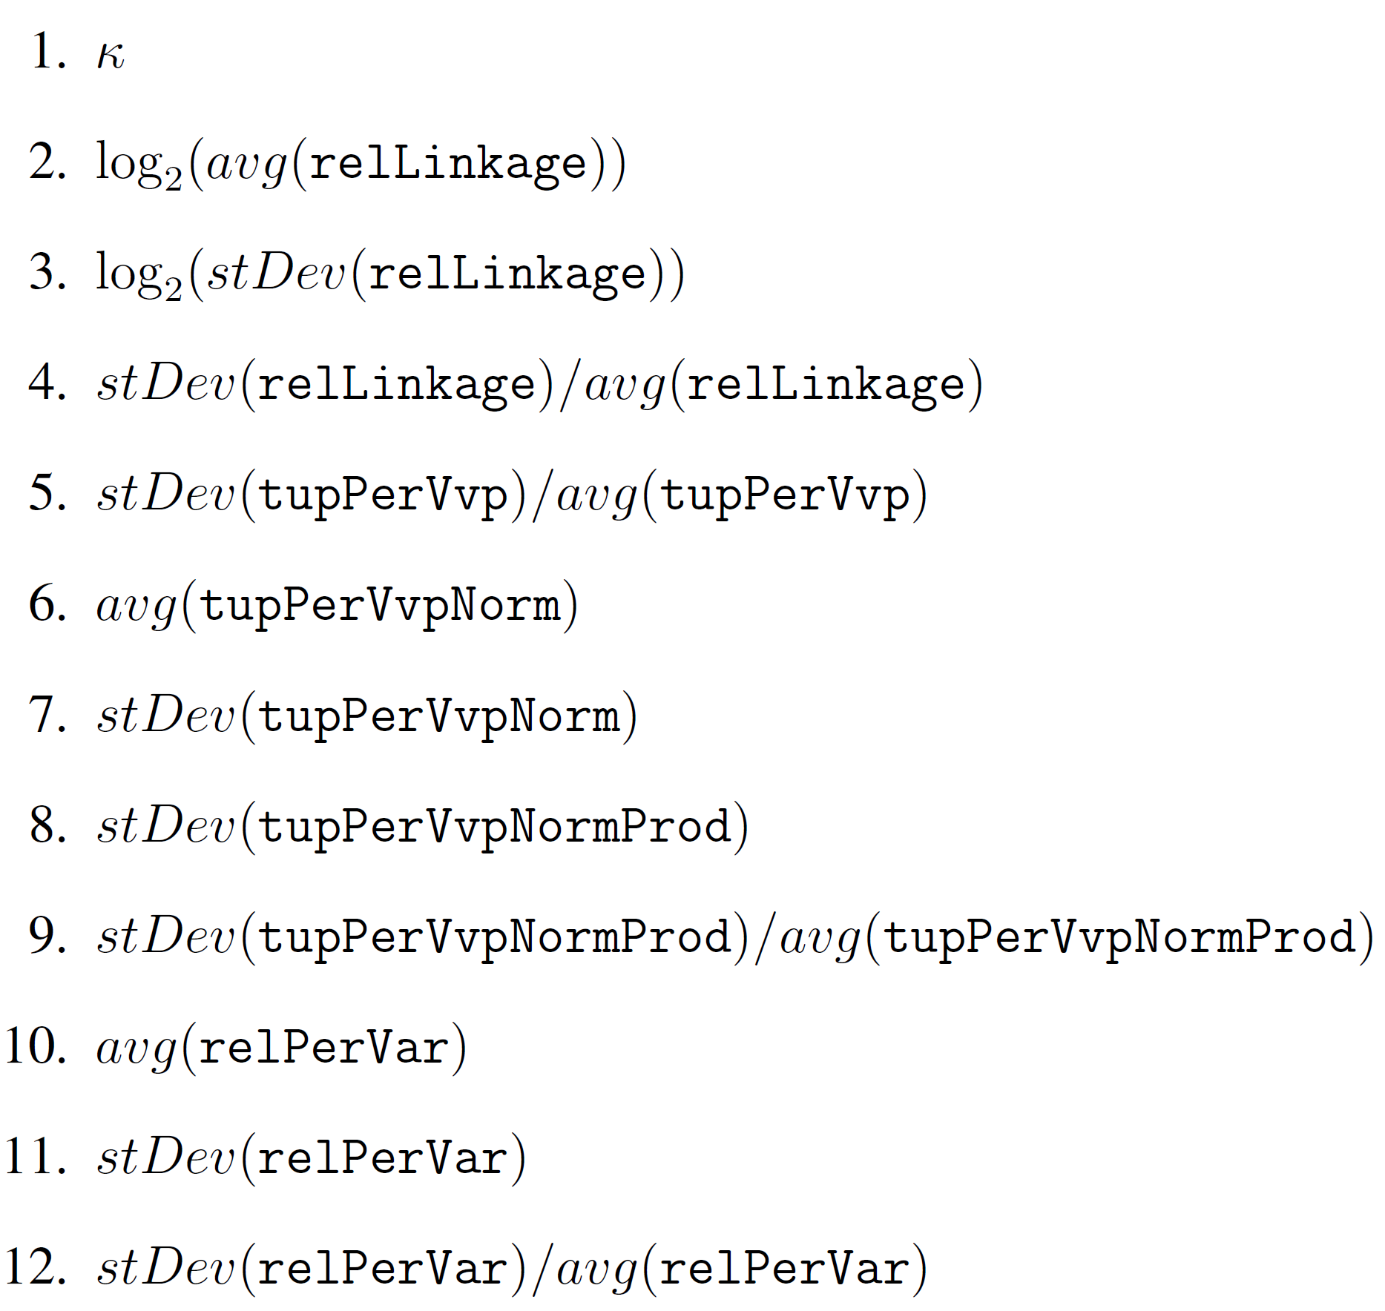
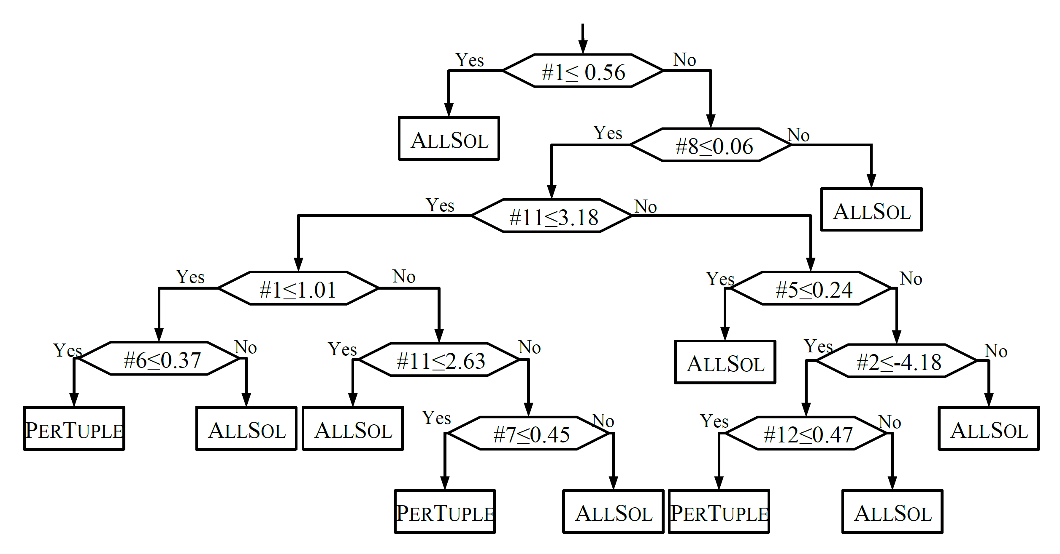


Selecting the Appropriate Consistency Algorithm for CSPs Using Machine Learning Classiﬁers
Daniel J. Geschwender, Shant Karakashian, Robert J. Woodward, Berthe Y. Choueiry, Stephen D. Scott
Department of Computer Science & Engineering • University of Nebraska-Lincoln
Constraint Satisfaction Problem:
Used to model constrained combinatorial problems
Important real-world applications: hardware & software verification, scheduling, resource allocation, etc.
B≠1
B
The Problem of AllSol vs. PerTuple:
The performance of the two algorithms varies widely
One algorithm may complete quickly while the other may not terminate
The performance depends on size and difficult of the CSP instance
Question: Can we use Machine Learning to classify the instance
& predict the best algorithm?
Experiment Results:
A
A≥B
{1,2,3,4}
Strategy | F-measure | Time saved |  | Time lost
 |  | % | ms | ms
All instances | .727 | 99.87% | 15,301,950 | 19,350
δ_{t} ≥ 100ms | .729 | 99.90% | 15,306,510 | 14,790
Weighted | .743 | 99.96% | 15,314,980 | 6,320
Cost | .557 | 99.57% | 15,255,190 | 66,110
{1,2,3}
A+C<3
C
{0,1}
Feature Set:
Characteristics of the problem selected to differentiate the classes
Kappa – predicts if instance is near phase transition
relLinkage – likelihood of a tuple at the overlap of relations to be in solution
tupPerVvp – count of tuples containing a given variable value pair
relPerVar – number of relations on a given variable
A CSP is defined as follows:
Given
A set of variables {A,B,C}
Their domains D_{A}={1,2,3}, D_{B}={1,2,3,4}, D_{C}={0,1}
A set of constraints: {A≥B,B≠2,A+C<3}
Question
Find a solution NP-complete
Count number of solutions #P
Find minimal network NP-complete
Minimize number of broken constraints NP-hard
Our Classification: 3592 instances from 5 benchmarks
Practical Tractability: [Karakashian+ AAAI 2013]
Enforces minimality on each cluster of a tree decomposition
Bolsters propagation between clusters by adding constraints to separators
Solves many instances in a backtrack-free manner
Tree Decomposition:
Used to break up a CSP into clusters arranged in a tree structure
Each cluster is a subproblem that can be independently handled
Filtering performed on a cluster propagates to neighboring clusters
Using Machine Learning:
We used a decision tree classifier (J48 from Weka Machine Learning suite) to make our predictions
Each instance is a single cluster from a tree decomposition
The 12 features of the CSP are observed
CPU time for AllSol & PerTuple is recorded for each instance
Experimented with four sets of training conditions
Larger Instance Space: 318158 instances from 119 benchmarks
Minimal Network:
Is a consistency property
Guarantees that every tuple allowed by a constraint must participate in some solution to the CSP (i.e., the constraints are as minimal as possible)
Two Algorithms for Enforcing Minimality:
AllSol: better when there are many ‘almost’ solutions
  Finds all solutions without storing them, keeps tuples that appear in at least one solution
  One search explores the entire search space
PerTuple: better when many solutions are available
  For each tuple, finds one solution where it appears
  Many searches that stop after the first solution
Experiments:
All instances – Trained using all data collected
δt ≥ 100ms – Removed all instances where the difference in time was less than 100ms
Weighted – All instances are given a weight equal to the difference in execution time of the two algorithms
Cost – A cost matrix is used in the training, which provides average misclassification costs for each class
Future Work:
Use a larger & more diverse set of benchmarks
Explore additional features and classifiers
Consider additional consistency properties & propagation algorithms
A
(1,1) (2,1) (2,2)
(3,1) (3,2) (3,3)
B
{1,2,3}
A≥B
{1,2,3,4}
Supported by NSF Grant No. RI-111795 and Undergraduate Creative Activities and Research Experiences Program (UCARE) of the University of Nebraska-Lincoln. Experiments conducted at UNL’s Holland Computing Center.
Date July 7, 2013

