Slide 1



A Partial Taxonomy of Substitutability & Interchangeability
Shant Karakashian
Robert J. Woodward
Berthe Y. Choueiry
Steven D. Prestwich
Eugene C. Freuder
Acknowledgments: This work was supported in part by Science Foundation Ireland under Grant 00/PI.1/C075
Notes:
The goal of our study is to analyze the various forms of interchangeability and substitutability twenty years after their introduction.

Slide 2
Outline
Introduction
Basic form & extensions
Features & use
Further developments
Taxonomy using a partial order
One example
Relation to
General forms of symmetry
Symmetry breaking during search
Future research & conclusions
Notes:
The talk has two parts.
In the first part we will give some background information about interchangeability and provide a taxonomy for the various forms of interchangeability in the literature.
And in the second part, we will relate the work on interchangeability to that on symmetry.
Then, we will give our conclusions.
Importantly, the material of the first part of the talk is covered in the paper. But the material in the second part of the talk is additional material, not included in our workshop’s paper, but will be in the journal version on which we are working.

Slide 3
Interchangeability & Symmetry
Eliminating Interchangeable Values in Constraint Satisfaction Problems [Freuder, AAAI 91]
“The detection of symmetries is a research avenue pioneered by Freuder [AAAI 1991] and subsequently investigated by many others.” [Van Hentenryck, SARA 2006]
Interchangeability is a form of ‘solution symmetry’
Symmetry is not specified, but is detected
We survey work on interchangeability & substitutability
Identifying & proving relationships among different forms of interchangeability/substitutability
We welcome your input

Slide 4
Basics
[Freuder 91]
Substitutability
Local vs Global
Neighborhood Interchangeability (NI)
K-Interchangeability (KI)
Full Interchangeability (FI)
Weakening
Substitutability (ref. dominance)
Partial interchangeability
Subproblem interchangeability
Generalization
Dynamic interchangeability (ref. SBDS & SBDD)
Meta interchangeability
Functional/isomorphic interchangeability: mapping values between different variables (ref. symmetry)
Partial
FI
Subproblem
global
KI
Substitutability
Partial
NI
local
Subproblem

Slide 5
NI and FI
FI: Global, semantic level, likely intractable
NI: Local, syntactic level, efficiently determined
NI ⇒ FI
W
i
j
Y
Z
d
e
g
h
a,b,c are FI
a,b are NI
X
a
b
c
Notes:
Define FI
Consider the microstructure of this simple CSP. We omit the constraint between W and X, and between Y and Z for readibility.
This problem has one solution with i-e-g, but X can take values a,b,c. Giving us three solutions.
‘a’, ‘b’ and ‘c’ are FI, they are all equivalent in the solution ‘i’ ‘e’ ‘g’
Define NI: two values are NI if they have the same neighborhood in the microstructure
‘a’ and ‘b’ are NI, they have the neighborhood in the microstructure: red edges for ‘a’ and blue edges for ‘b’
Detecting that two values for a variable are NI is easy and can be done by comparing their neighborhood.
FI is likely intractable, but NI=>FI i.e. if we identify two values to be NI, then we know that they are FI and NI is efficiently determined
Hence we can efficiently compute subsets of FI values

Slide 6
Interchangeability Researchers
Audemard
Benhamou
Neagu
Faltings
Chmeiss
Weil
Haselboeck
Benson
Beckwith
Agren
Bistarelli
Freuder
Van Hentenryck
Prestwich
Lal
Kokeny
Mazure
Sais
Bliek
Bowen
Likitvivatanavong
Pearson
Naanaa
Choueiry
Bellicha
Capelle
Davis
Petcu
Mancini
Wilson
Weigel
Flener
Meisels
Vilarem
Brown
Burke
Bordeaux
Cadoli
Razgon
Heus
Etc.
Notes:
Many researchers worked on interchangeability since it was first defined by Freuder in 1991.
They have provided new algorithms for detecting interchangeability, they have proposed new forms, and they have used those concepts and algorithms in applications.

Slide 7
Further Developments
Exploration
Interchangeability types
Their detection cost
Their benefits for problem solving
Context
Finding all solutions
Problem decomposition
CSP Extensions
Distributed CSPs
Quantified CSPs
Soft CSPs

Slide 8
Features & Use
May be viewed as an extension of the fundamental CP concept of inconsistency filtering & propagation
Can remove values without removing all solutions
Trade amount of filtering against difficulty of recovering removed solutions
Automatic symmetry detection
Bundling interchangeable values for the same variable
Yields a compact representation of a CSP
Yields ‘robust/flexible’ solutions
Nogood bundling dramatically reduces search cost
Shown to be beneficial in
Backtrack search & local search, interaction w/ users
Random CSPs, benchmarks, resource allocation problems

Slide 9
Outline
Introduction
Basic form & extensions
Features & use
Further developments
Taxonomy using a partial order
One example
Relation to
General forms of symmetry
Symmetry breaking during search
Future research & conclusions

Slide 10
Taxonomy
Surveyed & analyzed interchangeability concepts
Identified those that are satisfiability preserving
Classified them in terms of implication
X ⇒ Y iff ∀a, b X(a,b) ⇒ Y(a,b)
Identified 22 interchangeability concepts
231 relations between concepts
94 relations are covered in paper
In extended paper, we will justify the remaining 137 incomparability results
Notes:
Implication is a partial order
94 relations are covered in the paper either with proofs or by transitivity

Slide 11
The Interchangeability Landscape
Sub
FDynSub
ConI
ConSub
FI
CtxDepI ≣ FDynI
PI
TupSub
global
semantic
SPrI
Not Sat preserving
KI
NSub
GNSub
ConNI
ConNSub
NI
DynNI
ForwNI
NTI
NPI ≣ DirI
NI_{C}
NSub_{C}
local
syntactic
DirSub
Notes:
In the diagram, we partition the concepts into two levels.
The concepts in the lower plane are defined
considering the microstructure
they are defined at the local level,
These are syntactic forms of interchangeability
The concepts at the upper plane may require
Considering all the solutions of the problem
We say that they are defined at the global level
These re semantic forms of interchangeability
Moving from right to left in each plane we get weakened forms of interchangeability, obtained by relaxing the conditions
The arrows signify implication. NI is hence the strongest that implies all other forms of inter.
The concepts in doted rectangles are not satisfiability preserving, meaning that replacing one interchangeable value with another may affect the satisfiability of the problem
These concepts are useful in particular situations, where they can be used to preserve satifiability preserving although in general they are not satifiability preserving.

Slide 12
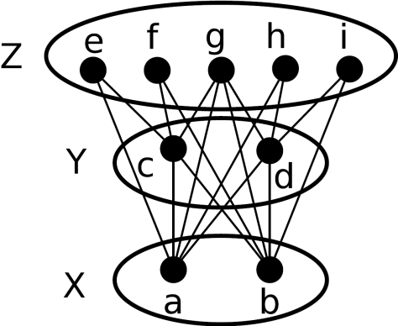
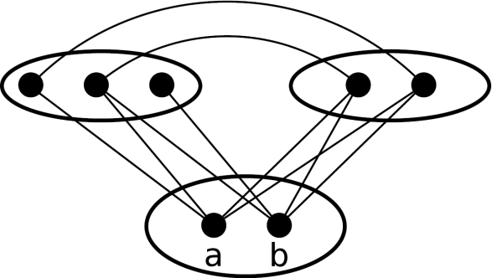
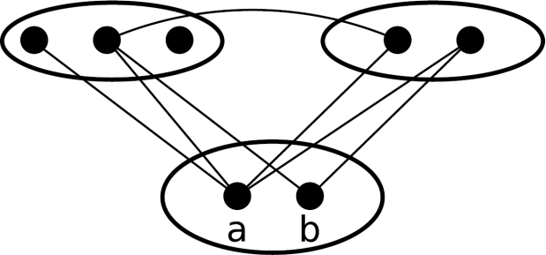
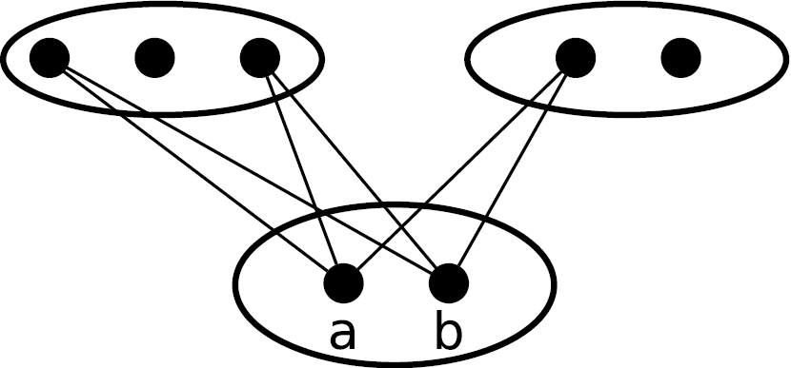
Substitutability
Sub
FDynSub
FDynSub
FI
global
semantic
KI
Sub
NSub
NI
NSub
local
syntactic
NI
Notes:
Now we look at how the different concepts generalize as we follow the arrows:
1st figure: NI: ‘a’ and ‘b’ are NI because they have the same set of supports (red and blue edges)
2nd figure: NSUB: ‘a’ is N-substitutable for ‘b’ because the set of supports for ‘b’ is a subset of the set of supports for ‘a’
Moving from the local to global level:
3rd figure: SUB: ‘a’ is substitutable for ‘b’ because the set of solutions with ‘b’ is a subset of the set of solutions with ‘a’
But ‘a’ is not N-substitutable for ‘b’ because of the additional support that ‘b’ has (shown with the red arrow)
4th figure: ‘a’ and ‘b’ are not sub because ‘a’ participates in a solution that ‘b’ does not, and ‘b’ participates in a solution that ‘a’ does not (shown in red edges)
But once ‘g’ is assigned as a value for Z, these solutions become irrelevant, and ‘a’ becomes substitutable for ‘b’
IN THIS SLIDE IT IS IMPORTANT TO SHOW ON THE “MOVEMENT” ON THE FIGURE AT THE LEFT HANDSIDE, AS WE ARE MOVING FROM ONE FORM TO THE OTHER OF THE FIGURES IN THE RIGHT HANDSIDE

Slide 13
Outline
Introduction
Basic form & extensions
Features & use
Further developments
Taxonomy using a partial order
One example
Relation to
General forms of symmetry
Symmetry breaking during search
Future research & conclusions
Notes:
Now, we will quickly discuss the relationship between research on interchangeability and the research on symmetry.
Importantly, this material was developed recently and is not included in the workshop paper.

Slide 14
Diagram of Symmetry Concepts
Value Symmetry for Satisfiability [Benhamou 94]
Value Symmetry for Satisfiability [Benhamou 94]
Symmetry [McDonald+ 02]
Symmetry [McDonald+ 02]
Functional Interchangeability [Freuder 91]
Functional Interchangeability [Freuder 91]
Functional Interchangeability [Freuder 91]
Solution Symmetry [Cohen+ 05]
Solution Symmetry [Cohen+ 05]
Value Symmetry for All Solutions [Benhamou 94]
Value Symmetry for All Solutions [Benhamou 94]
Constraint Symmetry [Cohen+ 05]
Constraint Symmetry [Cohen+ 05]
Isomorphic Interchangeability [Freuder 91]
Isomorphic Interchangeability [Freuder 91]
Syntactic Symmetry [Benhamou 94]
Syntactic Symmetry [Benhamou 94]
(a,b)-Supermodel
[Ginsberg+ 98]
Full Interchangeability [Freuder 91]
(a,b)-Supermodel
[Ginsberg+ 98]
Full Interchangeability [Freuder 91]
Neighborhood Interchangeability
[Freuder 91]
Neighborhood Interchangeability
[Freuder 91]
(1,0)-Supermodel
[Ginsberg+ 98]
(1,0)-Supermodel
[Ginsberg+ 98]
Notes:
This diagram shows many of the symmetry definitions that we found in the literature
The arrows signify implication: the top definition is the most general definition for symmetry
(advance animation 1) we see the symmetry definitions proposed in the literature on symmetry in CSP in blue.
(advance animation 2) now we see how the concept of supermodels relate to different symmetry concepts
(advance animation 3) the interchangeability concepts: NI very strong form of symmetry
(advance animation 4) observe that functional inter. is a general form of symmetry that generalizes both solution symmetry and value symmetry for all solutions
(advance animation 5) The definitions that are at the local/syntactic level are show in the shaded background

Slide 15
Relation to SBDS & SBDD
Dynamic interchangeability
New opportunities for interchangeability appear during search
Forms proposed: DynNI, FDynI, DynSub & ForwNI
SBDS & SBDD are related to dynamic interchangeability
Break symmetries during search
Can implement dynamic interchangeability
 | Dynamic Interchangeability | SBDS/SBDD
Discovers symmetry | Yes | No
Overhead | Polynomial | Exponential
Space complexity | Polynomial | Exponential/Polynomial
Broken symmetries | Expressed by the concept | All specified symmetries
Advantages | Time & space complexity | Breaks more symmetries

Slide 16
High-Level Observations
 | Interchangeability |  | Symmetry
Research focus | Efficient detection techniques |  | Efficient breaking techniques
Detected by… | Examining supports & nogoods |  | Given by user Using graph automorphism tools, e.g. Nauty
Defined over | Individual variable-value pairs, tuples Partial assignments Solutions
Variations | Substitutability | ≈ |  | Dominance
 | Meta interchangeability | ≈ |  | Indistinguishable variables
 | Partial interchangeability | ≈ |  | Super-solutions
 | Dynamic variations | ≈ |  | Symmetry breaking during search
State of affairs | Many concepts proposed yet to be exploited |  | Has received intensive attention in recent years
Notes:
Variations: different variations of interchangeability are related to variations in symmetry
substitutability is related to the notion of dominance
meta interchangeability can express the symmetry identified by indistinguishable variables
partial interchangeability is related to super-solutions
dynamic interchangeability is the interchangeability counterpart of symmetry breaking during search

Slide 17
Future Research
Analysis of symmetry definition was started by [Cohen+ 2005], and is still an ongoing effort
In interchangeability, many concepts are yet to be investigated
Detection algorithms
Exploitation in problem solving
New opportunities: building hybrids of
Concepts
Algorithms
… where the whole is more powerful than the sum of its parts
Notes:
the whole is more powerful than the sum of the parts:
combining two concepts into a single hybrid concept may be more powerful than both concepts taken separately
and capture more interchangeability or symmetry

Slide 18
Thank you

