Slide 1
Constraint Satisfaction: Modeling and Reformulation with Application to Geospatial Reasoning
Berthe Y. Choueiry
Constraint Systems Laboratory
Department of Computer Science & Engineering
University of Nebraska-Lincoln
Joint work with Ken Bayer, Martin Michalowski and Craig A. Knoblock
Supported by NSF CAREER Award #0133568 and
AFOSR grants FA9550-04-1-0105 and FA9550-07-1-0416

Slide 2
Outline
Background
Constraint Satisfaction Problem (CSP): definition, propagation algorithms, search
Reformulation
Building Identification Problem [Michalowski & Knoblock, 05]
Constraint model
Custom solver
Reformulation techniques
Query reformulation, domain reformulation, constraint relaxation, symmetry detection
Application to CSP, BID & evaluation on real-world BID data
Conclusions & future work

Slide 3
Constraint Satisfaction Problem (CSP)
V₁
V₂
Given P = (V, D, C)
V : set of variables
D : set of their domains
C : set of constraints (relations) restricting the acceptable combination of values for variables
Solution is a consistent assignment of values to variables
Query: find 1 solution, all solutions, etc.
Deciding satisfiability is NP-complete in general
{d}
{c, d, e, f}
V₄
V₃
{a, b, d}
{a, b, c}

Slide 4
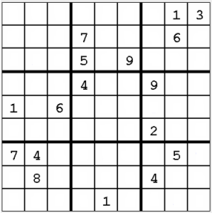
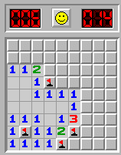
Examples
Industrial applications: scheduling, resource allocation, product configuration, etc.
AI: Logic inference, temporal reasoning, NLP, etc.
Puzzles: Sudoku & Minesweeper

Slide 5
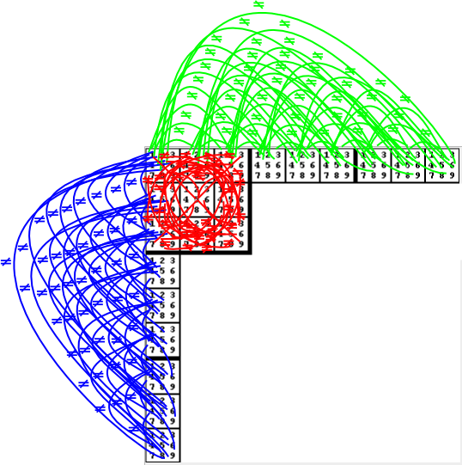
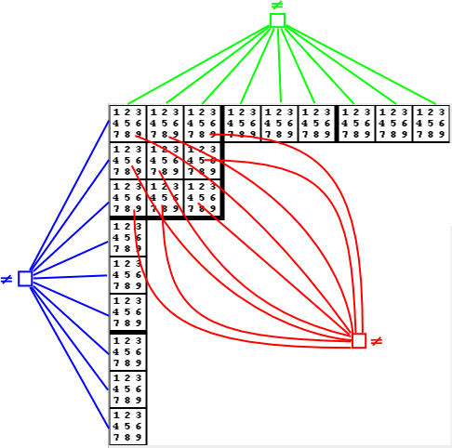
Sudoku as a CSP
Each cell is a variable with the domain {1,2,…,9}
Two models: Binary, 810 AllDiff binary constraints
Non-binary, 27 AllDiff constraints of arity 9

Slide 6

Minesweeper as a CSP
Variables are the cells
Domains are {0,1} (i.e., safe or mined)
One constraint for each cell with a number (arity 1...8)
Exactly two mines:
0000011
0000101
0000110, etc.
Exactly three mines:
0000111
0001101
0001110, etc.

Slide 7
Solving CSPs
Constraint propagation
Search
Islands of tractability
Special constraint types (e.g., linear inequalities)
Special graph structures (e.g., bounded width)
Look-ahead:
propagate while searching

Slide 8
Constraint propagation
Removes from the problem values (or combinations of values) that are inconsistent with the constraints
Does not eliminate any solution
<
3,5,7
2,4,6,9
<
<
<
<
5,6,7,8
3,5,7
<
1,6,11
>
=
=
<
1,2,10
<
8,9,11

Slide 9

Consistency algorithms: examples
Arc Consistency (AC)
Generalized AC (GAC)
GAC on AllDiff [Régin, 94]
Arcs that do not appear in any matching that saturates the variables correspond to variable-value pairs that cannot appear in any solution
GAC on AllDiff is poly time
c₁
1
c₂
2
c₃
3
c₄
4
c₅
5
c₆
6
c₇
7
c₈
8
c₉
9

Slide 10
Levels of consistency
Properties & algorithms for achieving them
In general, efficient (polynomial time)
Applicable to arbitrary constraints
Dedicated to specific constraint types
Basis for Constraint Programming (e.g., AllDiff)
Examples on the Sudoku Solver
sudoku.unl.edu/Solver [with Reeson, 07]
Conjecture: SGAC solves every 9x9 well-formed Sudoku

Slide 11
Search
Backtrack search
Constructive
Complete (in theory) and sound
Note:
Variable ordering (backdoor)
Look-ahead
Iterative repair (i.e., local search)
Repairs a complete but inconsistent assignment of values to variables by doing local repairs
In general, neither sound nor complete
Past variables
Future
variables
Filter values

Slide 12
Abstraction & Reformulation
Original problem
Reformulated problem
Reformulation
technique
Original formulation
Original query
Reformulated formulation
Reformulated query
The reformulation may be an approximation
Original space
Reformulated space
Φ(Solutions(P_{o}))
Solutions(P_{o})
Solutions(P_{r})

Slide 13
Outline
Background
BID: CSP model & custom solver
Reformulation techniques
Conclusions & future work

Slide 14
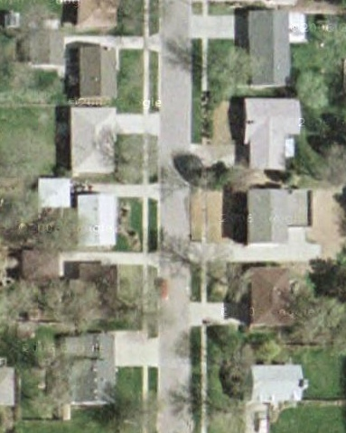
Issue: finding Ken’s house
Google Maps
Yahoo Maps
Actual location
Microsoft Live Local
(as of November 2006)

Slide 15
Building Identification (BID) problem
Layout: streets and buildings
Phone book
Complete/incomplete
Assumption: all addresses in
phone book correspond to a building in the layout
S1
S2
B2
= Building
B1
B3
B4
= Corner building
S3
Si
= Street
B6
B7
B10
B5
B8
B9
S1#1, S1#4, S1#8, S2#7, S2#8, S3#1,
S3#2, S3#3, S3#15, …

Slide 16
Basic (address numbering) rules
No two buildings can have the same address
Ordering
Numbers increase/decrease along a street
Parity
Numbers on a given side of a street are odd/even
Parity
Ordering
B1
Odd
B3
B1
<
B2
<
B3
B2
Even
B4
Notes:
Say it quick, say it once.

Slide 17
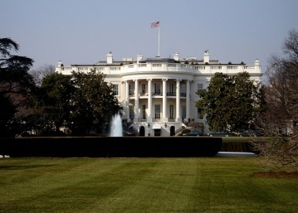
Additional information
Landmarks
Gridlines
1600 Pennsylvania Avenue
S1 #138
S1 #208
B1
B2
B1
B2
S1

Slide 18
Query
Given an address, what buildings could it be?
Given a building, what addresses could it have?
= Building
= Corner building
S1
S2
S1#1,S1#4,
S1#8,S2#7,
S2#8,S3#1,
S3#2,S3#3,
S3#15
B2
Si
= Street
B1
B3
B4
S1#1,
S3#1,
S3#15
S3
B6
B7
B10
B5
B8
B9

Slide 19
CSP model
IncreasingEast
S2
B2
B1
B1c
S1
OddOnNorth
B1
B2
B3
B4
B5
Parity constraints
Ordering constraints
Corner constraints
Phone-book constraints
Optional: grid constraints

Slide 20
Example constraint network
S1
B2
S2
B1
B3
B4
S3
B6
B7
B10
B5
B8
B9
= Building
S1#1,S1#4,
S1#8,S2#7,
S2#8,S3#1,
S3#2,S3#3,
S3#15
= Corner building
Si
= Street

Slide 21
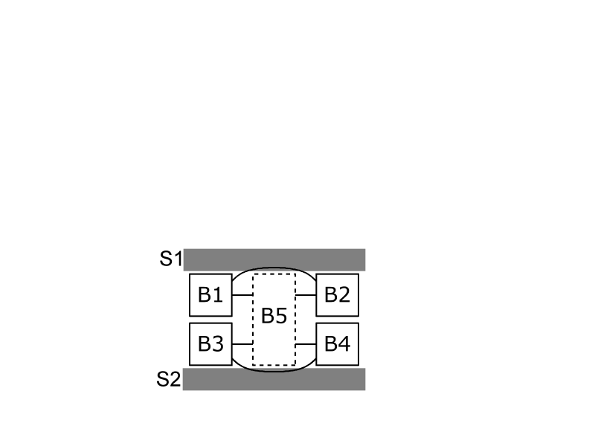
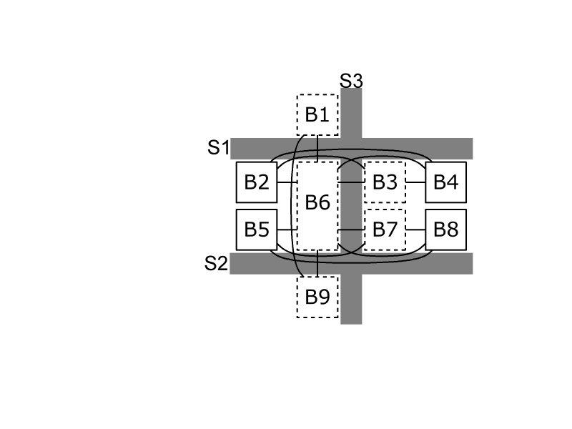
Special configurations
Orientations vary per street (e.g., Belgrade)
Non-corner building on two streets
Corner building on more than two streets
→ All gracefully handled by the model

Slide 22
Custom solver
Backtrack search
Forward checking (nFC3)
Conflict-directed backtracking
Domains implemented as intervals (box consistency)
Variable ordering
Orientation variables
Corner variables
Building variables
Backdoor variables
Orientation + corner variables
Orientation &
corner variables
Building
variables
Filter values

Slide 23
Backdoor variables
B3
B7
B3
B7
B1
B2
B4
B6
B8
B11
B1
B2
B4
B6
B8
B11
B5
B9
B5
B9
B10
B10
We instantiate only orientation & corner variables
We guarantee solvability without instantiating building variables

Slide 24
Features of new model & solver
Improvement over previous work [Michalowski +, 05]
Model
Reduces number of variables and constraints arity
Reflects topology: Constraints can be declared locally & in restricted ‘contexts,’ important feature for Michalowski’s work
Solver
Exploits structure of problem (backdoor variables)
Implements domains as (possibly infinite) intervals
Incorporates all reformulations (to be introduced)

Slide 25
Outline
Background
BID model & custom solver
Reformulation techniques
Query reformulation
AllDiff-Atmost & domain reformulation
Constraint relaxation
Reformulation via symmetry detection
Conclusions & future work
10/12/2007
25

Slide 26
Query in the Building Identification Problem
Problem: BID instances have many solutions
B1 | B2 | B3 | B4
2 | 4 | 6 | 8
2 | 4 | 8 | 10
2 | 4 | 8 | 12
4 | 8 | 10 | 12
4 | 6 | 8 | 10
4 | 6 | 8 | 12
B1
B2
B3
B4
Phone book: {4,8}
We only need to know which values (address) appear in at least one solution for a variable (building)

Slide 27
Query reformulation
Original BID
Reformulated BID
Query
reformulation
Query:
Find all solutions,
Collect values for variables
Query:
For each variable-value pair (vvp),
determine satisfiability
Original query | Reformulated query
Single enumeration problem | Many satisfiability problems
All solutions | One solution per variable-value pair
Exhaustive search | One path
Impractical when there are many solutions | Costly when there are few solutions
For every variable-value pair (vvp)
Consider CSP + vvp
Find one solution using BT search

Slide 28
Evaluations: real-world data from El Segundo
[Shewale]
Case study | Phone book | Number of…
 | Completeness | Buildings | Corner buildings | Blocks
NSeg125-c | 100.0% | 125 | 17 | 4
NSeg125-i | 45.6%
NSeg206-c | 100.0% | 206 | 28 | 7
NSeg206-I | 50.5%
SSeg131-c | 100.0% | 131 | 36 | 8
SSeg131-i | 60.3%
SSeg178-c | 100.0% | 178 | 46 | 12
SSeg178-i | 65.6%
Previous work did not scale up beyond 34 7 1

Slide 29
Evaluation: query reformulation
Incomplete phone book → many solutions → better performance
Case study | Original query | New query [s]
NSeg125-i | >1 week | 744.7
NSeg206-i | >1 week | 14,818.9
SSeg131-i | >1 week | 66,901.1
SSeg178-i | >1 week | 119,002.4
Complete phone book → few solutions → worse performance
Case study | Original query [s] | New query [s]
NSeg125-c | 1.5 | 139.2
NSeg206-c | 20.2 | 4,971.2
SSeg131-c | 1123.4 | 38,618.4
SSeg178-c | 3291.2 | 117,279.1

Slide 30
Generalizing query reformulation
Relational (i,m)-consistency, algorithm R(i,m)C
For every m constraints
m
Compute all solutions of length s
To generate tuples of length i
Space: O(d ^{s} )
s
i
Query reformulation for Relational (i,m)-consistency
For each combination of values for i variables
Try to extend to one solution of length s
Space: O(( )d ^{i} ), i < s
s
i
Reformulated BID query is R(1,|C |)C

Slide 31
Application to Minesweeper
Current implementation [with Bayer & Snyder, 06] of Minesweeper achieves
R(1,1)C ≡ GAC
R(1,2)C
R(1,3)C
By generates all solutions of length s
On-going [with Woodward] Use query reformulation to compute R(1,x)C for x>3

Slide 32
Outline
Background
BID model & custom solver
Reformulation techniques
Query reformulation
AllDiff-Atmost & domain reformulation
Constraint relaxation
Reformulation via symmetry detection
Conclusions & future work
10/12/2007
32

Slide 33
AllDiff-Atmost in the BID
12 | 48 | 30 | 32 | 34
12 | 14 | 16 | 38 | 48
10 | 12 | 14 | 20 | 48
2 | 4 | 6 | 12 | 48
… | … | 12 | 48 | …
Even side
B1
B2
B3
B4
B5
Phone book: {12,48}
Original domain = {2, 4, …, 998, 1000}
Can use at most
3 addresses in [2,12)
3 addresses in (12,48)
3 addresses in (48,1000]
AllDiff-Atmost({B1,B2,..,B5},3,[2,12))
AllDiff-Atmost({B1,B2,..,B5},3,(12,48))
AllDiff-Atmost({B1,B2,..,B5},3,(48,1000))
Reformulated domain
{ s₁, s₂, s₃, 12, s₄, s₅, s₆, 48, s₇, s₈, s₉ }
Original domain
{ 2, 4, …, 10, 12, 14, …, 46, 48, 30, …, 998, 1000 }

Slide 34
AllDiff-Atmost reformulation
Given AllDiff-Atmost(A,k,d)
The variables in A can be assigned at most k values from the set d
Replace
interval d of values (potentially infinite)
with k symbolic values

Slide 35
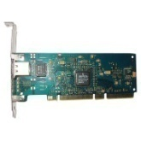

AllDiff-Atmost constraint
AllDiff-Atmost(A,k,d)
The variables in A can be assigned at most k values from the set d
{ High-end graphics card,
Low-end graphics card,
Sound card,
10MB ethernet card,
100MB ethernet card,
1GB ethernet card,
…}
At most one network card
Three expansion slots

Slide 36
Evaluation: domain reformulation
Reduced domain size → improved search performance
Case study | Phone-book completeness | Average domain size |  | Runtime [s]
 |  | Original | Reformulated | Original | Reformulated
NSeg125-i | 45.6% | 1103.1 | 236.1 | 2943.7 | 744.7
NSeg206-i | 50.5% | 1102.0 | 438.8 | 14,818.9 | 5533.8
SSeg131-i | 60.3% | 792.9 | 192.9 | 67,910.1 | 66,901.1
SSeg178-i | 65.6% | 785.5 | 186.3 | 119,002.4 | 117,826.7

Slide 37
Outline
Background
BID model & custom solver
Reformulation techniques
Query reformulation
AllDiff-Atmost & domain reformulation
Constraint relaxation
Reformulation via symmetry detection
Conclusions & future work
10/12/2007
37

Slide 38
BID as a matching problem
Assume we have no grid constraints
S1
S2
B2
S1#1,S1#4,
S1#8,S2#7,
S2#8,S3#1,
S3#2,S3#3,
S3#15
B1
B3
B4
S3
B6
B7
B10
B5
B8
B9
Original BID is in P

Slide 39
BID w/o grid constraints
BID instances without grid constraints can be solved in polynomial time
Case study | Runtime [s]
 | BT search | Matching
NSeg125-c | 139.2 | 4.8
NSeg206-c | 4971.2 | 16.3
SSeg131-c | 38618.3 | 7.3
SSeg178-c | 117279.1 | 22.5
NSeg125-i | 744.7 | 2.5
NSeg206-i | 5533.8 | 8.5
SSeg131-i | 38618.3 | 7.3
SSeg178-i | 117826.7 | 4.9

Slide 40
BID w/ grid constraints
Matching reformulation exploited in two ways:
Domain filtering à la GAC of [Régin, 94] Edges that do not appear in any maximal matching indicate the values that can be filtered out from the domains
Constraint-model relaxation Ignoring the grid constraint yields a necessary approximation of the BID

Slide 41
Filtering the CSP
Remove variable-value pairs that do not appear in any maximum matching
Before search: Preprocessing 1
During search: Look-ahead
Instantiated variables (corners)
Matching relaxation
Uninstantiated
variables
Filter values

Slide 42
Approximating the BID
Relaxed CSP is a necessary approximation of the BID Preprocessing 2
Solutions to BID instance
Reformulation
Solutions to the matching reformulation
No solution to
the original BID
No solution to
matching reformulation

Slide 43
Matching reformulation in Solver
Filter CSP.. Preproc1
For every variable-value pair
Consider CSP + variable-value pair
Find one solution using BT search
If relaxed CSP is solvable Preproc2
At each instantiation, filter CSP Lookahead

Slide 44
Evaluation: matching reformulation
Generally, improves performance
Rarely, the overhead exceeds the gains
Case Study | BT | Preproc2 +BT | % (from BT) | Lkhd +BT | % (from BT) | Lkhd +Preproc1&2 + BT | % (from Lkhd+BT)
NSeg125-i | 1232.5 | 1159.1 | 6.0% | 726.6 | 41.0% | 701.1 | 3.5%
NSeg206-c | 2277.5 | 614.2 | 73.0% | 1559.2 | 31.5% | 443.8 | 71.5%
SSeg178-i | 138404.2 | 103244.7 | 25.4% | 121492.4 | 12.2% | 85185.9 | 29.9%
Case Study | BT | Preproc2 +BT | % (from BT) | Lkhd +BT | % (from BT) | Lkhd +Preproc1&2 + BT | % (from Lkhd+BT)
NSeg125-c | 100.8 | 33.2 | 67.1% | 140.2 | -39.0% | 29.8 | 78.7%
NSeg131-i | 114405.9 | 114141.3 | 0.2% | 107896.3 | 5.7% | 108646.6 | -0.7%

Slide 45
Outline
Background
BID model & custom solver
Reformulation techniques
Query reformulation
AllDiff-Atmost & domain reformulation
Constraint relaxation
Reformulation via symmetry detection
Conclusions & future work
10/12/2007
45

Slide 46
Symmetric solutions in BID
Exploring symmetric solutions is time consuming
Goal: break symmetries to improve scalability Hot topic in CP

Slide 47
Symmetric maximum matchings
All matchings can be produced from the symmetric difference of
a single matching and
a set of disjoint alternating cycles & paths starting @ free vertex
S
(
)
Δ
=
Some symmetric solutions do not break grid constraints
Ignore symmetric solutions during search
Some do, we do not know how to use them…

Slide 48
Conclusions
We showed that the original BID problem is in P
We proposed four reformulation techniques
We described their usefulness for general CSPs
We demonstrated their effectiveness on the BID
Lesson: Reformulation is an effective approach to improve the scalability of complex combinatorial systems

Slide 49
Future work
Empirically evaluate our new algorithm for relational (i,m)-consistency
Exploit the symmetries we identified
Enhance the model by incorporating new constraints [Michalowski]

Slide 50
Questions?

