Slide 1
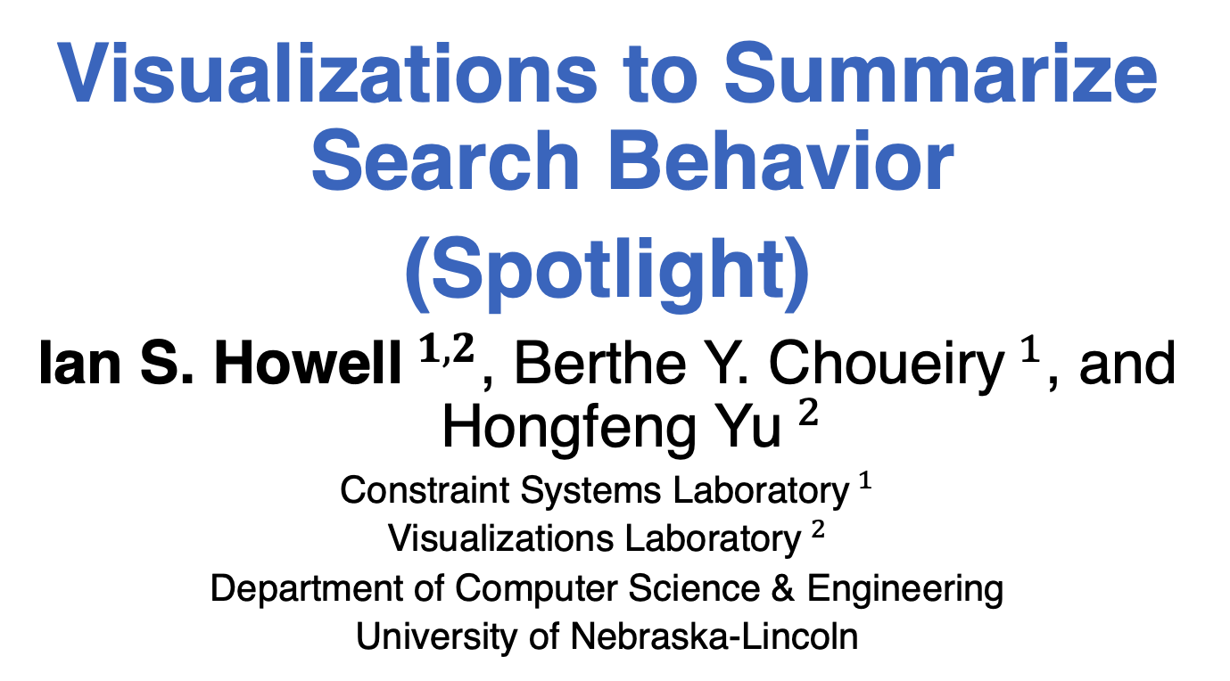
Visualizations to Summarize Search Behavior
(Spotlight)
Ian S. Howell$^{1,2}$, Berthe Y. Choueiry$^{1}$, and Hongfeng Yu$^{2}$
Constraint Systems Laboratory$^{1}$
Visualizations Laboratory$^{2}$
Department of Computer Science & Engineering
University of Nebraska-Lincoln

Slide 2
Introduction
Backtrack search when solving a constraint satisfaction problem (CSP) suffers from thrashing
Enforcing a consistency property reduces thrashing at the cost of further processing
The tradeoff of running a higher-level consistency (HLC) is poorly understood.
We propose to summarize search

Slide 3
Contributions
Criteria for computing distance between two time samples based on the BpD
A clustering technique for summarizing search into a history of qualitatively distinct regimes
A new visualization that examines the behavior of variable ordering heuristics

Slide 4


Distance between timestamps
Design goal: capture the “shape” change
#BT at time $t$
#BT at time $t′$
Depth

Slide 5

Summarizing search history
Perform agglomerative hierarchical clustering and cut the resulting tree to create a history
Divergence
$$δ$$
r₁
r₂
r₃
r₄
r₅
time
t₀
t₁
t₂
t₃
t₄
t₅
t₆
t₇
t₈
t₉
t₁₀
t₁₁

Slide 6
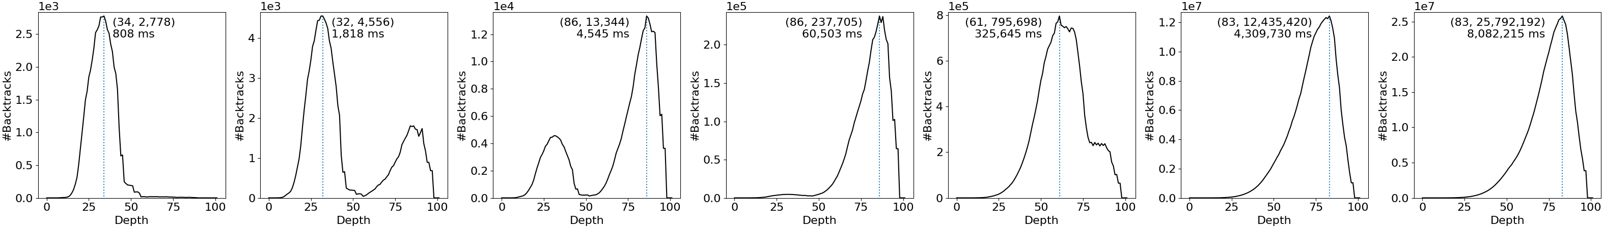
Example: Analyzing structure
0.1-summarization of GAC on mug100-25-3

Slide 7
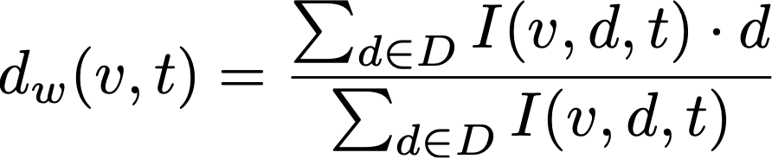
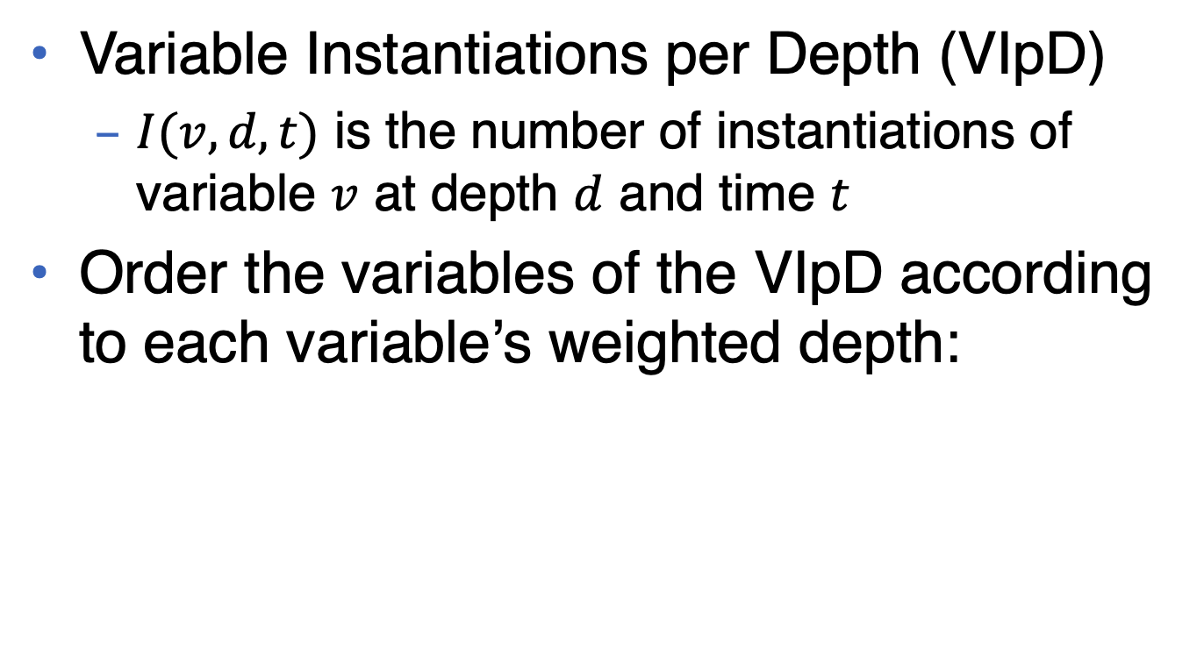
Visualizing variable ordering
Variable Instantiations per Depth (VIpD)
$I(v,d,t)$ is the number of instantiations of variable $v$ at depth $d$ and time $t$
Order the variables of the VIpD according to each variable’s weighted depth:

Slide 8
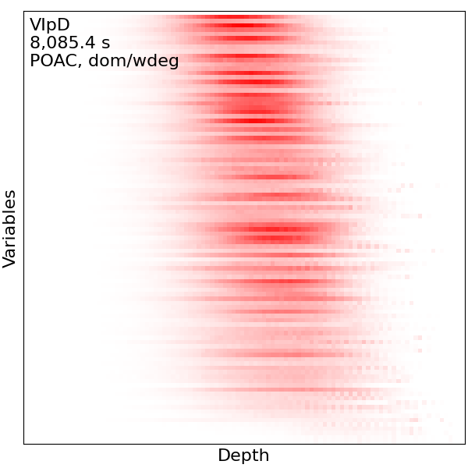
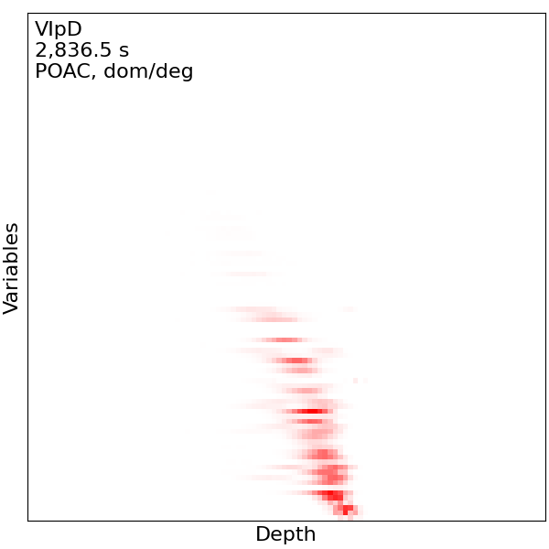
Example: Variable ordering
VIpD of POAC with dom/wdeg and dom/deg on mug100-1-3

Slide 9
Conclusions and discussion
Summarizations can be used to help explain the (changing) behavior of search
Researchers and developers can use these tools iteratively to better study the impact of a strategy on a given problem
Summarizations can catch small and large behavior that a human could not

