Slide 1

Exploiting Local Interactions
To Build Global Strategies
In Honor of Eugene C. Freuder
Jonathan Livingston Seagull of CP
Joint work with C. Bessiere, A. Davis, B.V. Faltings,
E.C. Freuder, S. Karakashian, A. Lal, S. Prestwich,
C. Reeson, A.M. Swearngin, R.J. Woodward, and others
Berthe Y. Choueiry
Constraint Systems Laboratory
University of Nebraska-Lincoln

Slide 2
Outline
Local consistency [Freuder+ 78,82,85,96]
  k-consistency, (i,j)-consistency, inverse consistency
Decomposition strategies [Freuder+ 93,95]
  Factoring Out Failure, Inferred Disjunctive Constraints
  A general schema: disjunctive/conjunctive, properties
Interchangeability [Freuder+ 91,95,97,05,10]
  A theory of interchangeability: Core concepts & variations (local, weak, generalizations)
  In multi-dimensional CSPs

Slide 3
Higher Consistency Levels
k-consistency, (i,j)consistency
  Enforcing it may require adding constraints ☹
Neighborhood Inverse Consistency, a (1,j)-consistency
  No added constraints, no additional space needed ☺
  Adapts to structure of constraint graph ☺
  Expensive on dense graphs, useless on sparse graphs (same pruning as arc consistency) ☹
Idea: Use the dual graph [2010,2011]
  Filtering relations
  Dense: remove redundant edges [Jégou 1989]
  Large loops: triangulate dual graph
  Higher levels consistency become possible!
  Algorithm’s complexity bounded by degree of dual graph

Slide 4
Outline
Local consistency [Freuder+ 78,82,85,96]
Decomposition strategies [Freuder+ 93,95]
Interchangeability [Freuder+ 91,95,97,05,10]

Slide 5
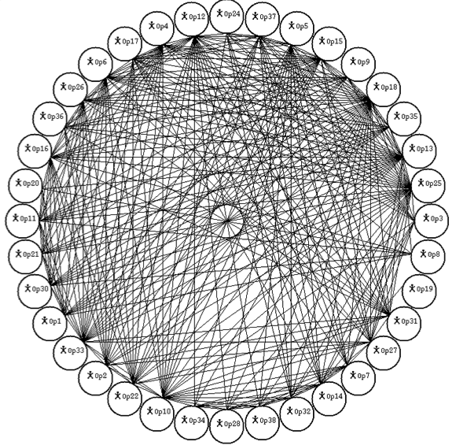
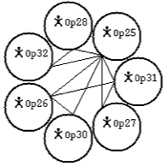
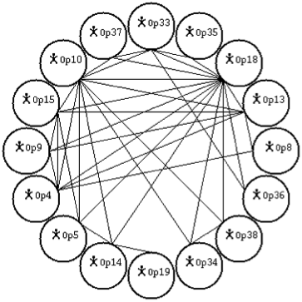
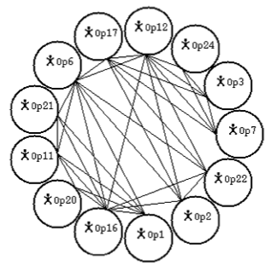
Complete NoGood Sets [1993—1997]
Consider a clique in the co-microstructure of a CSP
Related decompositions
  VAD: cliques efficiently computed
  Microstructure-based decomposition
  Inferred Disjunctive Constraints (IDC)
  Factoring Out Failure (FOF)
General Decomposition Schema

Slide 6
Outline
Local consistency [Freuder+ 78,82,85,96]
Decomposition strategies [Freuder+ 93,95]
Interchangeability [Freuder+ 91,95,97,05,10]

Slide 7
Interchangeability
Basic: Equivalence of 2 values for a variable
Local form: Neighborhood Interchangeability
S
S
S
V₁
{d}
V₂
{c,d,e,f }
V1
V1
d
V1
d
d
V₄
V2
V2
V2
V₃
c
e, f
d
c
d, e, f
{a,b,d}
{a,b,c}
c
e
f
d
Static bundling
Dynamic bundling
Dynamic Bundling [2001,2002]
  For non-binary CSPs [2003—+Freuder 2005]
  For join query computation in Relational DB [2004]

Slide 8
Dynamic Bundling: Advantages
Same operations as Forward Checking
Bundling no-goods is amazingly effective
{1, 2}
V
{3, 4}
V₃
V
{1, 2, 3}
{1, 2, 3,
4, 5, 6}
C₂
{1, 3}
V₁
{1}
V₂
C₁
{1, 2, 3}
V₄
{3}
V₂
{1}
{1, 2, 3}
C₃
V₁
C₄
{1, 2, 3}
✘
V₃
{2}
No-good
bundle
{1}
V₄
Solution
bundle

Slide 9
Concepts in Original Paper
Substitutability
Local vs Global
  Neighborhood Interchangeability (NI)
  Inverse k Interchangeability (IKI)
  Full Interchangeability (FI)
Weakening
  Substitutability (ref. dominance)
  Partial interchangeability
  Subproblem interchangeability
Generalization
  Dynamic interchangeability (ref. SBDS & SBDD)
  Meta interchangeability
  Functional/isomorphic interchangeability: mapping values between different variables (ref. symmetry)
Partial
FI
Subproblem
global
IKI
Substitutability
Partial
NI
local
Subproblem

Slide 10
Interchangeability Landscape [+Freuder 2010]
Original paper inspired many researchers
Sub
FDynSub
ConI
ConSub
FI
CtxDepI ≣ FDynI
PI
TupSub
global
semantic
SPrI
Not Sat preserving
IKI
NSub
GNSub
ConNI
ConNSub
NI
DynNI
ForwNI
NTI
NPI ≣ DirI
NI_{C}
NSub_{C}
local
syntactic
DirSub

Slide 11
Diagram of Symmetry Concepts [+Freuder 2010]
Value Symmetry for Satisfiability [Benhamou 94]
Value Symmetry for Satisfiability [Benhamou 94]
Symmetry [McDonald+ 02]
Symmetry [McDonald+ 02]
Functional Interchangeability [Freuder 91]
Functional Interchangeability [Freuder 91]
Functional Interchangeability [Freuder 91]
Solution Symmetry [Cohen+ 05]
Solution Symmetry [Cohen+ 05]
Value Symmetry for All Solutions [Benhamou 94]
Value Symmetry for All Solutions [Benhamou 94]
Constraint Symmetry [Cohen+ 05]
Constraint Symmetry [Cohen+ 05]
Isomorphic Interchangeability [Freuder 91]
Isomorphic Interchangeability [Freuder 91]
Syntactic Symmetry [Benhamou 94]
Syntactic Symmetry [Benhamou 94]
(a,b)-Supermodel
[Ginsberg+ 98]
Full Interchangeability [Freuder 91]
(a,b)-Supermodel
[Ginsberg+ 98]
Full Interchangeability [Freuder 91]
Neighborhood Interchangeability
[Freuder 91]
Neighborhood Interchangeability
[Freuder 91]
(1,0)-Supermodel
[Ginsberg+ 98]
(1,0)-Supermodel
[Ginsberg+ 98]
Notes:
(advance animation 1) we see the symmetry definitions proposed in the literature on symmetry in CSP in blue.
(advance animation 2) now we see how the concept of supermodels relate to different symmetry concepts
(advance animation 3) the interchangeability concepts: NI very strong form of symmetry
(advance animation 4) observe that functional inter. is a general form of symmetry that generalizes both solution symmetry and value symmetry for all solutions
(advance animation 5) The definitions that are at the local/syntactic level are show in the shaded background

Slide 12










In Multi-DimenSional CSPs [+Freuder 2011]
Meta-interchangeability on each domain dimension
Attribute/dom | c₁ | c₂ | c₃ | c₄ | c₅ | c₆ | c₇ | c₈ | c₉
Number | 3 | 1 | 1 | 2 | 3 | 3 | 1 | 3 | 1
Color | r | r | g | p | g | r | p | r | r
Filling | f | e | e | f | f | f | f | e | e
Shape | o | d | s | d | d | s | d | o | o
c₁
c₂
c₃
c₄
c₅
c₆
Attribute/dom | c₁ | c₅ | c₆ | c₈ | c₂ | c₃ | c₇ | c₉ | c₄
Number | 3 | 3 | 3 | 3 | 1 | 1 | 1 | 1 | 2
Attribute/dom | c₁ | c₂ | c₆ | c₈ | c₉ | c₃ | c₅ | c₄ | c₇
Color | r | r | r | r | r | g | g | p | p
c₇
c₈
c₉
Attribute/dom | c₁ | c₄ | c₅ | c₆ | c₇ | c₂ | c₃ | c₈ | c₉
Filling | f | f | f | f | f | e | e | e | e
Attribute/dom | c₁ | c₇ | c₈ | c₉ | c₂ | c₄ | c₅ | c₃ | c₆
Shape | o | o | o | o | d | d | d | s | s

Slide 13
Reformulation Strategy
P_{o}: Original CSP
Uni-dimensional constraints: {C₁,C₂,C₃,…,C_{n}}
Exploit approximate
symmetries to enforce C₁
P₁: A set of reformulated CSPs
Uni-dimensional constraints: {C₂,C₃,…,C_{n}}
Exploit approximate
symmetries to enforce C₁
P₂: A set of reformulated CSPs
Uni-dimensional constraints: {C₃,…,C_{n}}
Exploit approximate
symmetries to enforce C₁
P_{n}: A set of reformulated CSPs
Uni-dimensional constraints: ∅
Enforce remaining constraints
using some Constraint Solver

Slide 14



Enforcing a Constraint
c₁
c₂
c₃
c₁,c₂,c₃ c₄,c₅ c₆
N⁼⊕N≠
V₁
V₁
c₄
c₅
c₆
id≠
V₂
c₁,c₂,c₃ c₄,c₅ c₇
V₂
S⁼ ⊕S≠
c₁,c₂,c₃ c₄,c₅ c₆
V₃
V₃
N⁼
N=1
N=2
N=3
N≠
c₁,c₂,c₃
c₄,c₅
c₆
c₁,c₂,c₃
V₁
V₁
V₁
V₁
c₁,c₂,c₃
c₄,c₅
c₆
c₄,c₅
V₂
V₂
V₂
V₂
c₁,c₂,c₃
c₄,c₅
c₆
c₆
V₃
V₃
V₃
V₃

Slide 15
Dispensability [Freuder 2011]
Removing values, instantiations (a set of vvps)
  Inconsistent, enforcing consistency
  Consistent, because satisfiability is preserved
Dispensable values, instantiations
  Inconsistent ⇒ Interchangeable ⇒ Substitutable ⇒ Removable [Bordeaux+ 08] ⇒ Dispensable
Ties
  Consistency, Interchangeability, Decomposition
That’s is all reformulation, folks!

Slide 16
On a Personal Note…
My first presentation in grad school (1990)
  Backtrack-free search & backtrack-bounded search
Reason for SARA’s archival proceedings
Hosted & mentored my students during Summer 2010
  Lived my own dream through them
… A visionary, a builder, a talent ‘gatherer’
  A single day visiting with him, Steven Prestwich, Rick Wallace, Nick Wilson, etc. is worth months of solitary study in my office
  4C is the largest academic group in CP, entrusted in the good hands of Barry
My wishes to Gene
  Lots of fun, that is, more time for research… in the US

Slide 17
Summary
Local consistency [Freuder+ 78,82,85,96]
  k-consistency, (i,j)-consistency, inverse consistency
Decomposition strategies [Freuder+ 93,95]
  Factoring Out Failure, Inferred Disjunctive Constraints
  A general schema: disjunctive/conjunctive, properties
Interchangeability [Freuder+ 91,95,97,05,10]
  A theory of interchangeability: Core concepts & variations (local, weak, generalizations)
  In multi-dimensional CSPs

Slide 18
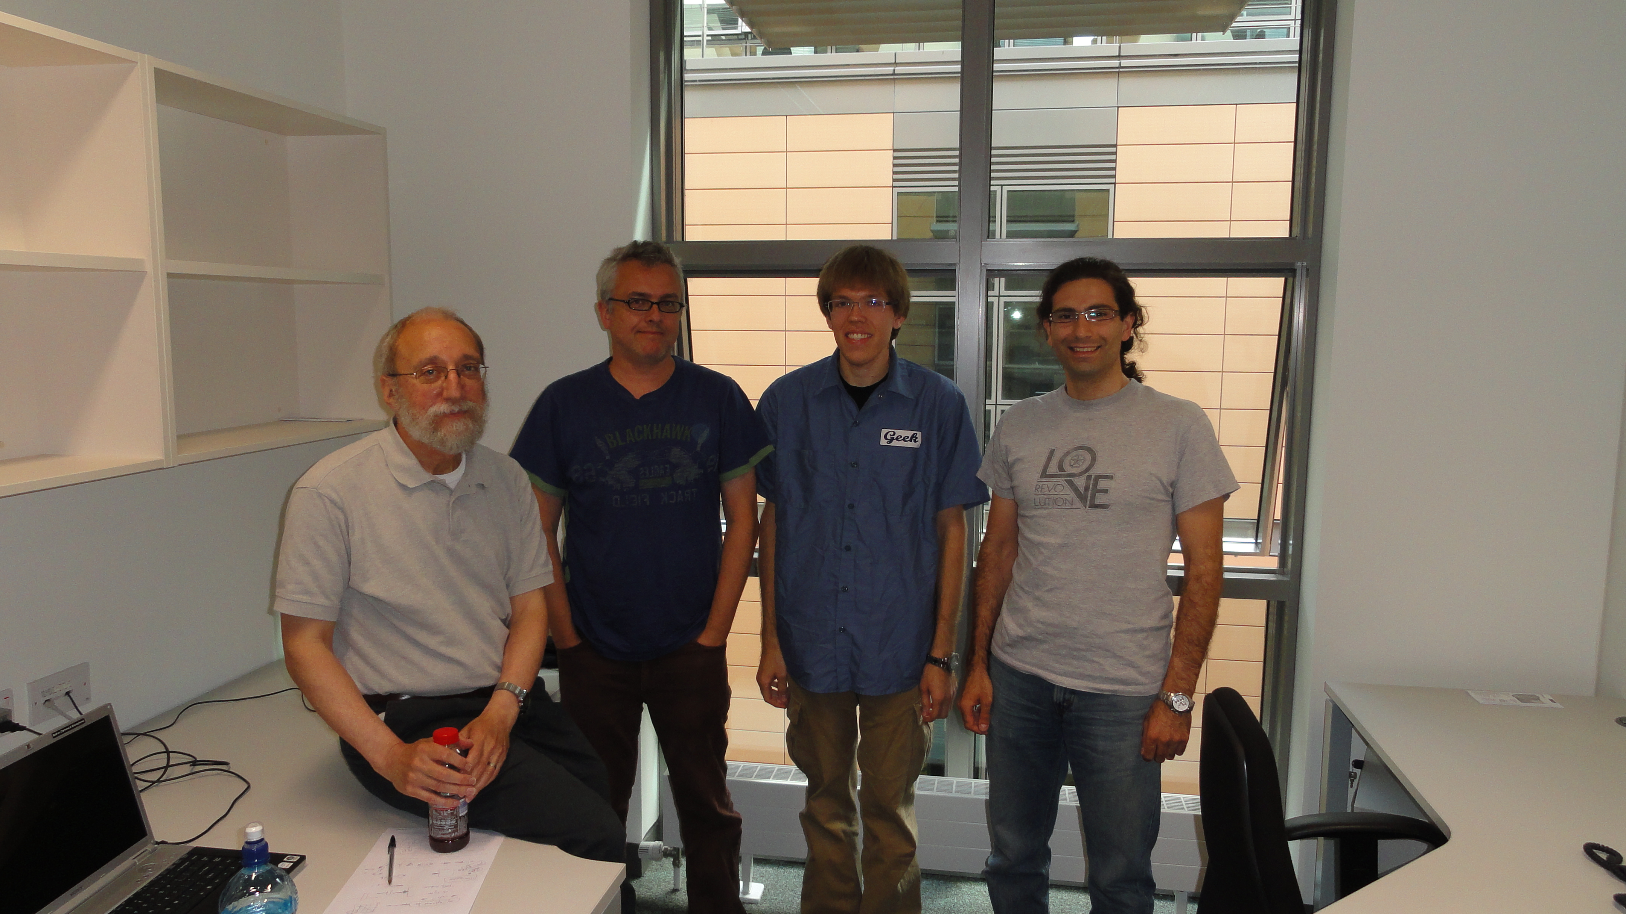
Summer 2010 @ 4C

