Slide 1


Algorithm Configuration for
Random Problem Generation
Daniel Geschwender

Slide 2
Outline
Introduction to algorithm configuration
Goals
Types
SMAC
Case study: Random-problem generation
AllSol vs. PerTuple
RBGenerator
Experimental results
SMAC usage tutorial
Quickstart example
File descriptions
Setting up problem generation

Slide 3
Introduction to Algorithm Configuration

Slide 4
Algorithm Configuration
An algorithm A
Is tuned with parameters p₁,p₂,…,p_{k}
Takes as input a problem instance I
Outputs a result evaluated with a performance metric m
Algorithm Configuration
Task: Find the parameters that yield
an optimal performance of A
according to metric m
on a class of problems similar to I
Goal: Automate a task that is manually executed
p₁
p₂
…
p_{k}
i
A
m

Slide 5
Context
Helps algorithm designers tune their algorithms
Saves manual work
Often provides better configurations than manual selections
Encourages algorithm designers
To create open and flexible algorithms
With exposed parameters
Achieves significant performance gains on targeted difficult problem classes

Slide 6
The Task
[Hoos Auto. Search 2012]
Given
Algorithm A with parameters p₁,p₂,…,p_{k}
Configuration space C, where each configuration c∈C specifies values for the parameters
A set of problem instances I
A performance metric m
Find
Configuration c*∈C that yields an optimal performance
Of the algorithm A
On a class I of problem instances
According to metric m

Slide 7
Graphical Illustration
c*
c
C
p₁
p₂
…
p_{k}
I
m
A

Slide 8
Types: Racing Procedures
[Hoos Auto. Search 2012]
Sample configurations from the configuration space
Racing Process
Take a set of candidate configurations, starting with all candidates
‘Race’ candidates on a subset of the benchmark instances
Drop candidates that fall sufficiently behind the leader
Go back to Step 2
Notes
The best configurations are evaluated the most thoroughly
Number of configurations is limited because all configurations must be specified in advance
Sampling configurations and racing can be interleaved for a finer ‘control’

Slide 9
Types: Iterated Local Search
[Hoos Auto. Search 2012]
Begins from an initial configuration
Alternates between two operations
Local search to improve the current configuration
Perturbation of the configuration to break from local minima
Optionally, may include random restarts
To save time, we may terminate poor configurations early
‘Adaptive capping’ saves time by halting bad runs and preserves the configuration space ‘trajectory’
‘Aggressive capping’ is a heuristic approach that can save runtime, but may alter the search ‘trajectory’

Slide 10
Types: Model-Based Optimization
[Hoos Auto. Search 2012]
Maintains a model of the configuration space to estimate favorable configurations
Several random configurations are run to build the initial model
New configurations are selected using the model to locate the area of highest ‘expected improvement’
Each new algorithm run is factored into the model to improve its accuracy
Techniques used
originally supported only integer and real valued parameters,
but now support categorical parameters

Slide 11
Sequential Model-based Algorithm Configuration (SMAC)
[Hutter+ LION-5]
A model-based algorithm configurator developed by the BETA-lab at the University of British-Columbia
Utilizes random forests, a machine learning tool for regression, allowing for categorical parameters
Allows for multiple instances to be used when training the model
Can use instance features when building the model to better predict performance on specific instances
Selection of new configuration looks for both good expected performance and high uncertainty

Slide 12
SMAC on CPLEX
[Hutter+ LION-5]
One of many tests included configuration of IBM ILOG CPLEX, a widely used commercial mixed integer programming solver
The CPLEX solver has 76 parameters
SMAC found configurations that significantly outperformed
the CPLEX defaults
configurations found by CPLEX’s own tuning tool

Slide 13
Case study: Random problem generation

Slide 14
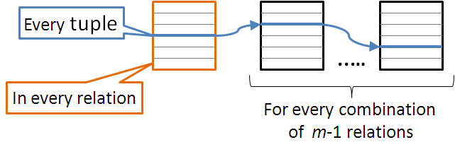
Minimality of CSP
Minimality is a global consistency property
Guarantees that every tuple in the relation of a constraint participates in some solution to the CSP (i.e., the constraints are minimal)

Slide 15
AllSol vs. PerTuple
AllSol: better when there are many ‘almost’ solutions
Finds all solutions without storing them
Keeps tuples that appear in at least one solution
One search explores the entire search space
PerTuple: better when many solutions are available
For each tuple, finds a solution where it appears
Many searches that stop after the first solution

Slide 16
RBGenerator
[Xu+ AIJ 2007]
Generates hard satisfiable CSP instances at the phase transition
Parameters
k: arity of the constraints
n: number of variables
α: domain size
r: # constraints
δ: distance from phase transition, , where
forced: forced satisfiable?
merged: merge similar scopes?

Slide 17
RBGenerator
SMAC: Sequential Model-based Algorithm Configuration
User-Defined Parameter Space
Parameter Space Response Model
User-Defined Algorithm Wrapper
Input parameters
AllSol
RBGenerator
Random
CSP
instance
Result
Instance
list
Random
seed
PerTuple

Slide 18
Experimental Results (I)
4 tests run, testing two factors:
Configuring to favor PerTuple and AllSol
With adjustable and fixed problem size parameters
Each test runs over 10 configuration seeds
Each configuration seed runs for 3 days
All 10 configurations run in parallel
Algorithm time-limit set to 20 minutes

Slide 19
Experimental Results (II)

Slide 20
Experimental Results (III)

Slide 21
Experimental Results (IV)

Slide 22
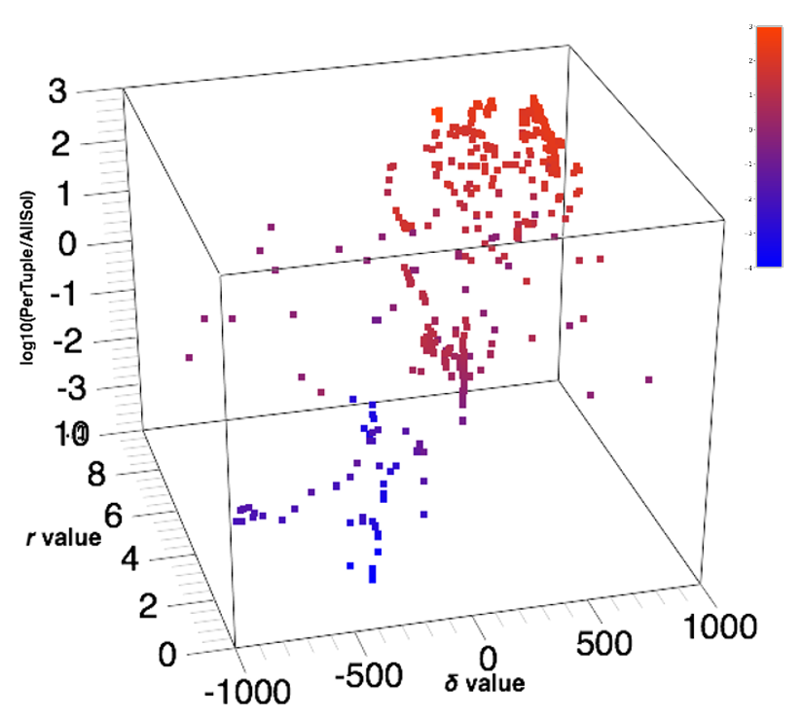
Experimental Results (V)
High values of δ (tight constraints) and high values of r (many constraints) lead to better AllSol performance

Slide 23
Experimental Results (VI)
Algorithm Configuration finds instances where
PerTuple performed 1000x faster
AllSol performed 100x faster
PerTuple configuration
fewer constraints, lower constraint tightness
AllSol configuration
more constraints, higher constraint tightness

Slide 24
SMAC Usage Tutorial

Slide 25
SMAC quickstart example
Example taken from the SMAC quickstart guide: http://www.cs.ubc.ca/labs/beta/Projects/SMAC/v2.08.00/quickstart.html
Set up SMAC:
wget http://www.cs.ubc.ca/labs/beta/Projects/SMAC/smac-v2.08.00-master- 731.tar.gz
tar -xzvf smac-v2.08.00-master-731.tar.gz
cd smac-v2.08.00-master-731
Run blackbox function example:
./smac --use-instances false --numberOfRunsLimit 100 --pcs-file example_scenarios/branin/params.pcs --algo "python example_scenarios/branin/branin.py" --run-objective QUALITY

Slide 26
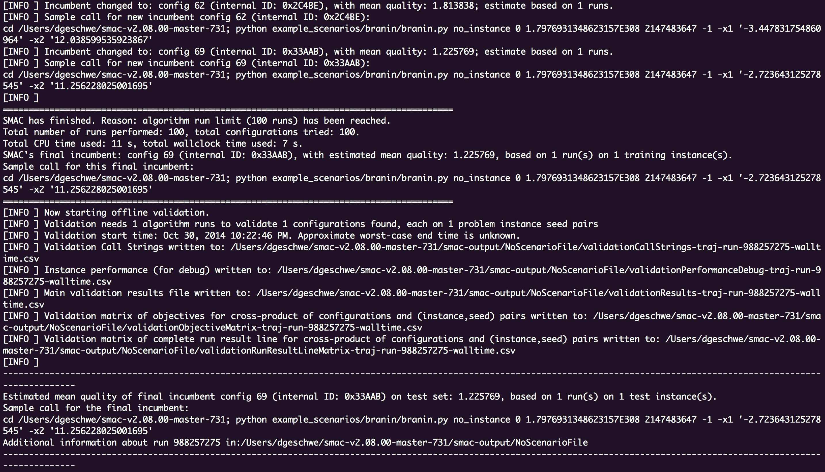
SMAC quickstart example

Slide 27

File descriptions
Parameter file
Specifies ranges and defaults
Can specify real, integer, and categorical

Slide 28
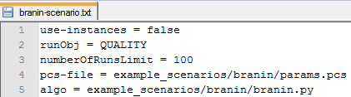
File descriptions
Scenario file
specifies SMAC command line options in a file

Slide 29
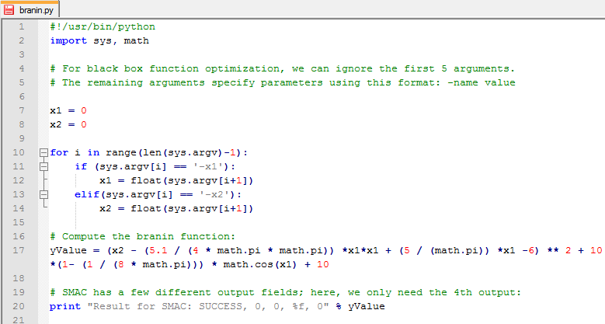
File descriptions
Algorithm wrapper
Script to handle execution of the algorithm
Requires specific input and output format

Slide 30
File descriptions
Algorithm wrapper
Script to handle execution of the algorithm
Requires specific input and output format
Algorithm wrapper callstring:
<algo> <instance> <instance_specifics> <runtime cutoff> <runlength> <seed> <solver parameters>
Algorithm wrapper return:
Result for SMAC: <status>, <runtime>, <runlength>, <quality>, <seed>

Slide 31
Setting up problem generation
Parameter file
Include all parameters for the problem generator
Set parameter ranges to be flexible but not too large
Scenario file
run_obj should be set to quality
overall_obj should be set to MEAN
cutoff_time should be enough to run generation and both algorithms comfortably
tunerTimeout should be enough to test a sufficient number of configurations (1 or more days)

Slide 32
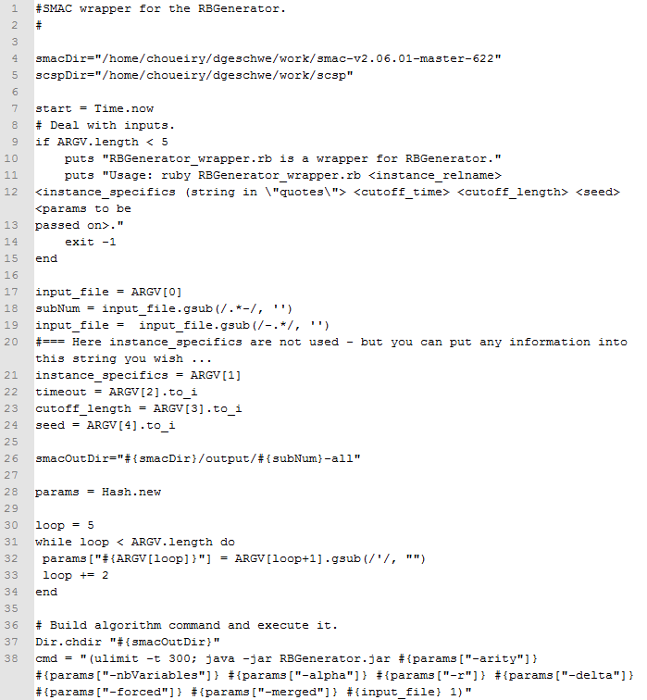
Setting up problem generation
Algorithm wrapper
Handle the wrapper input format
Pull all parameters from the input
Run problem generation with parameters
Limit the runtime of generation

Slide 33
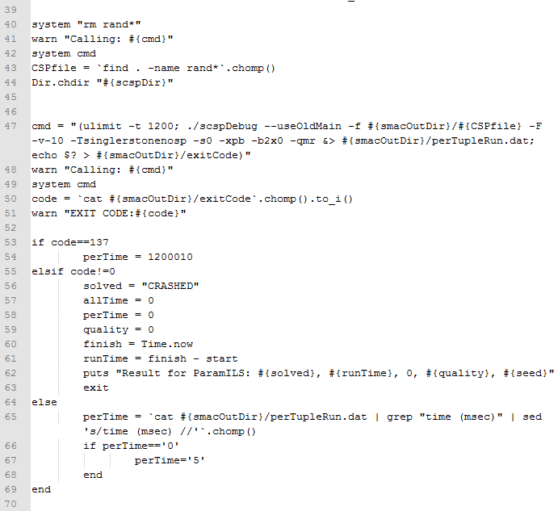
Setting up problem generation
Algorithm wrapper
Run the algorithm
Limit its execution time
If it timed out, treat its runtime as the max possible runtime
If it crashed, report the crashed run to SMAC

Slide 34
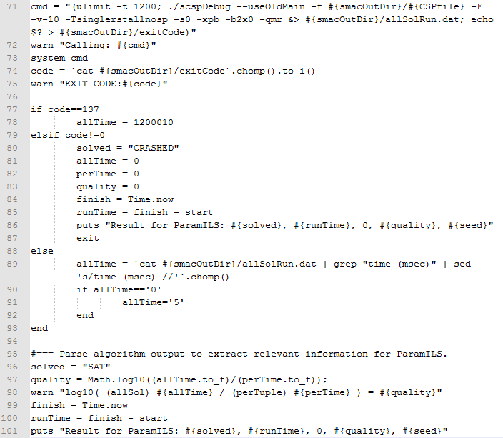
Setting up problem generation
Algorithm wrapper
Repeat with second algorithm
Calculate solution quality as the log of the two runtimes
Return results in the correct format

Slide 35
Questions?

