Slide 1

A Portfolio Approach
for Enforcing Minimality
in a Tree Decomposition
Daniel J. Geschwender^{1,2} R.J. Woodward^{1,2} B.Y. Choueiry^{1,2} S. D. Scott²
¹Constraint Systems Laboratory
²Department of Computer Science and Eng.
University of Nebraska-Lincoln
Acknowledgements
Experiments conducted at UNL’s Holland Computing Center
Geschwender supported by a NSF Graduate Research Fellowship Grant No. 1041000
NSF Grants No. RI-111795 and RI-1619344

Slide 2


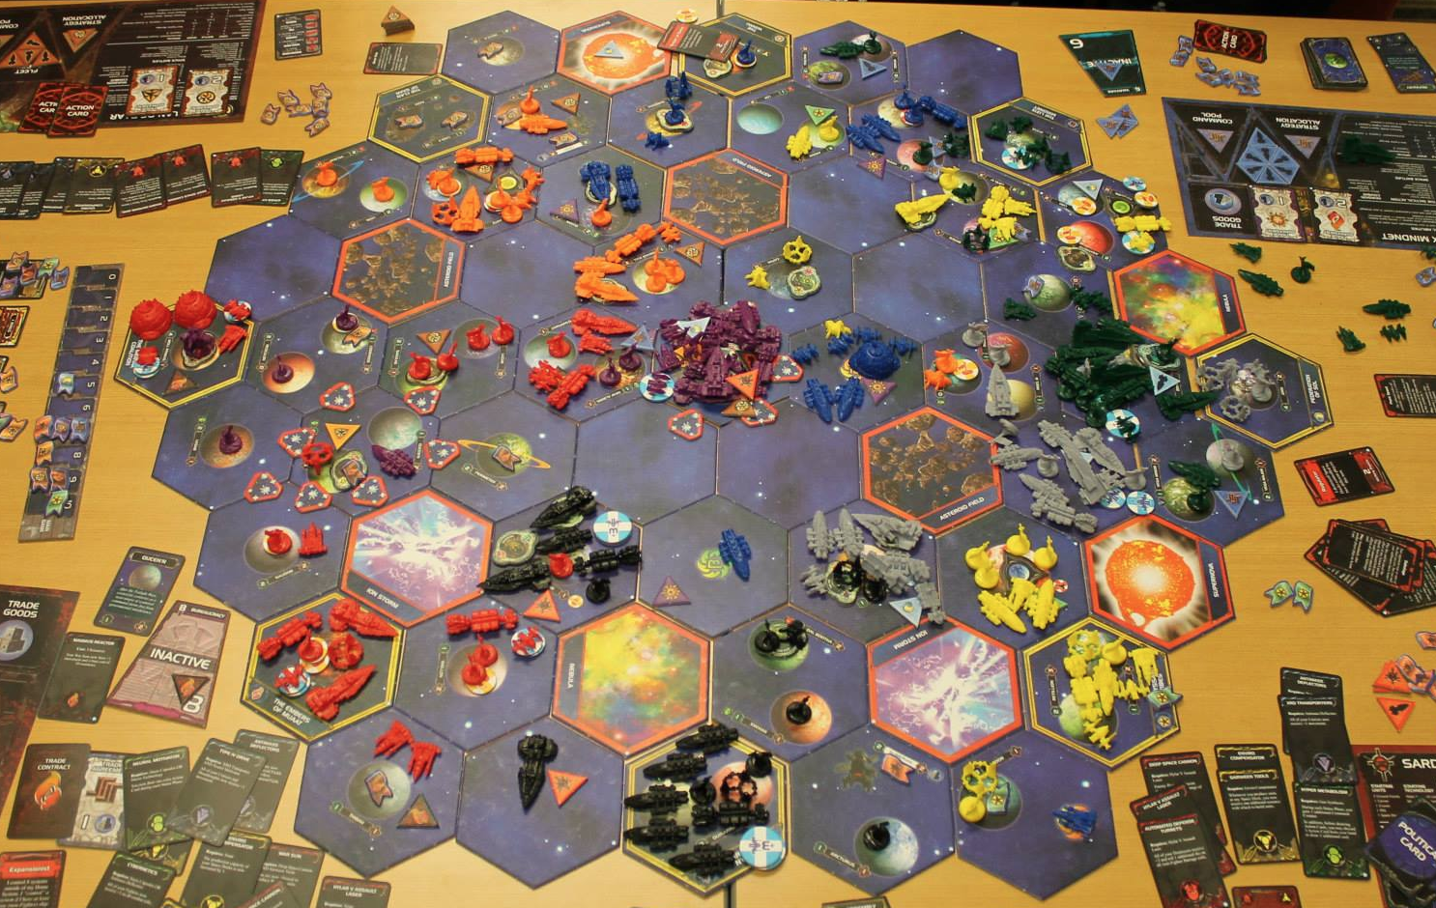
Daniel Geschwender
3rd year PhD student at University of Nebraska – Lincoln’s Constraint Systems Laboratory
Studying high-level relational consistencies and automated techniques for determining when to apply them
Always ready to play a board game!

Slide 3
Claim: Cluster-level portfolio
We advocate the use of an algorithm portfolio
for enforcing minimality
on the clusters of a tree decomposition
during lookahead in a backtrack search for solving CSPs

Slide 4
Outline
Background
Minimality: property and algorithms (AllSol, PerTuple)
Minimality in a tree decomposition
Processing clusters: FilterClusters
GAC interleave
Cluster-level portfolio
Cluster-processing timeout
Training the classifier
Experiments
Conclusion

Slide 5
Background: Minimality
Global consistency property
Every tuple in a relation can be extended to a full solution over the m relations

Slide 6
Background: AllSol/PerTuple
AllSol
One search explores the entire search space
Finds all solutions without storing them, keeps tuples that appear in at least one solution
Better when there are many ‘almost’ solutions
[Karakashian, PhD 2013]

Slide 7
Background: AllSol/PerTuple
PerTuple
For each tuple, finds one solution where it appears
Many searches that stop after the first solution
Better when many solutions are available
[Karakashian, PhD 2013]

Slide 8
Background: Tree decomposition, minimality
Minimality on clusters [Karakashian+ AAAI 2013]
Build a tree decomposition
Localize minimality to clusters
During search, after a variable instantiation
Enforce minimality on clusters
Propagate following tree structure
FilterClusters implements three improvements
GAC interleave
Cluster-level portfolio
Cluster-processing timeout

Slide 9
FilterClusters: GAC interleave
It is often beneficial to run a lightweight algorithm (e.g., GAC) prior to running a more costly algorithm
We extend this idea and interleave a global GAC run between the processing of clusters
Minimality
GAC
Minimality

Slide 10


FilterClusters: Cluster-level portfolio
Performance of AllSol and PerTuple vary
Sometimes both algorithms are too costly
Use algorithm portfolio on the cluster level
Different algorithms on different clusters
Different algorithms on the same cluster during propagation
‘AllSol’
‘PerTuple’
‘Neither’

Slide 11

FilterClusters: Cluster timeout
Limits the time for processing a single cluster
Allows recovery from a poor classification
When interrupted, partial results of
PerTuple yield useful filtering
AllSol are useless

Slide 12
Classifier Training: Data
9362 individual clusters taken from 175 benchmarks
For each cluster instance i, collected
The values of 73 classification features
The runtime of AllSol: allSol(i)
The runtime of PerTuple: perTuple(i)

Slide 13
Classifier Training: Labels
‘Neither’
Start
‘AllSol’
allSol(i)>10 min &
perTuple(i)>10 min
No
Yes
No
allSol(i)>perTuple(i)
Yes
‘PerTuple’
‘AllSol’
‘PerTuple’
‘Neither’

Slide 14
Classifier Training: Weights
Weight of a training instance i, weight(i)
Designed to emphasize instance with both a
large proportional difference
large absolute difference

Slide 15
Classifier Training: Features
CSP parameters
#variables, #constraints, #values, #tuples
Constraint arity, constraint tightness
Relational linkage
Graph parameters: on dual, primal, and incidence graph
Density
Degree
Eccentricity
Clustering coefficient
Using several descriptive statistics
min, max, mean, coefficient of variation, entropy

Slide 16
Classifier Training: Decision tree
We built a decision tree classifier using the J48 algorithm from the Weka machine learning software
Decision tree selected for:
Simplicity
Fast evaluation time
Only requires collection a subset of the features

Slide 17
Experiments: Set up
Used 1055 instances from 42 benchmarks
Backtrack search, dynamic dom/deg ordering
Intel Xeon E5-2650 v3 2.30GHz processors with 12 GB memory
2 hours total time out per instance
Compared GAC and six strategies (variants of FilterClusters)

Slide 18
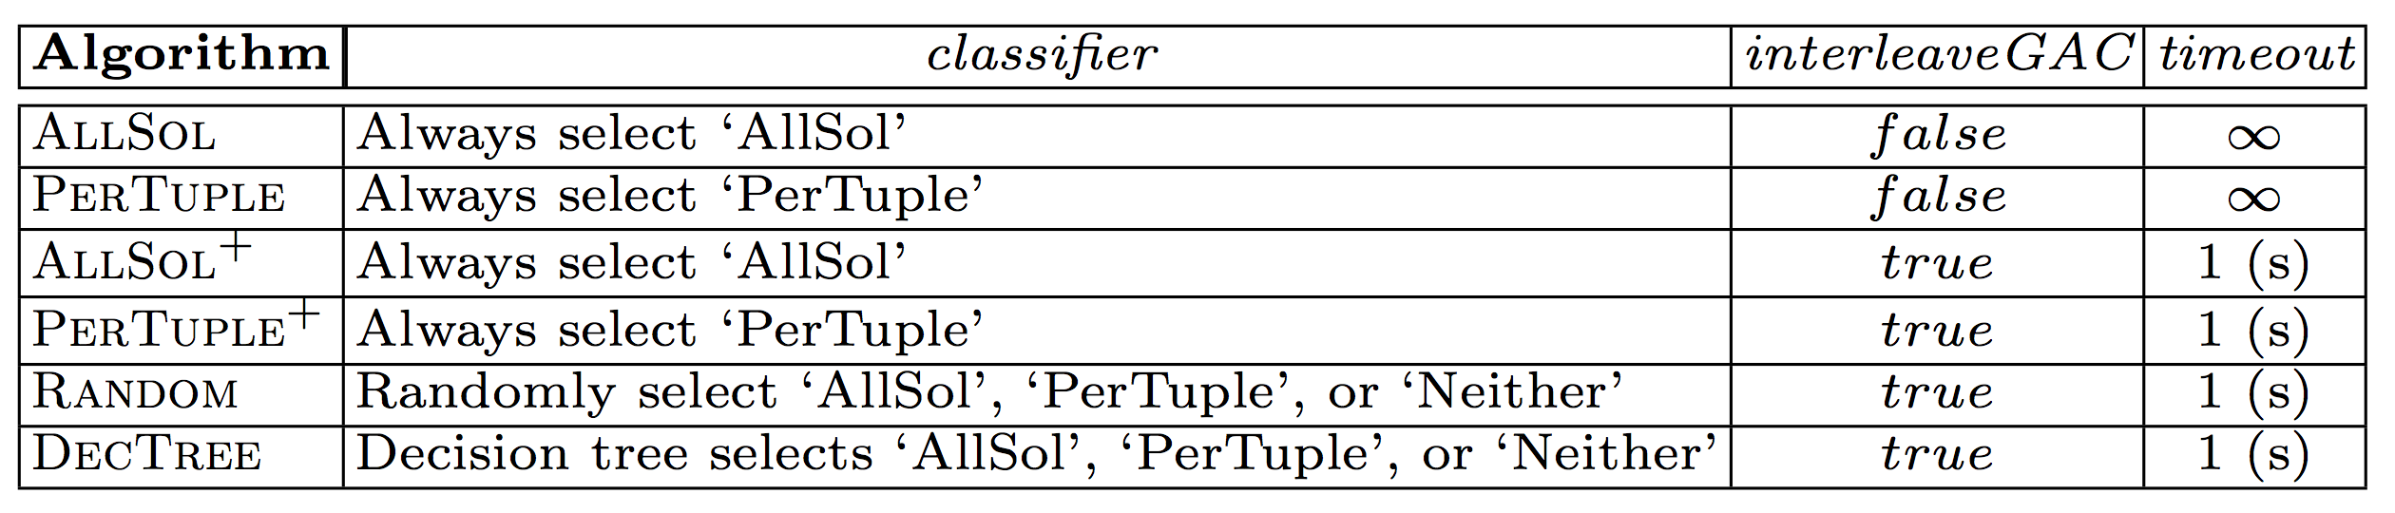
Experiments: Tested strategies

Slide 19
Experiments: Results
 | GAC | AllSol | PerTuple | AllSol⁺ | PerTuple⁺ | Random | DecTree
Instances Completed | 550 | 472 | 567 | 514 | 633 | 643 | 685
Average Time (s) | 2,471 | 3,075 | 2,081 | 2,789 | 1,622 | 1,427 | 1,121

Slide 20
Conclusions
A cluster-level portfolio, during lookahead
Is not only feasible, but also highly competitive
Enforcing a timeout on consistency algorithms
Prevents getting stuck on one part of the problem
Does not affect soundness
Future work
Dynamically determine timeout based on the anticipated amount of filtering
Heuristics for ordering the clusters

Slide 21
Thank you
Questions?

Slide 22
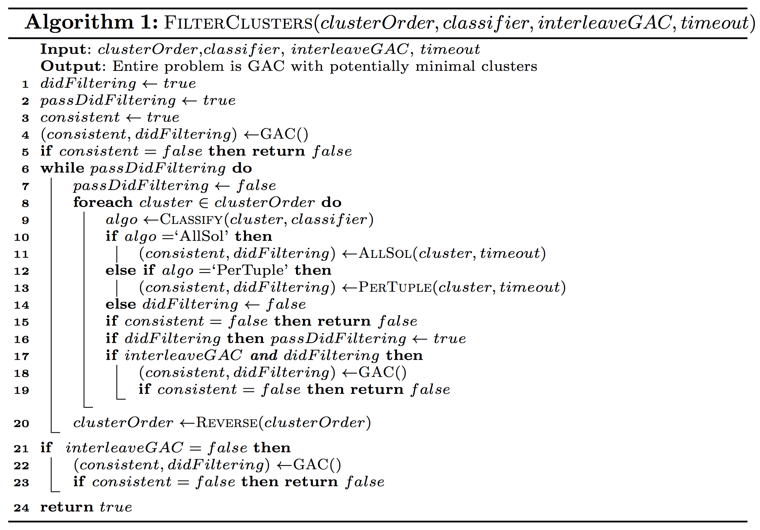

Slide 23
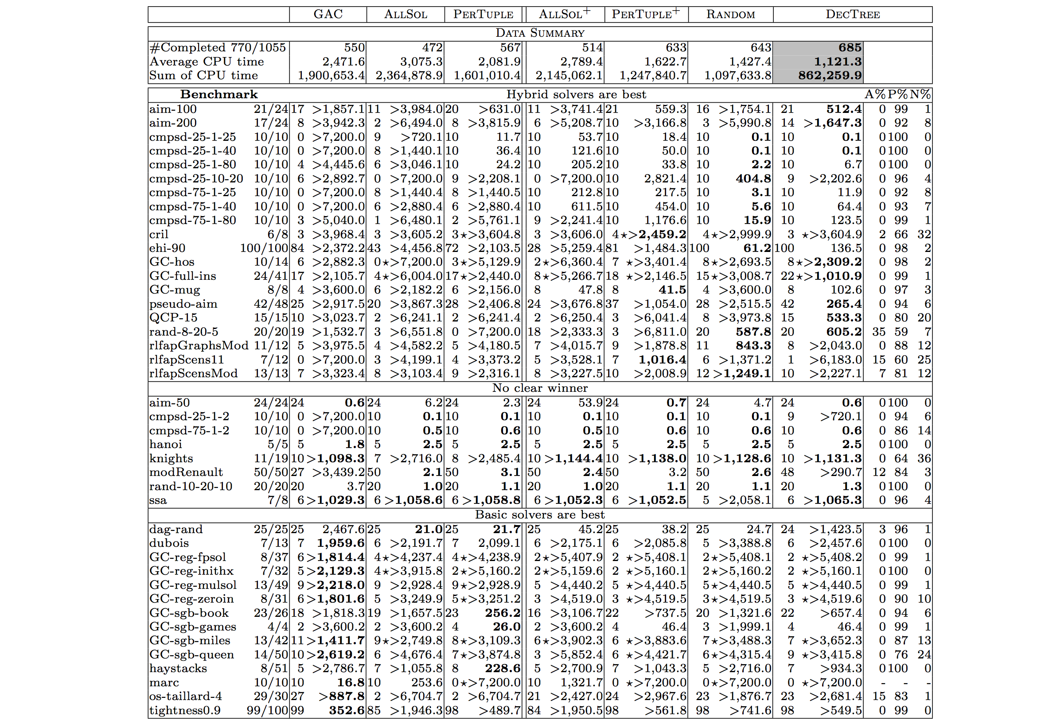

Slide 24
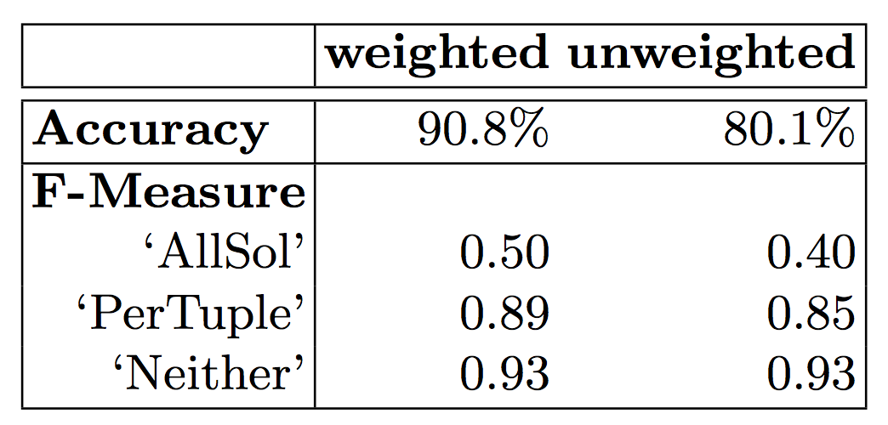
Classifier Training: Evaluation
Using 10-fold cross validation
Using both weighted and un-weighted instances

Slide 25
FilterClusters
Enforce GAC globally
Build cluster List
Repeat until quiescence
?
For cluster C in List
‘AllSol’
Classify C
‘PerTuple’
‘Neither’
Process C within time limit
Enforce GAC globally
Reverse List
25

Slide 26
Experiments: Tested strategies (2)
1 second cutoff per cluster

Slide 27
Experiments: Results (2)

Slide 28
Background: Tree decomposition, minimality
Build a tree decomposition
Localize the enforcement of minimality to the clusters
Process clusters in MaxCliques order back and forth to quiescence

