Slide 1
Reformulating Constraint Satisfaction Problems with Application to Geospatial Reasoning
Ken Bayer
Constraint Systems Laboratory
Department of Computer Science & Engineering
University of Nebraska-Lincoln
Joint work with M. Michalowski, B.Y. Choueiry, and C.A. Knoblock
Supported by NSF CAREER award #0133568 & AFOSR grants FA9550-04-1-0105, FA9550-07-1-0416

Slide 2
Main contributions
Four new reformulation techniques for CSPs
Query reformulation
Domain reformulation
Constraint relaxation
Reformulation via symmetry detection
BID as a CSP [Michalowski & Knoblock, AAAI 05]
Improved constraint model
Custom solver
Application of the reformulations to BID problem

Slide 3
Outline
Background
BID model & custom solver
Reformulation techniques
Description
General use in CSPs
Application to BID
Evaluation on real-world BID data
Conclusions & future work

Slide 4
Abstraction & Reformulation
Original problem
Reformulated problem
Reformulation
technique
Original formulation
Original query
Reformulated formulation
Reformulated query
… may be an approximation
Original space
Reformulated space
Φ(Solutions(P_{o}))
Solutions(P_{o})
Solutions(P_{r})

Slide 5
Constraint Satisfaction Problems
Formulation: F = (V, D, C )
V = set of variables
D = set of their domains
C = set of constraints restricting the acceptable combination of values for variables
Query: All consistent solutions, a single solution, etc.
Solved with
Constraint propagation
Search

Slide 6
Constraint propagation
Remove values that cannot appear in any solution
Arc consistency

Slide 7
Building Identification (BID) problem
Data input: map layout + phone book
Basic numbering rules
Additional information
= Building
= Corner building
S1
S2
S1#1,S1#4,
S1#8,S2#7,
S2#8,S3#1,
S3#2,S3#3,
S3#15
B2
Si
= Street
B1
B3
B4
S3
B6
B7
B10
B5
B8
B9

Slide 8
Basic numbering rules
Ordering
Parity
Phone book
B1
B1
B2
# 17
# 29
# 54
B1
<
B2
<
B3
Odd
B3
B2
Even
B3
B4
B4
Ordering: Increasing/decreasing numbers along a street
Parity: Odd/even numbers on opposing sides of a street
Phone book: Complete/incomplete
Assumption: all addresses in phone-book must be used
Notes:
Say it quick, say it once.

Slide 9
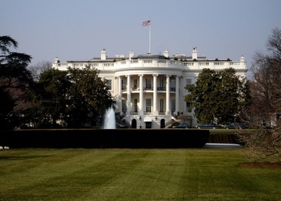
Additional information
Landmarks
Gridlines
1600 Pennsylvania Avenue
S1 #1xx
S1 #2xx
B1
B2
B1
B2
S1

Slide 10
Query
Given an address, what buildings could it be?
Given a building, what addresses could it have?
= Building
= Corner building
S1
S2
S1#1,S1#4,
S1#8,S2#7,
S2#8,S3#1,
S3#2,S3#3,
S3#15
B2
Si
= Street
B1
B3
B4
S1#1,
S3#1,
S3#15
S3
B6
B7
B10
B5
B8
B9

Slide 11
Outline
Background
BID model & custom solver
Reformulation techniques
Conclusions & future work
5/27/2007
11

Slide 12
CSP model: variables
Orientation variables
OddOnNorth, OddOnEast, IncreasingNorth, IncreasingEast
Domains: {true, false}
Corner variables
Corner buildings
Domains: set of streets
Building variables
Corner & non-corner buildings
Domains: set of addresses
S2
B2
B1
B1c
S1
D_{B1c} = {S1, S2}
D_{B1} = {S1#2, S1#4,…, S1#228,
S2#5, S2#9,…, S2#25}
D_{B2} = { S2#5, S2#9,…, S2#25}

Slide 13
CSP model: constraints
IncreasingEast
S2
B2
B1
B1c
S1
OddOnNorth
B1
B2
B3
B4
B5
Parity constraints
Ordering constraints
Corner constraints
Phone-book constraints
Optional: grid constraints

Slide 14
Example constraint network
S1
B2
S2
B1
B3
B4
S3
B6
B7
B10
B5
B8
B9
= Building
S1#1,S1#4,
S1#8,S2#7,
S2#8,S3#1,
S3#2,S3#3,
S3#15
= Corner building
Si
= Street

Slide 15
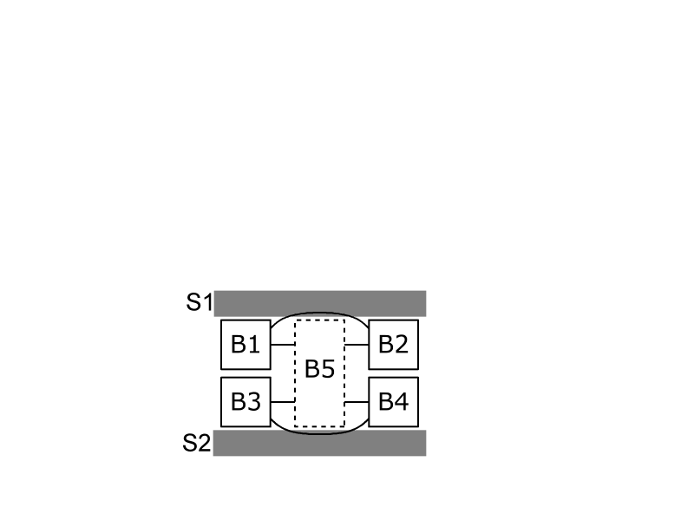
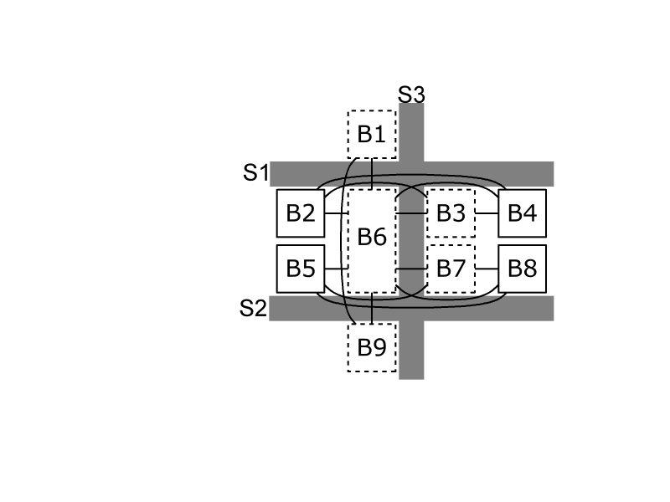
Special configurations
Orientations vary per street (e.g., Belgrade)
Non-corner building on two streets
Corner building on more than two streets
→ All gracefully handled by the model

Slide 16
Custom solver
Backtrack search
Conflict-directed backtracking
Forward checking (nFC3)
Domains implemented as intervals (box consistency)
Variable ordering
Orientation variables
Corner variables
Building variables
Backdoor variables
Orientation + corner variables
Orientation &
corner variables
Building
variables
Filter values

Slide 17
Backdoor variables
B3
B7
B3
B7
B1
B2
B4
B6
B8
B11
B1
B2
B4
B6
B8
B11
B5
B9
B5
B9
B10
B10
We instantiate only orientation & corner variables
We guarantee solvability without instantiating building variables

Slide 18
Features of new model & solver
Model
Reflects topology
Constraints can be declared locally & in restricted ‘contexts’ (feature important for Michalowski’s work)
Solver
Exploits structure of problem
Implements domains as possibly infinite intervals
Incorporates all reformulations (to be introduced)
Improvement over previous work [Michalowski +, 05]

Slide 19
Outline
Background
BID model & custom solver
Reformulation techniques
Query reformulation
AllDiff-Atmost & domain reformulation
Constraint relaxation
Reformulation via symmetry detection
Conclusions & future work
5/27/2007
19

Slide 20
Query in the BID
Problem: BID instances have many solutions
B1 | B2 | B3 | B4
2 | 4 | 6 | 8
2 | 4 | 8 | 10
2 | 4 | 8 | 12
4 | 8 | 10 | 12
4 | 6 | 8 | 10
4 | 6 | 8 | 12
B1
B2
B3
B4
Phone book: {4,8}
We only need to know which values appear in
at least one solution

Slide 21
Query reformulation
Solving the BID
Reformulated BID
Query
reformulation
Query: Find all solutions, collect values for variables
Query: For each variable-value combination, determine satisfiability
Original query | Reformulated query
Single counting problem | Many satisfiability problems
All solutions | Per-variable solution
Exhaustive search | One path
Impractical when there are many solutions | Costly when there are few solutions

Slide 22
Evaluations: real-world data from El Segundo
[Shewale]
Case study | Phone book | Number of…
 | Completeness | Buildings | Corner bldgs | Blocks
NSeg125-c | 100.0% | 125 | 17 | 4
NSeg125-i | 45.6%
NSeg206-c | 100.0% | 206 | 28 | 7
NSeg206-I | 50.5%
SSeg131-c | 100.0% | 131 | 36 | 8
SSeg131-i | 60.3%
SSeg178-c | 100.0% | 178 | 46 | 12
SSeg178-i | 65.6%
Previous work did not scale up beyond 34 buildings
All techniques tested return same solutions

Slide 23
Evaluation: query reformulation
Incomplete phone book → many solutions → better performance
Case study | Original query | New query [s]
NSeg125-i | >1 week | 744.7
NSeg206-i | >1 week | 14,818.9
SSeg131-i | >1 week | 66,901.1
SSeg178-i | >1 week | 119,002.4
Complete phone book → few solutions → worse performance
Case study | Original query [s] | New query [s]
NSeg125-c | 1.5 | 139.2
NSeg206-c | 20.2 | 4,971.2
SSeg131-c | 1123.4 | 38,618.4
SSeg178-c | 3291.2 | 117,279.1

Slide 24
Generalizing query reformulation
Relational (i,m)-consistency, R(i,m)C
Given m constraints, let s be the size of their scope
Compute all solutions of length s
To generate tuples of length i (i.e., constraints of arity i)
Space: O(d ^{s} )
Query reformulation
For each combination of values for i variables
Try to extend to one solution of length s
Space: O(( )d ^{i} ), i < s
Per-variable solution computes R(1,|C |)C
s
i

Slide 25
Outline
Background
BID model & custom solver
Reformulation techniques
Query reformulation
AllDiff-Atmost & domain reformulation
Constraint relaxation
Reformulation via symmetry detection
Conclusions & future work
5/27/2007
25

Slide 26
Domain reformulation
Domains in the BID are large
Min/max value?
Enumerate?
[3,8]
B1
B2
B3
B4
[0,245]
[0, ]
Phonebook = {3,8}
{1,2,3,…,8}
B1
B2
B3
B4

Slide 27
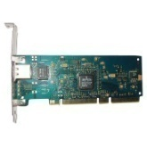

AllDiff-Atmost constraint
AllDiff-Atmost(A,k,d)
For a set of variables A, ensure that the variables in A collectively are not assigned more than k values from the set d
{ High end graphics card,
Low end graphics card,
Sound card,
10MB ethernet card,
100MB ethernet card,
1GB ethernet card,
…}
At most one network card
Three expansion slots

Slide 28
AllDiff-Atmost reformulation
Replaces
interval d of values (potentially infinite)
with k symbolic values

Slide 29
AllDiff-Atmost in the BID
12 | 28 | 30 | 32 | 34
12 | 14 | 16 | 28 | 36
10 | 12 | 14 | 20 | 28
2 | 4 | 6 | 12 | 28
… | … | 12 | 28 | …
Even side
B1
B2
B3
B4
B5
Phone book: {12,28}
Cannot use more than
3 addresses less than 12
3 addresses in (12,28)
3 addresses more than 28
Reformulated domain
{ s₁, s₂, s₃, 12, s₄, s₅, s₆, 28, s₇, s₈, s₉ }
Original domain
{ 2, 4, …, 10, 12, 14, …, 26, 28, 30, …, 998, 1000 }

Slide 30
Evaluation: domain reformulation
Reduced domain size → improved search performance
Case study | Phone-book completeness | Average domain size |  | Runtime [s]
 |  | Original | Reformulated | Original | Reformulated
NSeg125-i | 45.6% | 1103.1 | 236.1 | 2943.7 | 744.7
NSeg206-i | 50.5% | 1102.0 | 438.8 | 14,818.9 | 5533.8
SSeg131-i | 60.3% | 792.9 | 192.9 | 67,910.1 | 66,901.1
SSeg178-i | 65.6% | 785.5 | 186.3 | 119,002.4 | 117,826.7

Slide 31
Outline
Background
BID model & custom solver
Reformulation techniques
Query reformulation
AllDiff-Atmost & domain reformulation
Constraint relaxation
Reformulation via symmetry detection
Conclusions & future work
5/27/2007
31

Slide 32
Constraint relaxation
Resource allocation problems are often matching problems with additional constraints
Alice
Computer sales
Bob
TV sales
or
Charlie
Inventory
Additional constraint: We don’t want Bob and Charlie both working sales at the same time

Slide 33
BID as a matching problem
Assume we have no grid constraints
S1
S2
B2
S1#1,S1#4,
S1#8,S2#7,
S2#8,S3#1,
S3#2,S3#3,
S3#15
B1
B3
B4
S3
B6
B7
B10
B5
B8
B9

Slide 34
BID w/o grid constraints
BID instances without grid constraints can be solved in polynomial time
Case study | Runtime [s]
 | BT search | Matching
NSeg125-c | 139.2 | 4.8
NSeg206-c | 4971.2 | 16.3
SSeg131-c | 38618.3 | 7.3
SSeg178-c | 117279.1 | 22.5
NSeg125-i | 744.7 | 2.5
NSeg206-i | 5533.8 | 8.5
SSeg131-i | 38618.3 | 7.3
SSeg178-i | 117826.7 | 4.9

Slide 35
BID w/ grid constraints
The matching reformulation is a necessary approximation
Reformulation
Solutions to BID instance
Solutions to matching reformulation
No solution to matching reformulation → no solution to the original BID

Slide 36
Lookahead: relaxation during search
Filter vvps that do not appear in any maximum matching [Régin, 1994]
Instantiated variables (corners)
Matching relaxation
Uninstantiated
variables
Filter values

Slide 37
Using the relaxation prior to search
Preproc1
Prior to running per-variable solution loop
Remove vvps that don’t appear in any max. matching [Régin, 1994]
Preproc2
Prior to testing a CSP for solvability
Necessary approximation determines unsolvability
BID instance + vvp
Relax as matching
Preproc2
Is matching solvable?
No
Yes
BID cannot have a solution
Search determines solvability of CSP

Slide 38
Evaluation: constraint relaxation
Generally, improves performance
Rarely, the overhead exceeds the gains
Case Study | BT | Preproc2 +BT | % (from BT) | Lkhd +BT | % (from BT) | Lkhd +Preproc1&2 + BT | % (from Lkhd+BT)
NSeg125-i | 1232.5 | 1159.1 | 6.0% | 726.6 | 41.0% | 701.1 | 3.5%
NSeg206-c | 2277.5 | 614.2 | 73.0% | 1559.2 | 31.5% | 443.8 | 71.5%
SSeg178-i | 138404.2 | 103244.7 | 25.4% | 121492.4 | 12.2% | 85185.9 | 29.9%
Case Study | BT | Preproc2 +BT | % (from BT) | Lkhd +BT | % (from BT) | Lkhd +Preproc1&2 + BT | % (from Lkhd+BT)
NSeg125-i | 100.8 | 33.2 | 67.1% | 140.2 | -39.0% | 39.6 | 71.8%
NSeg206-c | 114405.9 | 114141.3 | 0.2% | 107896.3 | 5.7% | 108646.6 | -0.7%

Slide 39
Outline
Background
BID model & custom solver
Reformulation techniques
Query reformulation
AllDiff-Atmost & domain reformulation
Constraint relaxation
Reformulation via symmetry detection
Conclusions & future work
5/27/2007
39

Slide 40
Find all maximum matchings
Find one maximum matching [Hopcroft+Karp, 73]
Identify… [Berge, 73]
… even alternating
paths starting @
free vertex:
… alternating
cycles:

Slide 41
Symmetric maximum matchings
All matchings can be produced using the sets of disjoint alternating paths & cycles
→ Compact representation
Δ
=
S
(
)
Δ
=

Slide 42
Symmetric matchings in BID
Δ
Some symmetric solutions do not break the grid constraints
Use symmetry breaking constraints to avoid exploring them
Some do, we do not know how to use them…

Slide 43
Conclusions
We proposed four reformulation techniques
We described their usefulness for general CSPs
We demonstrated their effectiveness on the BID
Lesson: reformulation is an effective approach to improve the scalability of complex systems

Slide 44
Future work
Empirically evaluate our new algorithm for relational (i,m)-consistency
Identify other problems that benefit from a matching relaxation
Exploit the symmetries we identified
Enhance the model by inferring more constraints [Michalowski]

Slide 45
Questions?

Slide 46
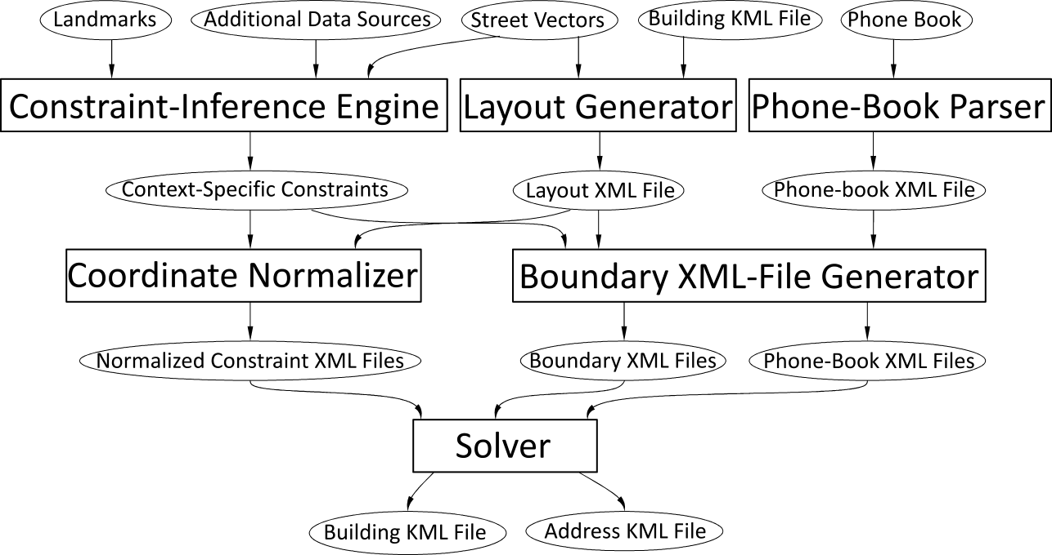
Overall architecture

Slide 47
Using query reformulation
Goal: Compute R(2,7)C with i=2, m=7
A
A | B
… | …
… | …
… | …
B
A | C
… | …
… | …
… | …
D
C
E
F
s=6
…
…
RC_{(i,m)}:
Space O(d^{s} )
New algor.:
Space O(( )d^{i} )
E | C
… | …
… | …
… | …
A | B | C | D | E | F
… | … | … | … | … | …
… | … | … | … | … | …
… | … | … | … | … | …
s
F | B
… | …
… | …
i
Note: i < s
D | B
… | …
… | …
…

