Slide 1
Outline
Interchangeability: Basics Robert
Beyond simple CSPs
Relating & Comparing Interchangeability Shant
Compacting the Search Space
  AND/OR graphs, SLDD, OBDD, FDynSub
SAT Steve

Slide 2
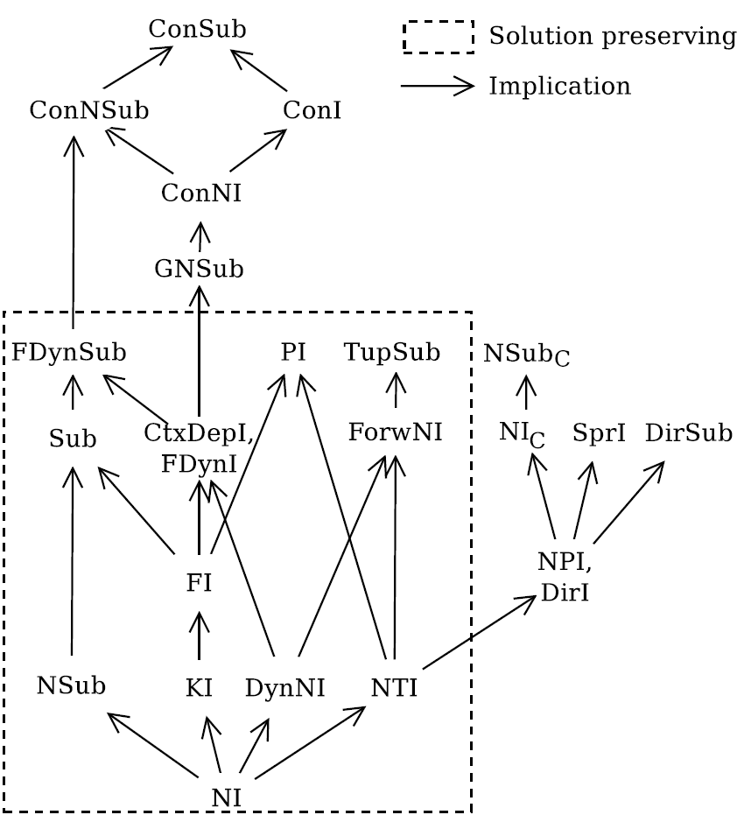
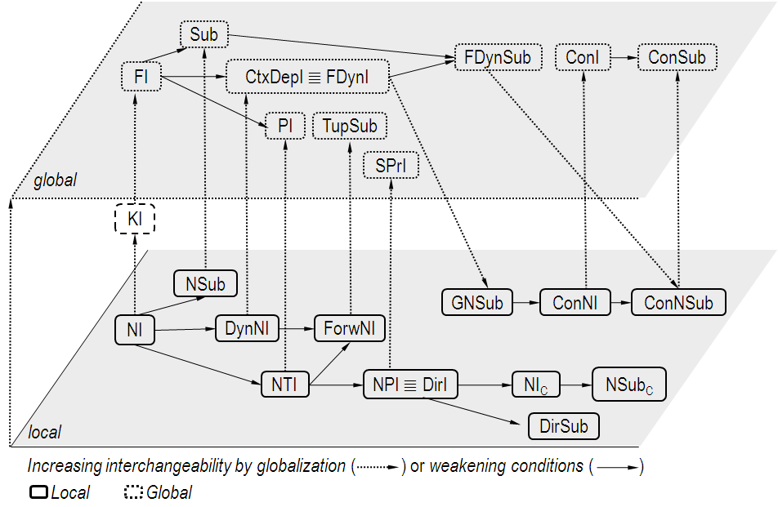
The Interchangeability Jungle
Main Interchangeability Concepts

Slide 3
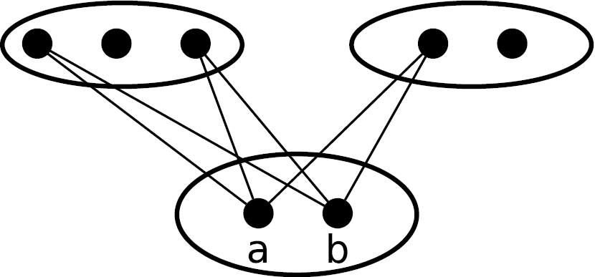
Generalizing Neighborhood Interchangeability:
Local ⟶Global and Strong ⟶ Weak
‘a’ and ‘b’ are NI
Full
Interchangeability
Partial assignment
Interchangeability
Substitutability
Subproblem
Interchangeability
NI

Slide 4
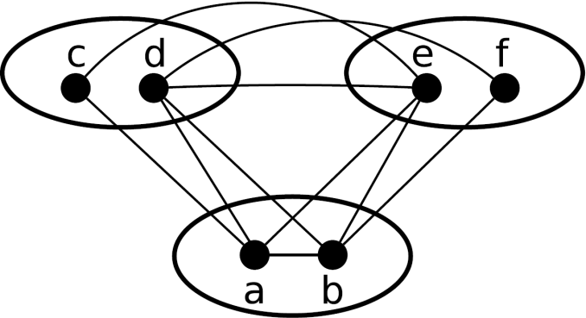
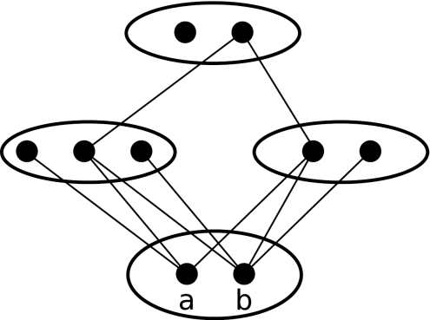
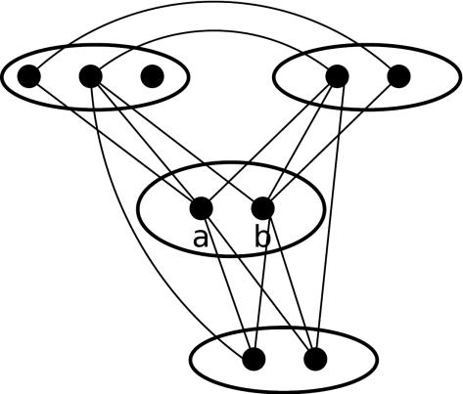
Global Forms: KI, FI, FDynI=CtxDepI
FDynI
CtxDepI
Full
Interchangeability
Partial assignment
Interchangeability
Substitutability
Subproblem
Interchangeability
NI
FI
KI
k=3
NI

Slide 5
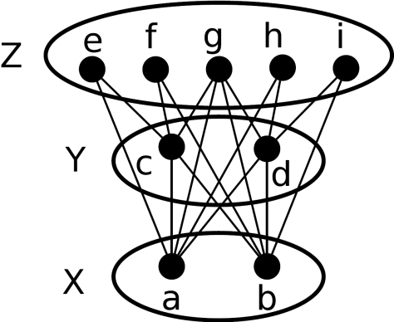
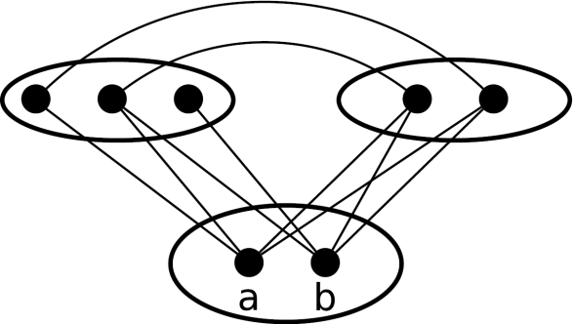
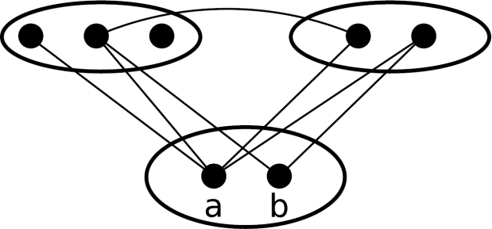
Substitutability
Full
Interchangeability
Partial assignment
Interchangeability
FDynSub
Substitutability
Subproblem
Interchangeability
NI
Sub
NSub
NI

Slide 6
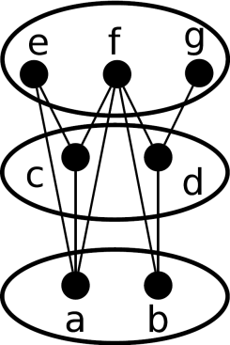
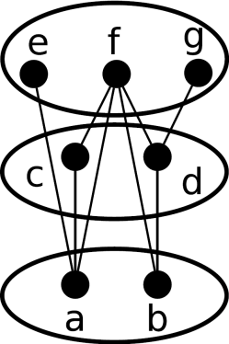
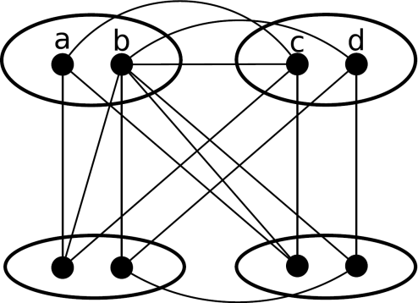
Partial Assignment Interchangeability
Full
Interchangeability
Partial assignment
Interchangeability
TupSub
Substitutability
Subproblem
Interchangeability
NI
ForwNI
DynNI
NI

Slide 7
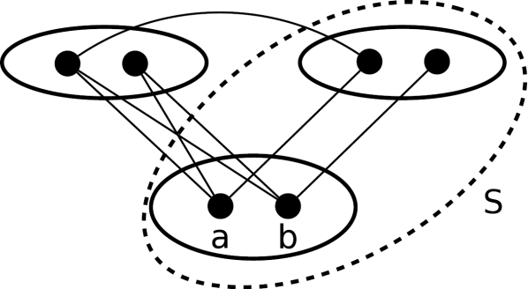
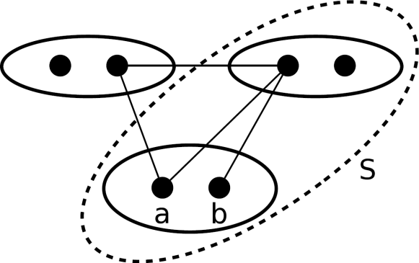
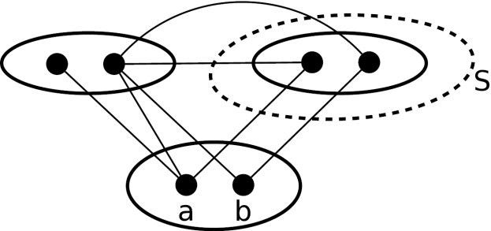
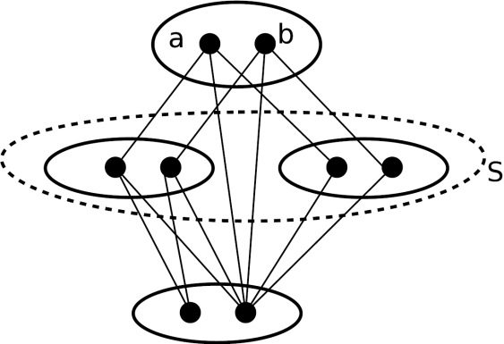
SubProblem Interchangeability
Full
Interchangeability
Partial assignment
Interchangeability
Substitutability
Subproblem
Interchangeability
SprI
NPI
DirI
NI
PI
NTI
NI

Slide 8
Search Space Compaction
Merging paths in the search yields a compact search space
Partial solutions can be
  Bundled from the root up to a given level in the search tree
  Joined at a given level in the tree, yielding a solution graph
Effectiveness
  If paths are compacted before being expanded, search effort is reduced
  Particularly effective when searching for all solutions to a problem
  Nogood bundling is extremely advantageous [Choueiry & Davis 02]

Slide 9
Bundling
Cross Product Representation (CPR) [Hubbe & Freuder 92]
  creates solution bundles by comparing future subproblems
  is not based on interchangeability
Can be static or dynamic
  NI [Brenson & Freuder 92]
  NI_{C} [Haselbock 93]
  CtxDepI [Weigel+ 96]
  DynNI [Choueiry & Davis 02, Lal+ 05]
  FDynSub [Prestwich 04]
  ForwNI [Wilson 05]
  DirI [Naanaa 07]

Slide 10
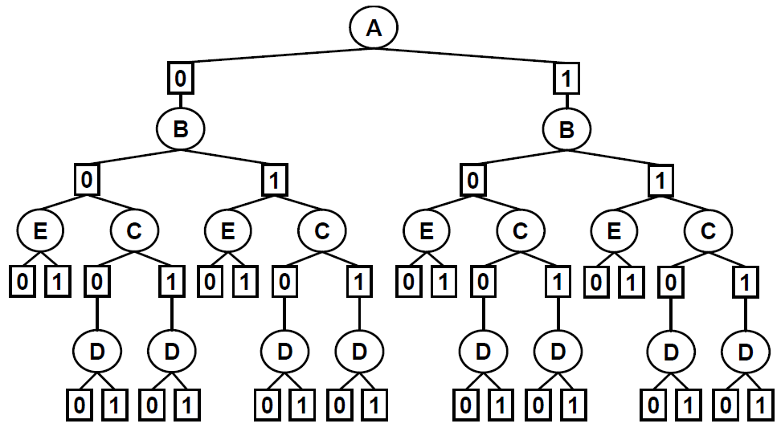
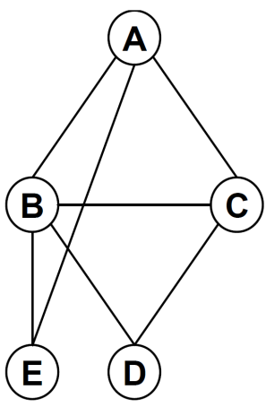
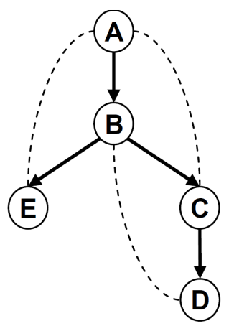
AND/OR trees
Pseudo Tree [Freuder & Quinn 85]
  For a given graph, the pseudo tree T is a rooted tree having the same set of nodes as the graph, and the edges are either tree edges or backarcs.
AND/OR search tree [Mateescu+ 08]
  Given a CSP and a pseudo tree, the associated AND/OR search tree has alternating levels of OR and AND nodes
    OR nodes: variables
    AND nodes: values

Slide 11
OBDD & AND/OR Graphs
Merging isomorphic subgraphs in an AND/OR tree results in AND/OR graph
Ordered binary decision diagrams (OBDD) can express the search space in a reduced form with all isomorphic subgraphs merged
AND/OR graphs
  Generalize OBDD into multi-valued AND/OR decision diagrams (MAODD)
  Express the graph compaction at least at the same level ?? Yield at least as compact a tree as OBDD

Slide 12
FDynSub, FowrNI & AND/OR Graphs
Each of FDynSub, FowrNI & AND/OR Graphs can yield different types of compaction
None of them is always better than the other
FDynSub and FowrNI can achieve the compaction obtained by the bundling methods

Slide 13
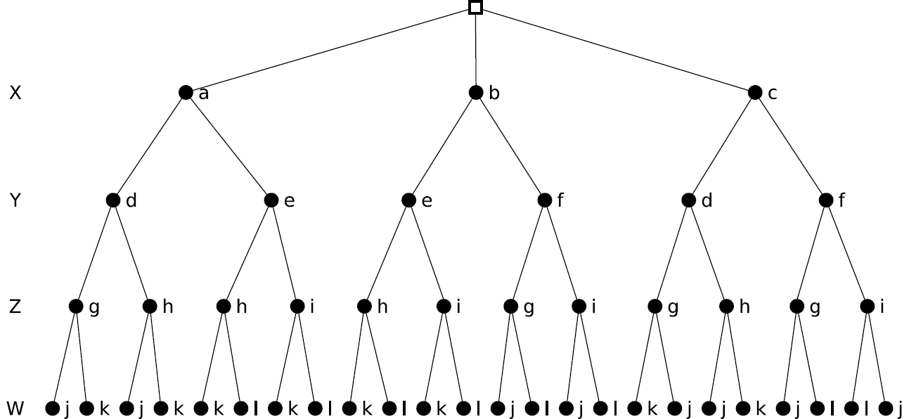
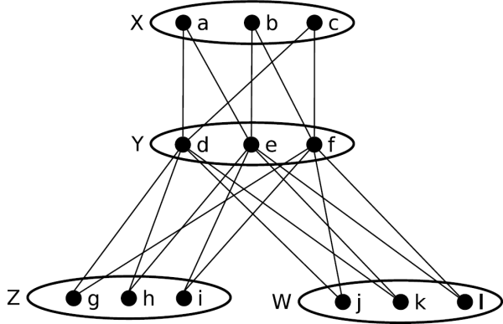
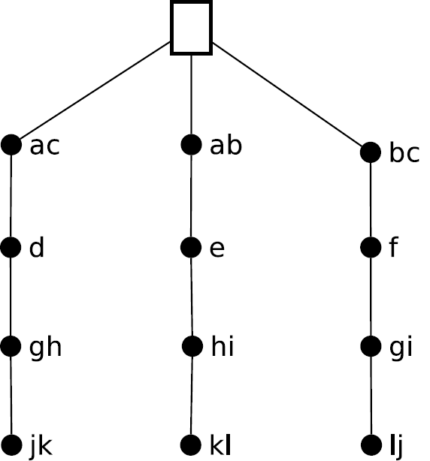
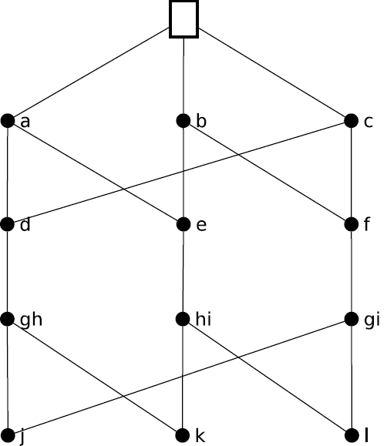
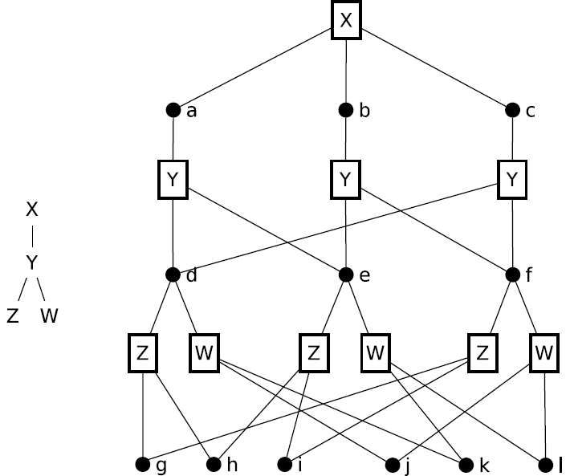
Search Graph Compactions

Slide 14
Comparison Criteria
Sensitivity to variable ordering
Exploit constraint-variable structure
Exploit support-value structure
Label of nodes that can be combined
Allow dynamic variable ordering
Bound the search space
Resilient to telescopic variables

Slide 15
Sensitivity to Variable Ordering
FDynSub yields the same compaction for any variable ordering
ForwNI and AND/OR graphs may have different compaction levels depending on the variable ordering
ForwNI
AND/OR
graph
FDynSub

Slide 16
Exploit Constraint-Variable Structure
FDynSub and ForwNI do not
AND/OR graphs exploit it through the pseudo tree to
  Further compact the space
  Efficiently identify nodes that can be combined
ForwNI
AND/OR
graph
FDynSub

Slide 17
Exploit Support-Value Structure
FDynSub and ForwNI consider it
AND/OR graphs: In general do not, but do in AOMDD
Interchangeability concepts provide many algorithms for it
Local concepts can be efficiently applied but give limited results
Global concepts give better results but in general are expensive
ForwNI
AND/OR
graph
FDynSub

Slide 18
Label of Nodes that Can Be Combined
FDynSub: different values, same variable
ForwNI: different variables and values
AND/OR graph: save variable and value
ForwNI
AND/OR
graph
FDynSub

Slide 19
Allow Dynamic Variable Ordering
FDynSub and ForwNI allow
AND/OR graphs allow but restricted to the pseudo tree
ForwNI
AND/OR
graph
FDynSub

Slide 20
Bound on the Search Space Size
ForwNI can guarantee a bound according to the constraint type irrespective of the scope
AND/OR graph can guarantee a bound given by the structure of the pseudo tree
ForwNI
AND/OR
graph
FDynSub

Slide 21

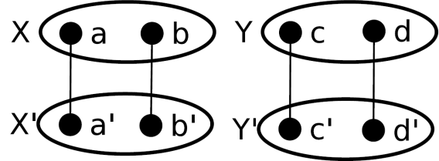
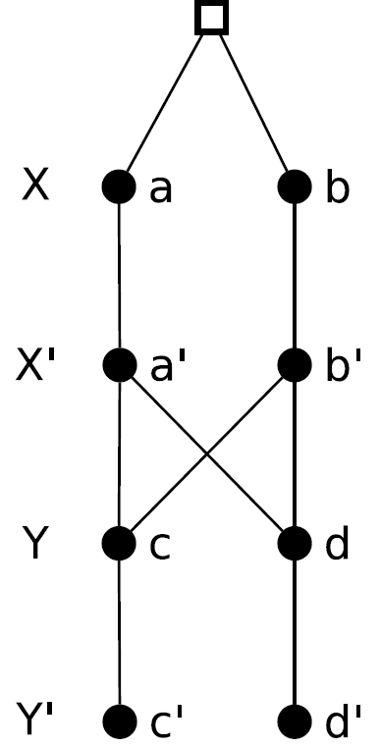
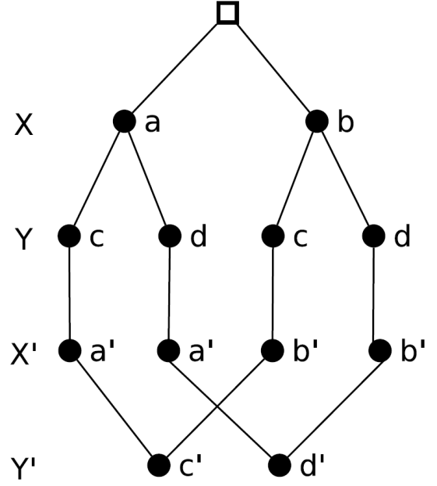
Resilient to Telescopic Variables
Telescopic variables are a set of variables that have the same domains and have equality constraints between them
AND/OR graphs and ForwNI partially handle them if the telescopic variables appear consequently in the variable ordering
FDynSub can not

