Slide 1
Interchangeability in
Constraint Programming
Shant Karakashian, Robert J. Woodward, Berthe Y. Choueiry,
Steven D. Prestwich and Eugene C. Freuder

Slide 2
Outline
Interchangeability: Basics Robert
  Full, Neighborhood, Subproblem, Partial, Substitutability
  Global versus Local, Strong versus Weak
Survey
  Beyond [Freuder 91]: Subsequent definitions
  Beyond simple CSPs: Quantified, Soft, Distributed CSPs
Relationships of Properties Shant
  AND/OR graphs, SLDD, OBDD, FDynSub
SAT Steve

Slide 3
Basics of Interchangeability
Interchangeability proposed by Freuder in 1991
  One of the first forms of symmetry detection for CSPs
  Symmetry is not specified, but is detected
Forms orginally defined
  Full Interchangeability (FI)
  Local
    Neighborhood Interchangeability (NI)
    k-Interchangeability (KI)
  Extended: Weak
    Subproblem Interchangeability (SPrI)
    Partial Interchangeability (PI)
    Substitutability (Sub)
  Extended: Other
    Meta-interchangeability (MI)
    Functional interchangeability
FI
Subproblem
global
KI
NI
local
Subproblem

Slide 4
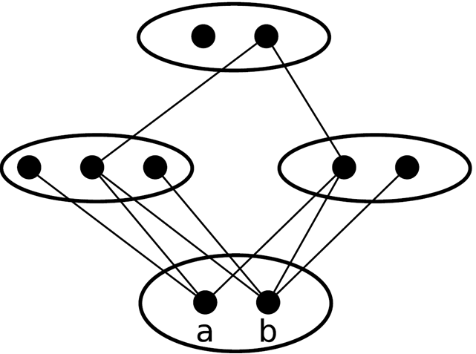
Full Interchangeability (FI)
A value a for variable v is fully interchangeable with value b iff every solution in which v=a remains a solution when b is substituted for a and vice-versa.
V3
f
g
Solutions
V2
V4
v | V2 | V3 | V4
a | d | g | h
b | d | g | h
c
d
e
h
i
v

Slide 5
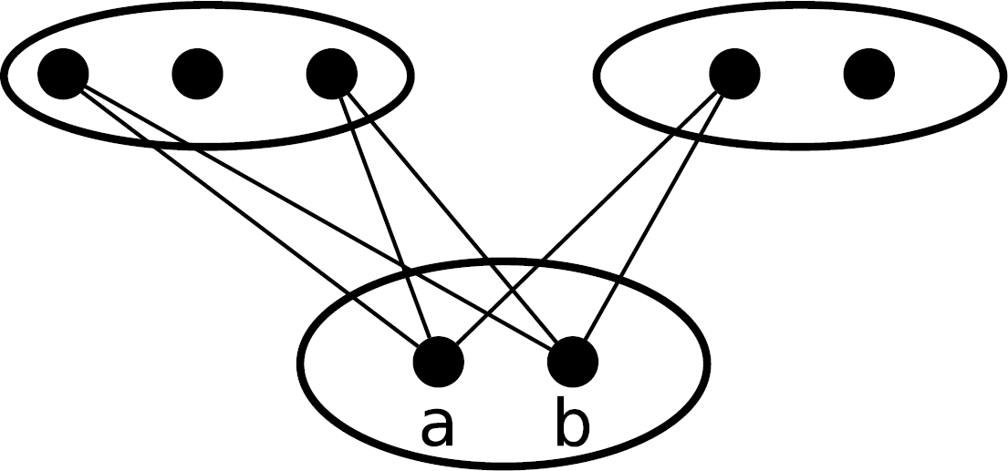
Neighborhood Interchangeability (NI)
A value a for variable v is neighborhood interchangeable with value b iff for every constraint on v, the values compatible with v=a are exactly those compatible with v=b.
c
d
e
f
g
a is compatible with: c, e, f
b is compatible with: c, e, f

Slide 6
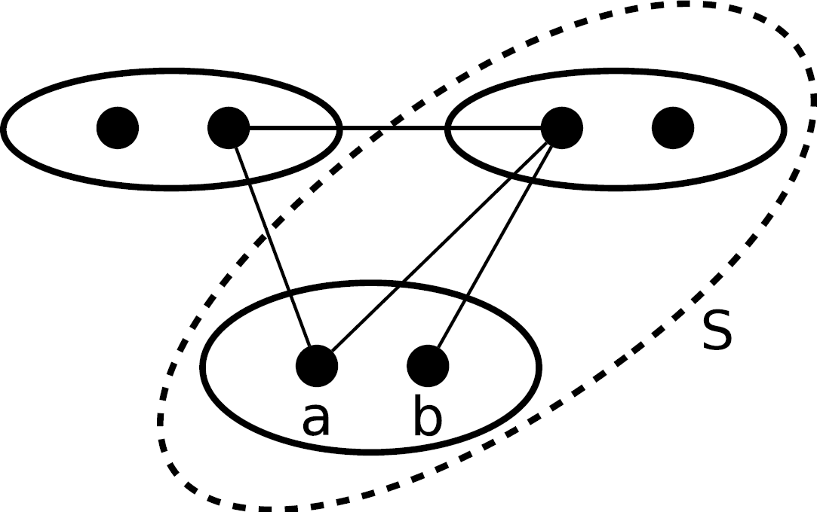
Subproblem Interchangeability (SPrI)
Two values are subproblem interchangeable, with respect to a subset of variables S, iff they are fully interchangeable with regards to the solutions of the subproblem of the CSP induced by S.
V2
V3
c
d
e
f
Solutions to S
V1 | V3
a | e
b | e
V1

Slide 7
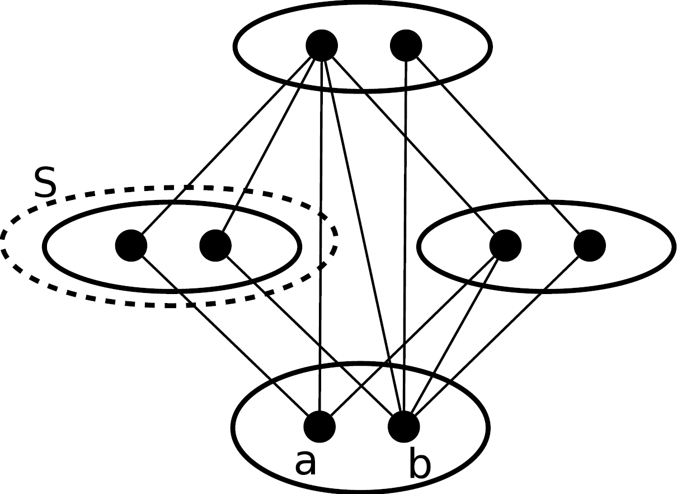
Partial Interchangeability (PI)
Two values are partially interchangeable with respect to a subset S of variables, iff any solution involving one implies a solution involving the other with possibly different values for variables in S.
V3
e
f
Solutions
V2
V1 | V2 | V3 | V4
a | c | e | g
b | d | e | g
V4
c
d
g
h
V1

Slide 8
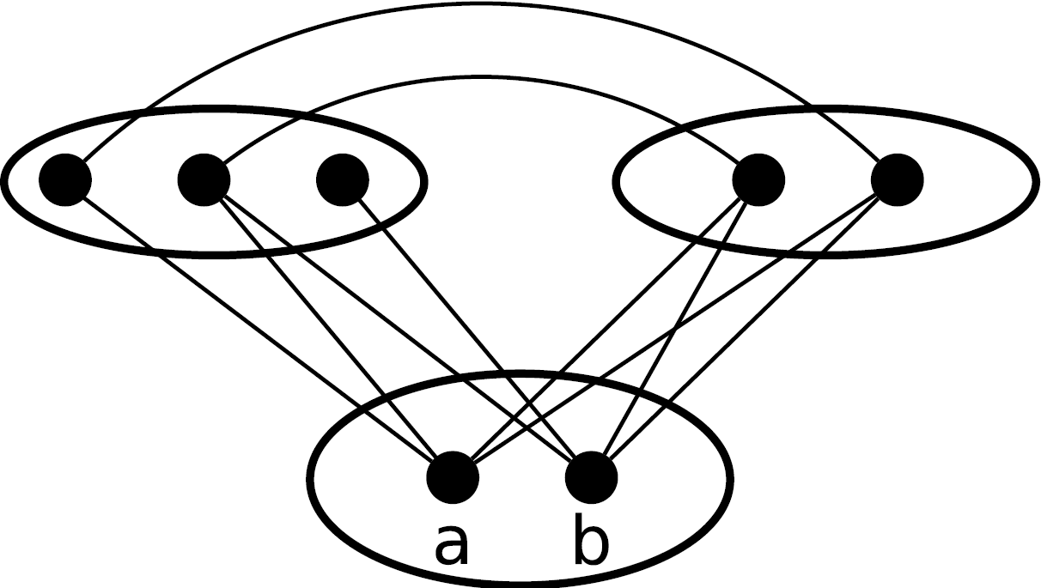
Substitutable (Sub)
For two values a and b for variable v, a is substitutable for b iff every solution in which v=b remains a solution when b is replaced by a but not necessarily vice-versa
V2
V3
Solutions
c
d
e
f
g
v | V2 | V3
a | c | g
a | d | f
b | d | f
v

Slide 9
Overview
Basics of Interchangeability
  Full Interchangeability
  Neighborhood Interchangeability
  Subproblem interchangeability
  Partial Interchangeability
  Substitutable
Summer Survey Project
  Quantified CSPs
  Soft CSPs
  Distributed CSPs
Relationships of Properties
SAT

Slide 10
Subsequent Definitions (chronological)
Neighborhood Partial Interchangeability (NPI) [Choueiry and Noubir, 1998]
Directional Interchangeability (DirI) [Naanaa, 2007]
Directional Substitutability (DirSub) [Naanaa, 2007]
Neighborhood Interchangeability Relative to a Constraint (NI_{C}) [Haselbock, 1993]
Neighborhood Substitutability Relative to a Constraint (NSub_{C}) [Boussemart et al., 2004]
Dynamic Neighborhood Interchangeability (DynNI) [Beckwith and Choueiry, 2001]
Full Dynamic Interchangeability (FDynI) [Prestwich, 2004a]
Conditional Interchangeability (ConI) [Zhang and Freuder, 2004]
Neighborhood Tuple Interchangeability (NTI) [Neagu and Faltings, 1999]
Forward Neighborhood Interchangeability (ForwNI) [Wilson, 2005]
Tuple Substitutability (TupSub) [Jeavons et al., 1994]
Full Dynamic Substitutability (FDynSub) [Prestwich, 2004b]
Context Dependent Interchangeability (CtxDepI) [Weigel et al., 1996]
Generalized Neighborhood Substitutability (GNSub) [Chmeiss and Sais, 2003]

Slide 11
Beyond Simple CSPs (order with presentation)
Quantified CSPs
Soft CSPs
Distributed CSPs
Other forms of symmetry
AND/OR trees
Interchangeability in particular classes of problems
Solution Robustness
SAT
… The list goes on
Notes:
Evaluate what has been done was not trivial; over 200 citations to the original paper

Slide 12
Quantified CSPs (QCSPs)
Informally, it is a constraint satisfaction problem where variables can be either universally (∀) or existentially quantified (∃)
  For the problem to be satisfiable, every value in the domain of a universally quantified variable needs to have a support in the remaining existentially quantified variables
One huge improvement to QCSP solvers is bundling NI values for universally quantified variables
[Gent et al., 2005; 2008]

Slide 13
Quantified CSPs (QCSPs)
In QCSPs, variables are either universally (∀) or existentially quantified (∃)
One huge improvement to QCSP solvers is bundling NI values for universally quantified variables
[Gent et al., 2005; 2008]

Slide 14
Soft CSPs
Soft CSPs do not have a precise definition of consistency
Defined for
  Interchangeability/substitutability, Global/local forms
Two types: δ and α
  ^{δ}Interchangeability: degradation
    When assignments are interchangeable up to a degradation level δ
  ^{α}Interchangeability: threshold
    When assignments are interchangeable within a threshold α
[Bistarelli et al., 2003]

Slide 15
Distributed CSPs
A CSP where variables, domains, and constraints are distributed over a set of autonomous agents
Original assumption was that each agent was given one variable, if not, could:
  Compilation: new variable is defined whose domain is the set of solutions to the original local problem
  Decomposition: each agent creates virtual agents for each variable in its local problem and simulates the activities for the virtual agents
Though these two techniques do not scale well
  Can combat compilation with interchangeability
[Burke and Brown, 2006]
Notes:
Problem is, these two techniques do not scale well to large problems. The compilation technique does not scale well because when a local problem becomes large and complex, finding all solutions to the local problem is no longer trivial. The decomposition does not scale well because communication with other agents is usually more expensive than performing local computations. So it becomes wasteful to simulate the communication between multiple virtual agents within a single real agent.

Slide 16
Overview
Basics of Interchangeability
  Full Interchangeability
  Neighborhood Interchangeability
  Subproblem interchangeability
  Partial Interchangeability
  Substitutable
Summer Survey Project
  Quantified CSPs
  Soft CSPs
  Distributed CSPs
Relationships of Properties
SAT

