Slide 1
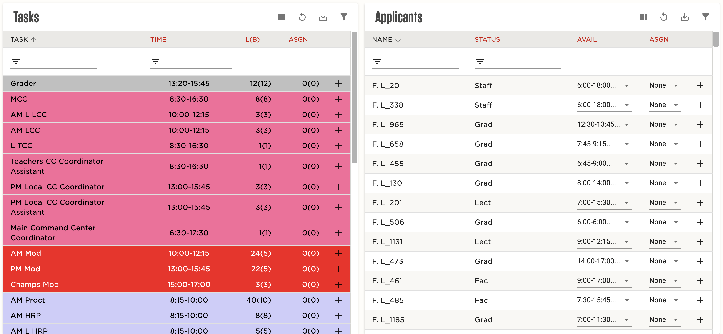
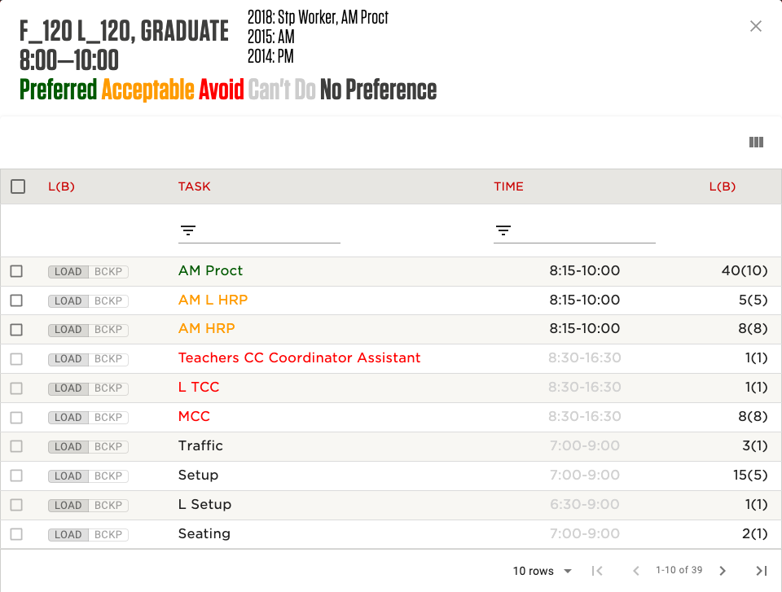
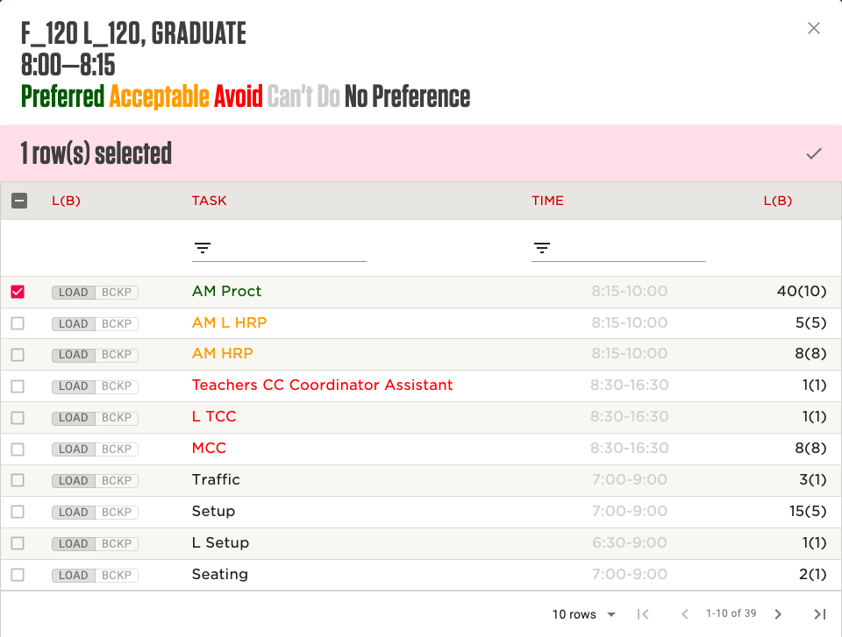
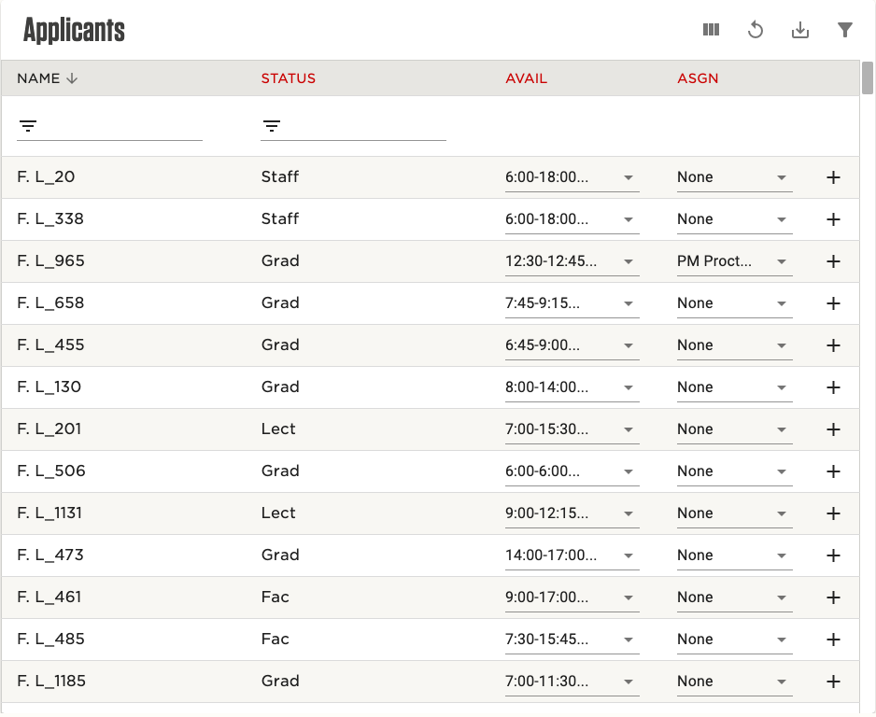
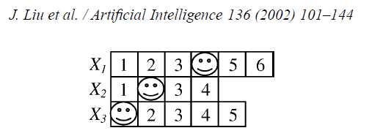
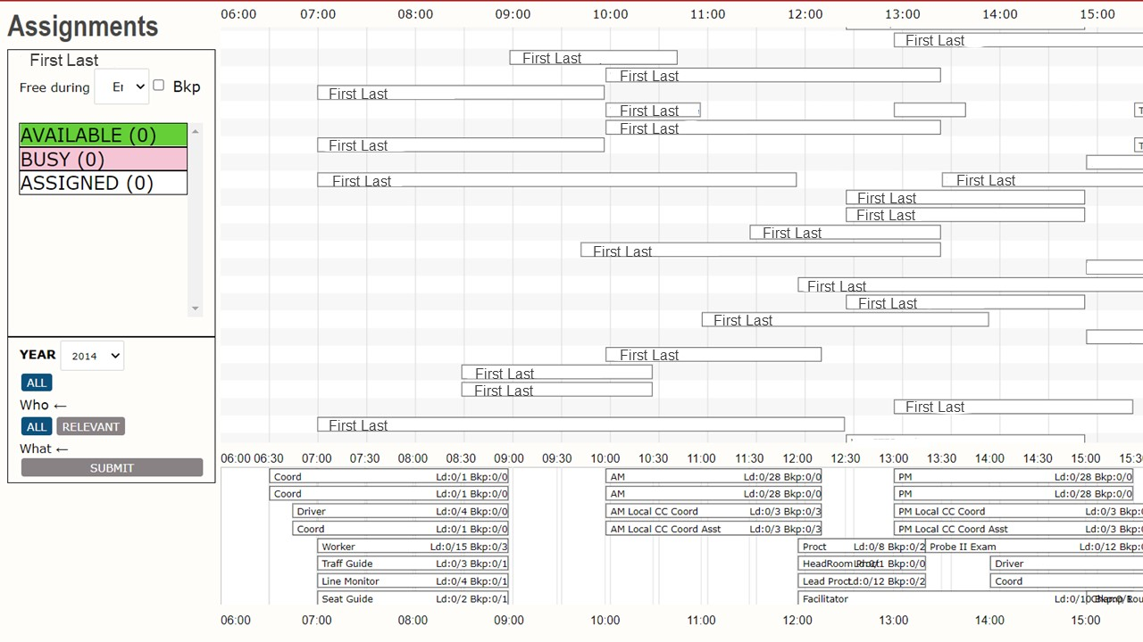
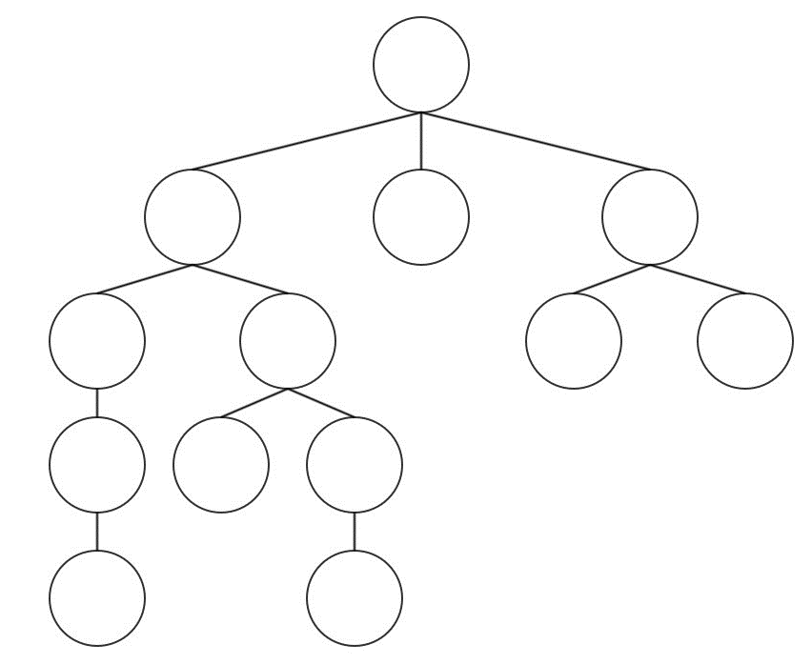
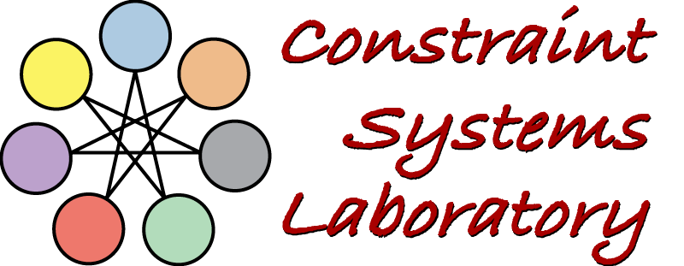
An Interactive Solver for the Math-Day Event
Caleb Koranda, Chase Resio, and Berthe Y. Choueiry
Constraint Systems Laboratory • School of Computing
Motivation
Math-Day is annually organized by UNL’s CSMCE and brings over 1,500 high school students from across Nebraska to compete in math for scholarships to UNL. In a traditional year, the Math-Day manager recruits over 350 volunteers to help run the event. These volunteers are assigned to 42 different types of tasks for the event to run smoothly. Each task has a load (the number of volunteers required for the task) and a backup load (the number of stand-by volunteers). Currently, the manager manually makes and manages these assignments using an Excel sheet. The goal of this project is to support her in this task by providing an interactive interface and, ultimately, a mixed-initiative framework in which automated solvers cooperate amongst each other, and with the human user to generate assignments.
New Design: Two Tables
Our new design organizes the interactive assignment in two tables: the tasks (left) and the volunteers (right). The system maintains the consistency of the two views.
Selecting Tasks to Assign
A table pop-up appears with the volunteer’s information in the heading and the list of tasks in the body. To help the manager, the tasks are sorted by best fit. Further, the manager can view the tasks the volunteer fulfilled during previous Math-Day events.
Math Day Website
The first online system was deployed in September 2017. New functionalities have been added over the years. The current system allows various categories of people to apply, specify their time availability, and express their preferences for the tasks open to their categories (e.g., ugrad, grad, faculty). The manager uses the website to access historical assignments, define the tasks for the current year, monitor applications, and communicate with groups of volunteers. The first interactive system, based on a Gantt chart that mimics the manager’s spreadsheet layout, had the same pitfalls. It did not fit well on the screen and was cluttered.
Assign Task to a Volunteer
An assignment can be made from either view according to the same workflow. Here, is an example of assigning a volunteer to a task. (The data is sanitized for privacy.) You start by clicking the ‘+’ icon in the volunteer table.
Towards a Mixed-Initiative Solver
We are developing a preliminary automated solver based on a highly decentralized, multi-agent architecture. Hui and Choueiry [2003] have shown that this technique, initially proposed by J. Liu et al. [AIJ 2002], is particularly robust to overcoming local minima and solving tight problem instances. We are also designing an automated solver based on systematic search, symmetry breaking constraints, branch and bound, and random restarts. Our goal is to characterize and compare the performance of the two approaches. Then, we will develop new mixed-initiative strategies for cooperation between them and for including the human manager in the decision loop.
Acknowledgements: Stephanie Vendetti, Charles Daniel, Denis Komissarov, Zach Madsen
Supported by UCARE (UNL) April 5, 2022

