Slide 1
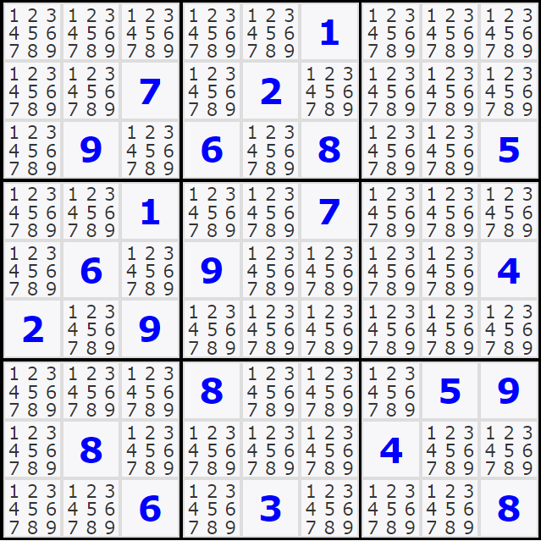
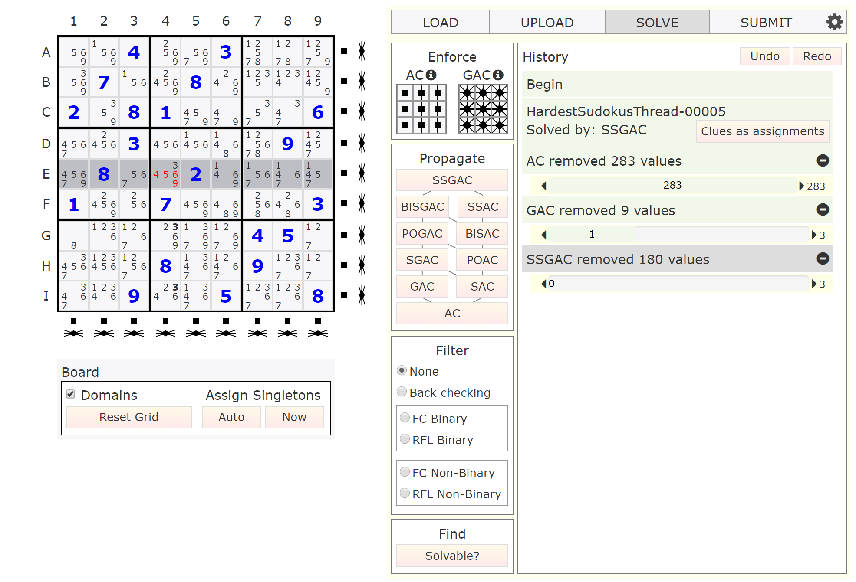
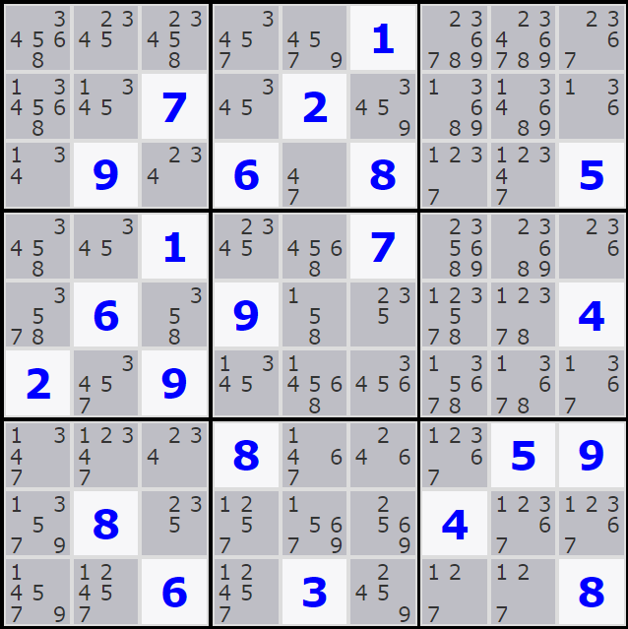
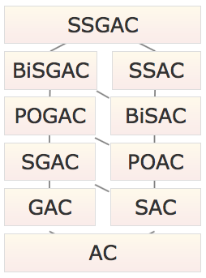
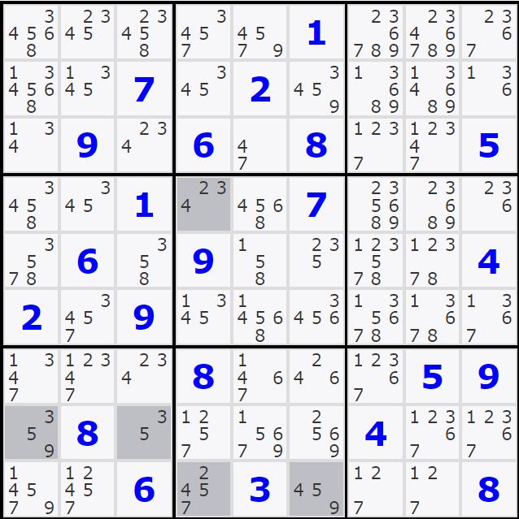
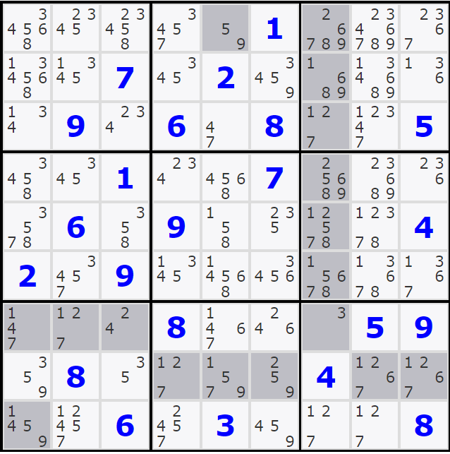
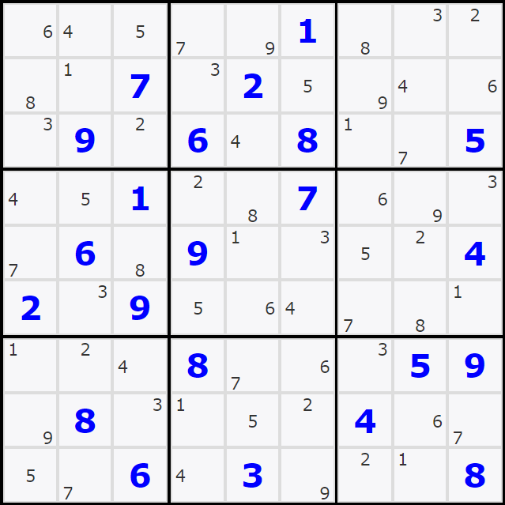
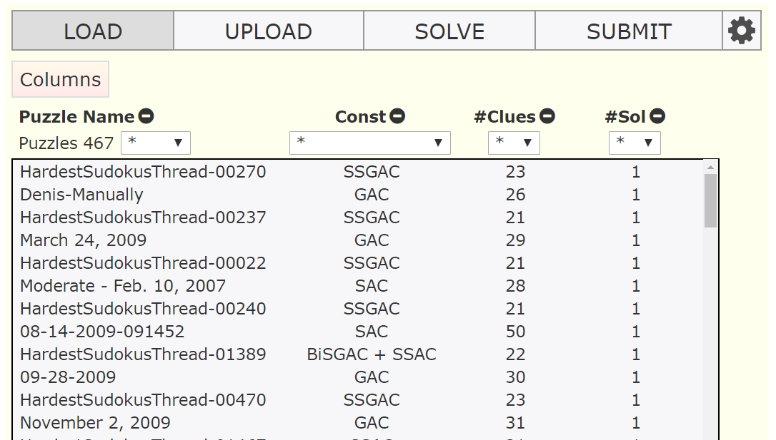
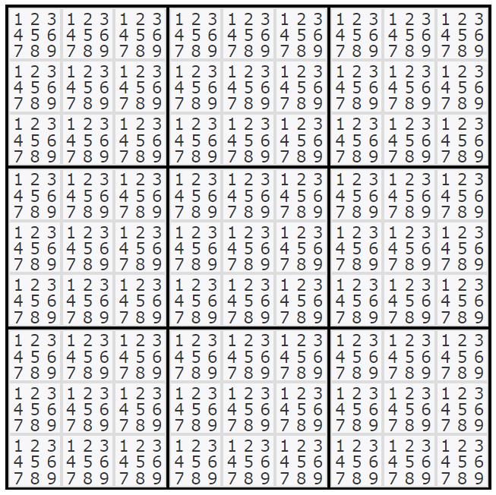


Solving Sudoku with Consistency: A Visual and Interactive Approach
Ian Howell¹ Robert J.Woodward^{1,2} Berthe Y.Choueiry¹ Christian Bessiere²
¹Constraint Systems Laboratory • University of Nebraska-Lincoln • USA
²LIRMM-CNRS • Université de Montpellier • France
  Goals
  Interface
  Consistency Algorithms
An interactive Sudoku solver to support
Research: Solve a Sudoku without search
Education: Illustrate basic, advanced techniques of Constraint Processing
Outreach: Demystify AI to the public
Highlights scope of
active constraint
Shows current domain, also reflected in history
Chooses to enforce a given consistency property
AC
  Features
Two constraint models: binary, nonbinary
Five consistency properties (one new) and ten algorithms
SGAC
POGAC
Five algorithms for maintaining consistency after user input
History (tracking, navigation) of user’s actions
Database storing puzzles along with the number of clues in a puzzle and the weakest consistency property that solves it
Puzzle recognition from uploaded images
375 hardest known puzzles, all of which solved by consistency algorithms alone
Navigable history of user actions
Maintains a given consistency when user makes an assignment
BiSGAC
Shows in red removed values, also reflected in history
Shows in bold values to be removed in future steps of the consistency algorithms
Finds and displays all solutions
  Two Constraint Models
  Load
Each cell in the sudoku is a variable whose domain is the numbers 1 to 9. ‘Different’ constraints prevent cells in the same row, column, or block from taking the same values.
  Open Question
  SSGAC can solve every 9x9 Sudoku puzzle in our Database including the 375 hardest known instances. However, determining the weakest level of consistency sufficient to solve any 9x9 Sudoku puzzle remains an open question.
Binary model: one constraint between two cells
Nonbinary model: One constraint of arity 9 for each row, column, block
User can interact with each model and test the corresponding consistency algorithms
Experiments were conducted on the equipment of the Holland Computing Center at the University of Nebraska-Lincoln.
This research was supported by NSF Grant No. RI-1619344.
Howell was supported by a UCARE grant.
Paper: IJCAI 2018. July 9th, 2018

