Slide 1
Visualization of Problem Solving with Constraint Processing: Case Study of the Minesweeper
By Chase Resio and Berthe Y. Choueiry

Slide 2
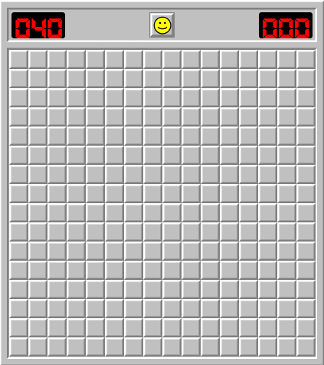
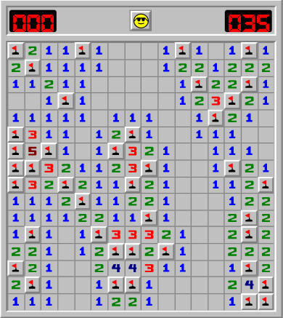
Minesweeper and NP-Completeness
Minesweeper is a popular computer game from the 1990’s
Click on cells to reveal a mine or a number indicating how many adjacent cells contain mines
Deciding whether an instance of Minesweeper consistent is NP-Complete
4/3/21
2

Slide 3
Goals and Purpose
Use Constraint Processing to model and solve Minesweeper
Study Constraint Processing
Learn and use React framework
Solve an NP-Complete problem
4/3/21
3

Slide 4
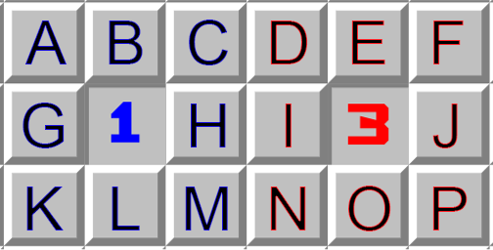
Approach
Minesweeper is a logic-based game
Model it as a Constraint Satisfaction Problem
Every cell is either safe or a mine
Safe cells contain a number that constrains neighboring cells
Use constraint satisfaction approaches to decide if a cell is safe
The 1 places a constraint on cells A,B,C,G,H,K,L,M that one of them must contain a mine and the rest are safe.
The 3 places a constraint on cells D,E,F,I,J,N,O,P that three of them must contain a mine and the other five are safe.
4/3/21
4

Slide 5
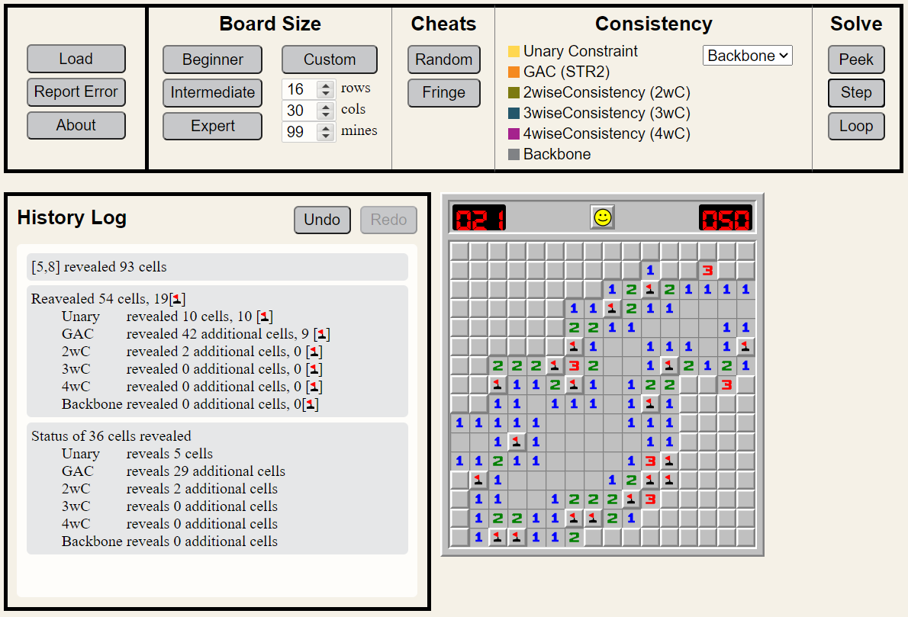
Web Application
4/3/21
5

Slide 6
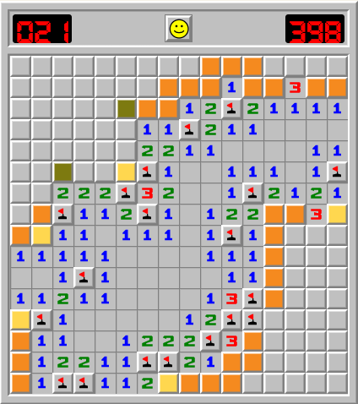
Consistency and Constraint Propagation
Six levels of consistency implemented
Unary ensures the consistency of each single constraint
GAC ensures the consistency of each constraint and propagates to other constraints via the shared variables
2wC ensures the consistency of every combination of two constraints with shared cells
4/3/21
6

Slide 7
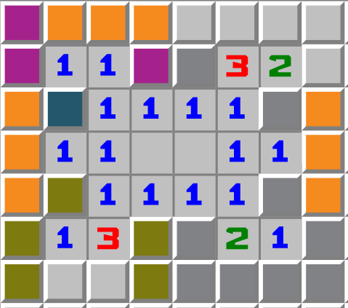
Consistency and Constraint Propagation (Cont.)
3wC ensures the consistency of every combination of three constraints that share cells
4wC ensures the consistency of every combination of four constraints that share cells
Backbone ensures the consistency by finding the cell that has the same value in all solutions
4/3/21
7

Slide 8
Conclusion
There is currently no way to efficiently solve all instances
Finding one would have profound impact on computing
Future improvements
Better mobile view
Use number of mines to solve cells once at steady state
4/3/21
8

Slide 9
Acknowledgments
Developers: Kenneth Bayer, Tomo Bessho, Taylor DeMint, Joshua Snyder, and Robert Woodward
UNL UCARE
NSF REU supplements grant RI-1619344

