Slide 1
Online Registration System for Math Day
Matthew DeHaven
Computer Science and Engineering
University of Nebraska-Lincoln May 2017

Slide 2
Undergraduate Thesis: VITA
VITA: Volunteer Interactive Task Assignment
MATH@UNL organizes Math Day in November
Recruiting and outreach event, math competition
1500+ high-school students from Nebraska
250+ volunteers (ugrads, grads, postdocs, lecturers, faculty, staff, emeriti, alumni, other)
42 tasks in 12 activities at different times, durations

Slide 3
VITA: Goal
Yearly set-up: Activities and their tasks
Volunteers apply online
Manager monitors applications
Manager generates and shares reports
Manager assigns volunteers to tasks (interactive, automated solvers)

Slide 4
Restrictions
Comply with university web-design standards
User authentication
Interface with university authentication system (CAS)
But allow outsiders (e.g., alumni) to use system
Allow users to express
Preferences for tasks
Availability as multiple time-intervals
Random comments
Data acquisition depends on a volunteer’s
Role (e.g., activity worker, department display, speaker)
Type (e.g., ugrad, grad, postdoc, lecturer, faculty, staff, alumni, emeriti)
Notes:
- Lots of red

Slide 5
VITA: Main Components
Components
Database
Volunteer interface
Admin interface
System features
WDNet (UNL style)
javascript (for client)
Ruby on Rails (for server)
MySQL database (25 tables)
Completed
Completed
Ongoing

Slide 6
Database: Challenges (1)
Problem: User’s profile has
Permanent features E.g., name, email, etc.
Features that change with time E.g., ugrad vs grad, affiliation, etc.
Solution: User profile stored in two tables
‘Profile’ is permanent
‘Application’ changes every year

Slide 7
Database: Challenges (2)
Problem
Tasks and activities may change from year to year
Solution
Maintain a ‘seed’ of activities and tasks
Every year, manager edits the seed
Seed is used to generate activities + tasks and for current year
Activities + tasks of previous years are not affected

Slide 8
Volunteer Interface: Components
Components
Authentication
UNL-based authentication
Email based
Application
Form to sign (Youth Activity Safety Policy, YASP)
Task Signup
Style
Guided, linear for registration
Accordion-based for updates

Slide 9
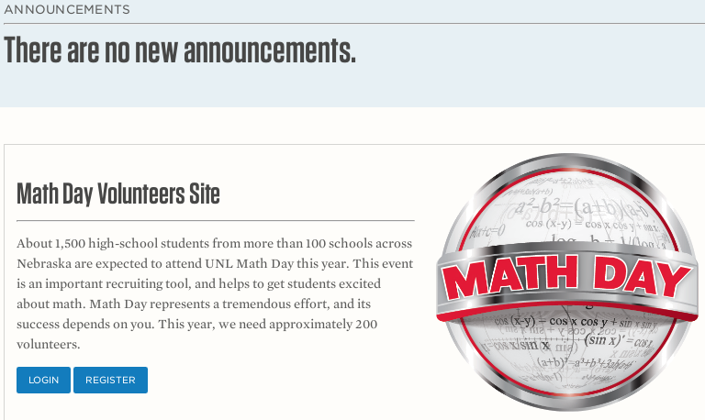
Page 1: Welcome
Display announcements
General information about Math Day
Prompt to log in (returning user) or register (new user)

Slide 10
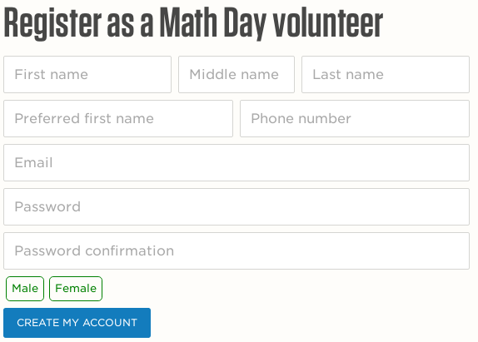
Page 2a: Registration by Email
Notes:
Prompted to choose email or UNL Authentication
Email Authentication
Redirect to registration from
UNL Authentication
Redirect to UNL sign in page
Return to registration form without password
Not necessary if registered for previous year

Slide 11
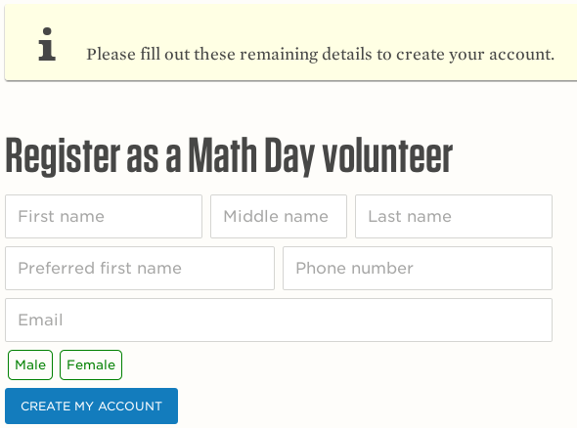
Page 2b: Registration via UNL (CAS)

Slide 12
Email Activation
After registering, an authentication email is sent
Link in email activates account
Once activated, volunteer is redirected to Application page

Slide 13
Application Process
Collects data for fluents
Three steps, user forced to follow linearly
Application
Youth Activity Worker Form
Task Signup (only for activity worker)

Slide 14
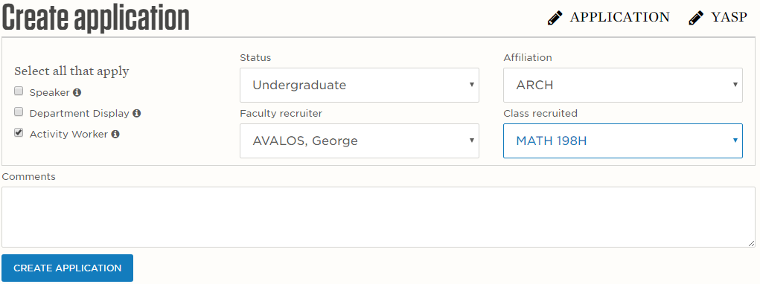
Page 3: Application
Notes:
Collect fluent information about volunteer
Volunteer chooses role
Information entered here affects later steps
Accepts comments

Slide 15

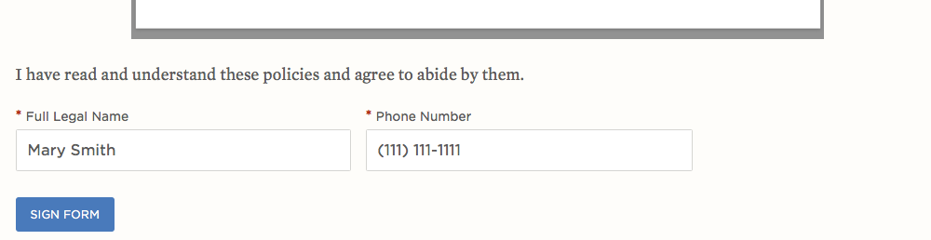
Page 4: YASP
Signing YASP is a university requirement
Page records signature and date in DB
Notes:
Youth Activity Safety Policy

Slide 16
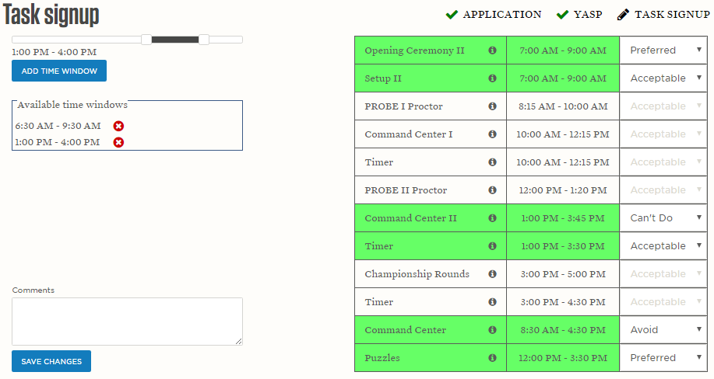
Page 5: Task Signup
Notes:
Shown for ‘Activity Workers’
Enter Availability
Enter Preferences for tasks
Visible tasks depend on Status from Application

Slide 17
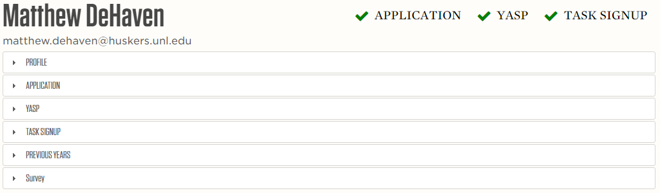
Page 6: Dashboard
A central location to view/edit information
User can update: Profile, Application, Task Signup
View tasks worked during previous years
Survey to provide feedback
Notes:
Provides central location to view/edit information
Can edit
Profile
Application
Task Sign
View tasks worked during previous years
Survey to provide feedback (JP)

Slide 18
Dashboard Access
All steps of the Application Process must first be completed before Dashboard can be accessed
If user changes status or role
Different options for Task Signup become possible
System re-directs the user to enter missing information
‘Stale’ data is preserved in DB but no longer visible, so that reversing change is easy

Slide 19
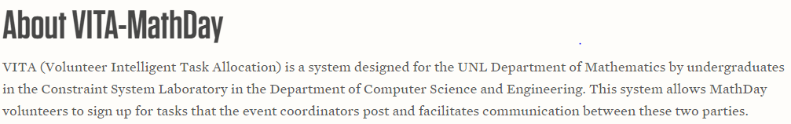
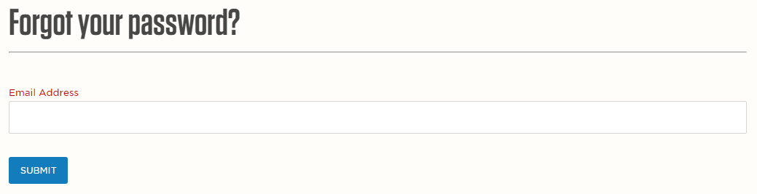
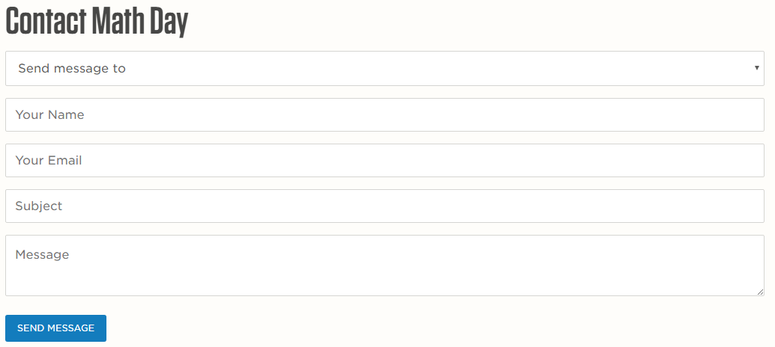
Additional Pages
About Us
Password Recovery
Contact Us

Slide 20
Administrator Interface
Pages to support administrator functionalities
Ideally match styling of rest of site
Ran out of time (DB design, knowledge elicitation from ‘customer,’ trials+errors, etc.)
Prototype
Used ‘Active Admin’ gem
Rapid prototyping
Provides core functionalities while new interface being developed

Slide 21
‘Active Admin’ Gem
Pros
Provides many needed functionalities out-of-box
Very easy to add functionalities
Cons
Look+feel is rigid, does not match style of rest of site
Adapting the style to our needs is an overkill

Slide 22
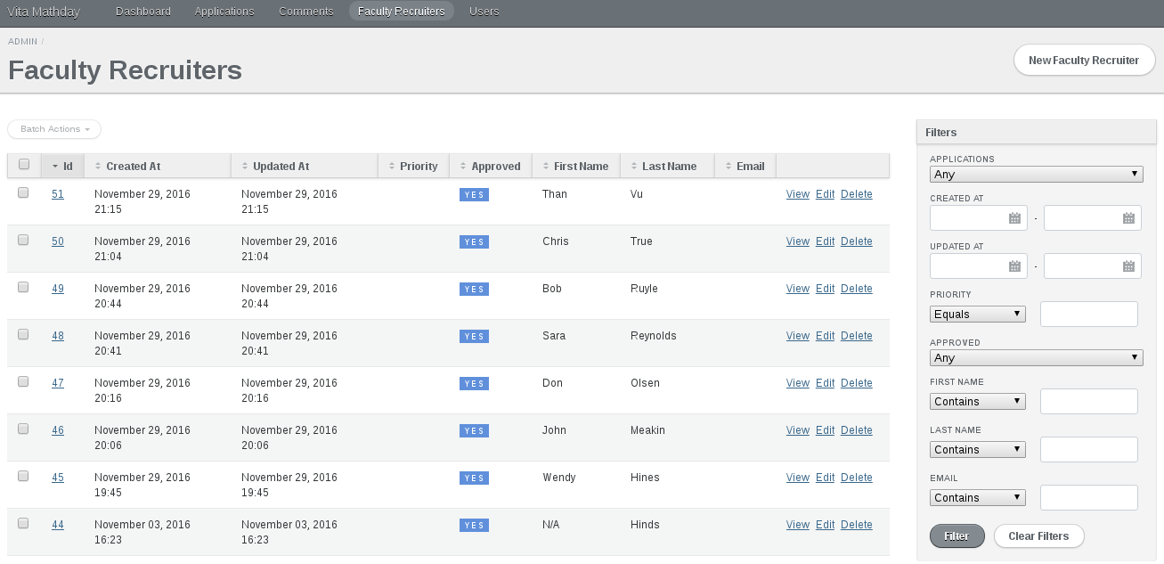
Active Admin

Slide 23

Conclusions
Website will be deployed Fall 2017
Volunteer interface completed
Core administrator functions available in temporary interface
Export data in familiar Excel format (JP Thornton)
To do
Complete administrator interface
Create solver and solution visualization

