Slide 1
A Comparative Study of
Generalized Arc-Consistency Algorithms
Olufikayo S. Adetunji
Constraint Systems Laboratory
Department of Computer Science & Engineering
University of Nebraska-Lincoln
Acknowledgements
Software platform developed by Shant Karakashian & Robert Woodward
Experiments conducted at UNL’s Holland Computing Center

Slide 2
Outline
Background
Overview of GAC algorithms
  GAC2001
  Simple Tabular Reduction: STR1, STR2, STR3, STR-Ni, eSTR1, eSTR2
  Multi-valued decision diagrams: mddc
Our contribution
  STR-h combines STR1 and STR-Ni
Evaluation and comparison of GAC algorithms
Conclusions and future work

Slide 3
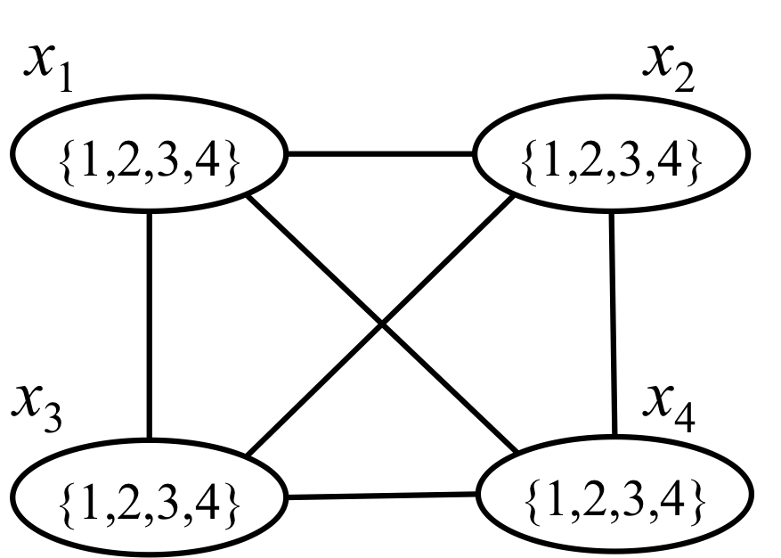
Constraint Satisfaction Problem
CSP
  Variables, domains, constraints
  Solution
Representation
  Constraint graph
Solving CSPs
  Search
  Enforcing consistency
  Lookahead = Search + Enforcing consistency
Notes:
A set of variables….. A set of variables’ domains……. A set of constraints that apply to variables, restricting the allowed combination of values for variables
A solution to the CSP is an assignment of a value to each variable such that the constraints are satisfied
Place n queens on a board such that no 2 queens can attack each other.
Representing a CSP as a graph makes it possible to apply graph algorithms into solving these problems

Slide 4
Constraint Representation
n₁
General
  Intension: set builder
  Extension: set of tuples
Extension implemented as
  A linked list
  Bit map
  Table
    Positive table: supports
    Negative table: conflicts/nogoods
  Multi-valued decision diagram
 | x₂ | x₃
0 | 2 | 1
1 | 3 | 1
2 | 3 | 2
3 | 4 | 1
4 | 4 | 2
5 | 4 | 3
x₂
2
3
4
n₂
n₃
n₄
x₃
x₃
x₃
1
2
1
1
3
2
n₅
tt
table(c₂₃)
MDD(c₂₃)
Notes:
Relations can be expressed in intension or extension because it is a set
Table constraint explicitly lists either all allowed or disallowed tuples i.e. positive or negative
MDD is an arc labeled directed acyclic diagram.

Slide 5
Local Consistency
Generalized Arc-Consistency (GAC)
  Property: Every value in the domain of a variable appears in some tuple in the constraint
  Algorithm: Remove values that are not ‘supported’
Pair-Wise Consistency (PWC)
  Property: Every tuple in a constraint can be extended to some tuple in every other constraint
  Algorithm: Remove tuples that are not ‘supported’
 | x₂ | x₃
0 | 2 | 1
1 | 3 | 1
2 | 3 | 2
3 | 4 | 1
4 | 4 | 2
5 | 4 | 3
✗
{1,2,3,4}
x₂
✗
{1,2,3,4}
x₃
 | x₁ | x₂
0 | 2 | 1
1 | 3 | 1
2 | 3 | 2
3 | 4 | 1
4 | 4 | 2
5 | 4 | 3
x₂
x₂
 | x₂ | x₃
0 | 2 | 1
1 | 3 | 1
2 | 3 | 2
3 | 4 | 1
4 | 4 | 2
5 | 4 | 3
Notes:
Consistency properties help to reduce the size of the search space. Two types, formulated on domains (GAC), and formulated on relations (PWC)
A CSP is GAC iff, for every relation, any value in the domain of any variable in the scope of the relation can be extended to a tuple satisfying the relation.

Slide 6
Motivation
Generalized Arc Consistency (GAC) is
  The most basic consistency property
  Applicable to both binary and non-binary CSPs
Algorithms for enforcing GAC
  Are implemented in all constraint solvers
  Have witnessed a surge of attention since 2007
Goal
  Study variety of GAC algorithms
  Evaluate progress
Notes:
Goal is to study various algorithms for enforcing GAC and evaluate and compare their performances.

Slide 7
Outline
Background
Overview of GAC algorithms
  GAC2001
  Simple Tabular Reduction: STR1, STR2, STR3, STR-Ni, eSTR1, eSTR2
  Multi-valued decision diagrams: mddc
Our contribution
  STR-h combines STR1 and STR-Ni
Evaluation and comparison of GAC algorithms
Conclusions and future work

Slide 8
GAC2001 [Bessiere et al., 2005]
Check whether value a in the domain of a variable x has a support in a constraint c
Last((x,a),c)⟵ 2
When 2 is removed, support of a is lost
Then, find a new support for a
Last((x,a),c)⟵ 4
If 4 is removed and a has no other support
Then remove a from the domain of x
Uses data structure Last((var,val),constraint)
✗
x
{a,b,c,d}
Last((x,a),c) ⟵ 2
⟵ 4
c
✗
✗
{1,2,3,4}
Notes:
r is the constraint arity, support is looked for in a O(rdr−1) space of tuples i.e., there are dr−1 tuples, constraint checks cost O(r), making the cost of checking for the viability of a value O(rdr−1). Support is found for rd values and thus making the total worst-case time for a call to the algorithm O(er2dr).

Slide 9
Simple Tabular Reduction (STR)
[Ullmann, 2007]
GAC2001
  Removes values that have no support in constraints
  Updates domains, but does not touch constraints
STR
  Updates both domains and constraints
  Removes values that have no support in constraints
  Removes tuples with values that do not appear in domains
  Keeps only ‘active’ values and ‘active’ tuples
Algorithm
  STR1
  Uses data structures gacValues(variable)
 | x₂ | x₃
0 | 2 | 1
1 | 3 | 1
2 | 3 | 2
3 | 4 | 1
4 | 4 | 2
5 | 4 | 3
✗
{1,2,3,4}
x₂
✗
✗
{1,2,3,4}
x₃
Notes:
- When-ever a value is detected to be inconsistent, it is not only removed from the domain of the variable it is associated with, but also, all the tables of a constraint that involves this variable are updated by removing all tuples that have become disallowed (all tu- ples that contain the removed value of this variable).
- r′ = |fut(c)| denotes the number of uninstantiated variables in c and t′ is the size of the current table of c.

Slide 10
STR2 [Lecoutre, 2011]
x_{i}
{2,3,4}
Improves on STR1 in two ways:
Stops iterating over the tuples of a constraint table, as soon as all the values in the variable of the scope of the constraint are found to be supported
If the domain of a variable has not changed between two subsequent consistency calls on a constraint on that variable, then the values in the variable’s domain are guaranteed to be GAC by the first call and need not be checked at the second call
 | x_{i} | x_{j}
0 | 2 | 1
1 | 3 | 1
2 | 3 | 2
3 | 4 | 1
4 | 4 | 2
5 | 4 | 3
6 | 2 | 2
7 | 2 | 5
8 | 3 | 4
9 | 4 | 4
4 | 4 | 2
5 | 4 | 3
6 | 2 | 2
7 | 2 | 5
8 | 3 | 4
9 | 4 | 4
Notes:
-- Opt-2 -- taking advantage of the knowledge of every tuple τ such that τ(x) ∈/ dom(x) that has been removed from the current table of c at the end of an invocation of STR2.
-- Initially Ssup to be the same as fut(c), while line 20 removes any variable X for which |gacValues(x)| ← |dom(x)| (i.e. all values of dom(x) are supported) from Ssup. As a result, we only iterate over variables in Ssup at lines 16 and 26.
-- For Sval -- whenever a tuple value τ(x) ∈/ dom(x) has been removed from the current table of c and there has been no backtrack, and neither has dom(x) changed between this invocation and the next, then it is certain that at the end of the next invocation τ(x) ∈ dom(x) for every tuple τ in the current table. Initially, Sval also contains the last assigned variable if it belongs to the scope of the constraint c. Although the last assigned variable is a past variable, we still want to check it because after any variable assignment x ← a, some tuples may become inactive due to the removal of some values in dom(x).

Slide 11
STR3 [Lecoutre et al., 2012]
Complex representation of constraint tables
  associates the domain values
  to the tuples they appear in
Tuples are not removed from tables but partitioned into
  ‘deleted’ and
  ‘unchecked or active’
 | x₁ | x₂
0 | 2 | 1
1 | 3 | 1
2 | 3 | 2
3 | 4 | 1
4 | 4 | 2
5 | 4 | 3
val | t_{ind} | sep
1 | {} | -1
2 | {0} | 0
3 | {1,2} | 1
4 | {3,4,5} | 2
val | t_{ind} | sep
1 | {0,1,3} | 2
2 | {2,4} | 1
3 | {5} | 0
4 | {} | -1
row (c₁₂, x₁)
row (c₁₂, x₂)
Notes:
there is an indirect partitioning off of tuples in the equivalent tuple representation. The reason for this is that it allows for the avoidance of duplicated effort in re-establishing the consistency of values across the search tree.

Slide 12
STR-Ni [Li et al., 2013]
Like STR1, but operates on negative tables (conflicts)
An active tuple confirms that the value of a variable has one less support
Advantage: Works well when the constraint has less conflicts than supports
 | x_{i} | x_{j}
0 | 1 | 2
1 | 1 | 3
2 | 2 | 1
3 | 2 | 3
4 | 3 | 1
5 | 3 | 2
 | x_{i} | x_{j}
0 | 1 | 1
1 | 2 | 2
2 | 3 | 3
{1,2,3}
x_{i}
≠
{1,2,3}
x_{j}
conflicts
supports
Notes:
-- The best advantage of the STR- N algorithm over the previous STR algorithms is that it works directly on negative table constraints (no need to convert conflicts to supports) and as such will perform better for loose constraints.
-- Count is calculated by finding the product of the current domain sizes of all the variables in scp(c) except for x.

Slide 13
eSTR1, eSTR2 [Lecoutre et al., 2013]
 | x₁ | x₂
0 | 2 | 1
1 | 3 | 1
2 | 3 | 2
3 | 4 | 1
4 | 4 | 2
5 | 4 | 3
Enforce GAC + PWC
GAC: same as STR1 and STR2
PWC, for each constraint
  Store the number of times that each sub-tuple appears in a constraint
    C(x₁,x₂) and C(x₂,x₃) share x₂
    Sub-tuple x₂ = 1 appears in 3 tuples, etc.
  If the count is 0 for a sub-tuple of a constraint, the corresponding tuples in the intersecting constraints are removed
1 | 3
2 | 2
3 | 1
0
 | x₂ | x₃
0 | 2 | 1
1 | 3 | 1
2 | 3 | 2
3 | 4 | 1
4 | 4 | 2
5 | 4 | 3
2 | 1
3 | 2
4 | 3
0
Notes:
g is the number of intersecting constraints.

Slide 14
mddc: GAC for MDD [Cheng and Yap, 2010]
Enforces GAC on constraints represented as MDDs
Recursively traverses an MDD constraint to recognize unsupported values in the domains of variables
  Partitions nodes into ‘satisfiable’ and ‘unsatisfiable’.
n₁
x₂
✗
2
3
4
{1,2,3,4}
✗
x₂
n₂
n₃
n₄
x₃
x₃
x₃
✗
✗
{1,2,3,4}
1
2
1
x₃
1
3
2
n₅
tt
tt
Notes:
We use mdds because of the compact representation

Slide 15
Outline
Background
Overview of GAC algorithms
  GAC2001
  Simple Tabular Reduction: STR1, STR2, STR3, STR-Ni, eSTR1, eSTR2
  Multi-valued decision diagrams: mddc
Our contribution
  STR-h combines STR1 and STR-Ni
Evaluation and comparison of GAC algorithms
Conclusions and future work

Slide 16
Our Contribution: A Hybrid STR (STR-h)
Motivation
  STR1 effective on tables of supports
  STR-Ni effective on tables of conflicts
  STR1 and STR-Ni use compatible data structures
STR-h operates as follows
  Checks the size of each relation
  Represents a constraint with the smallest table
    Tight constraints are represented as tables of supports
    Loose constraints are represented as tables of conflicts
  Processes constraints with appropriate algorithm

Slide 17
Outline
Background
Overview of GAC algorithms
  GAC2001
  Simple Tabular Reduction: STR1, STR2, STR3, STR-Ni, eSTR1, eSTR2
  Multi-valued decision diagrams: mddc
Our contribution
  STR-h combines STR1 and STR-Ni
Evaluation and comparison of GAC algorithms
Conclusions and future work

Slide 18
Empirical Evaluations
Tested
  Randomly generated CSPs
  Benchmark problems
Solving the CSP
  Backtrack search finds first solution
  Consistency algorithm enforces real full lookahead
Running time 2 hours per instance
Notes:
Enforce consistency at preprocessing and maintain it during search by enforcing it every time a variable is instantiated

Slide 19
Randomly Generated CSPs
Generator Model RB for non-binary CSPs
Parameters
  Constraint tightness in {0.1,0.2,…,0.9}
  Fixed: Number of variables, domain size, constraint arity, constraint density
30 instances per value of constraint tightness
Notes:
Phase transition analysis is a popular phenomenon in combinatorial science. Problems at the phase transition are acknowledged to me probabilistically the most difficult to solve, empirical studies to compare performances are usually conducted in this area

Slide 20
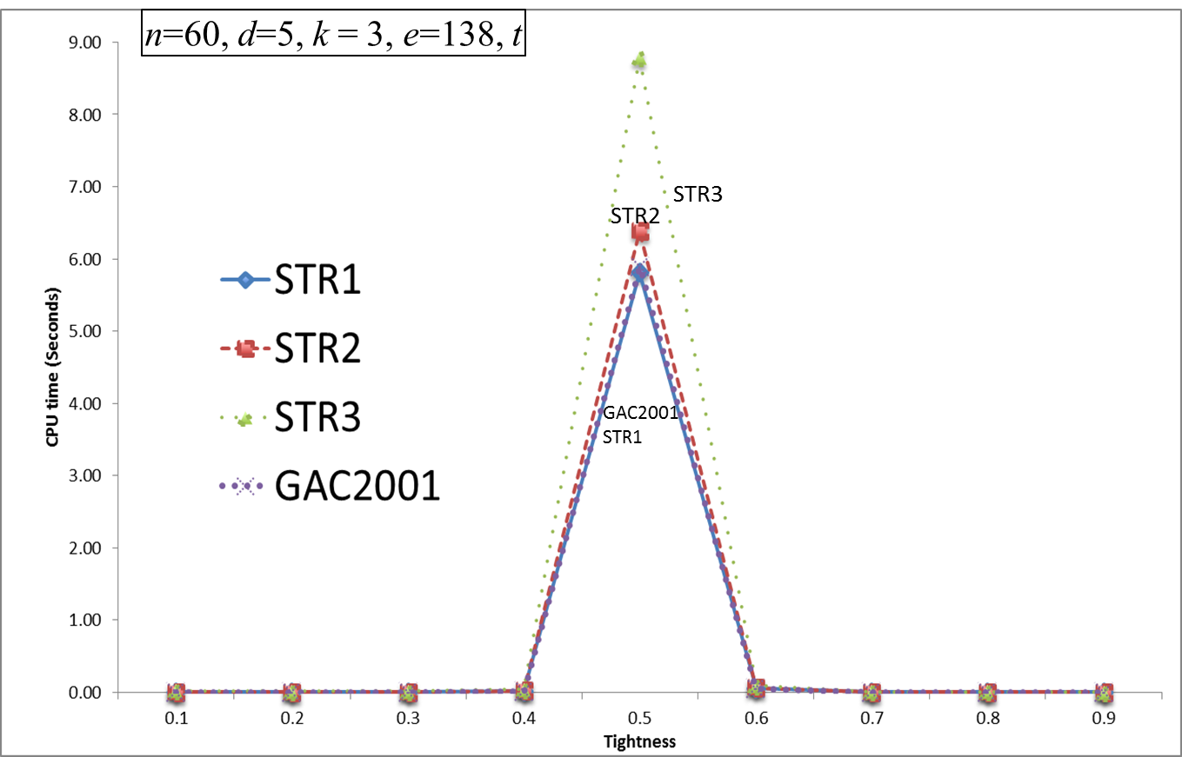
Comparing STR* algorithms against GAC2001
Notes:
The algorithm is correct. It does the same amount of filtering and yields the same search tree as other algorithms and so visits the same number of nodes and does the same amount of backtracks. But they take more time because our implementation has a problem that we do not have the time to examine and fix

Slide 21
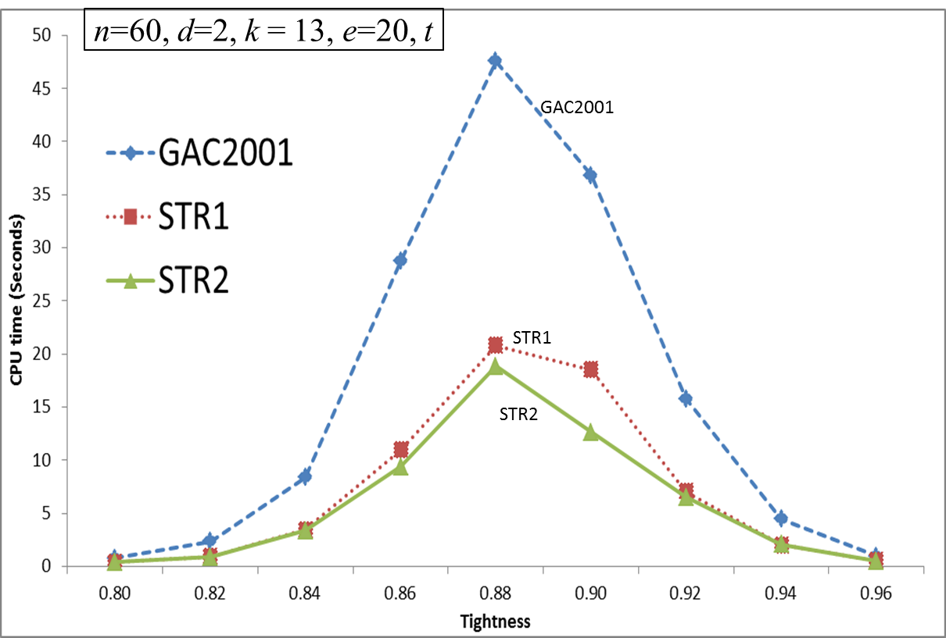
Comparing STR* algorithms against GAC2001

Slide 22
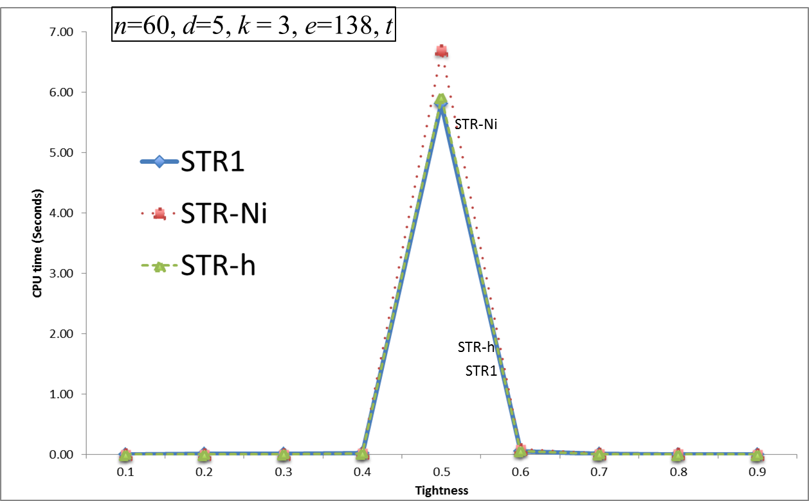
Comparing STR-h against STR1 and STR-Ni

Slide 23
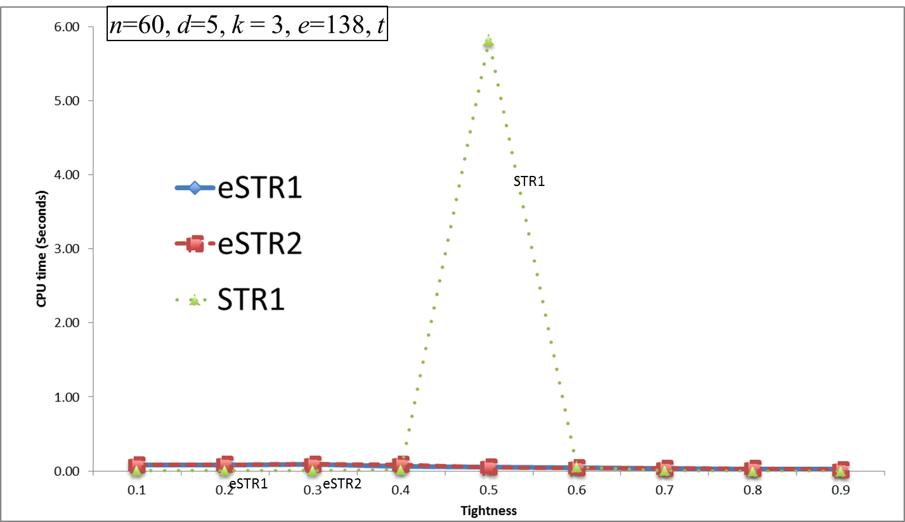
Comparing eSTR1 and eSTR2 against STR1
Notes:
Pairwise consistency is very effective at the phase transition (diffucult problems) We increase the domain size

Slide 24
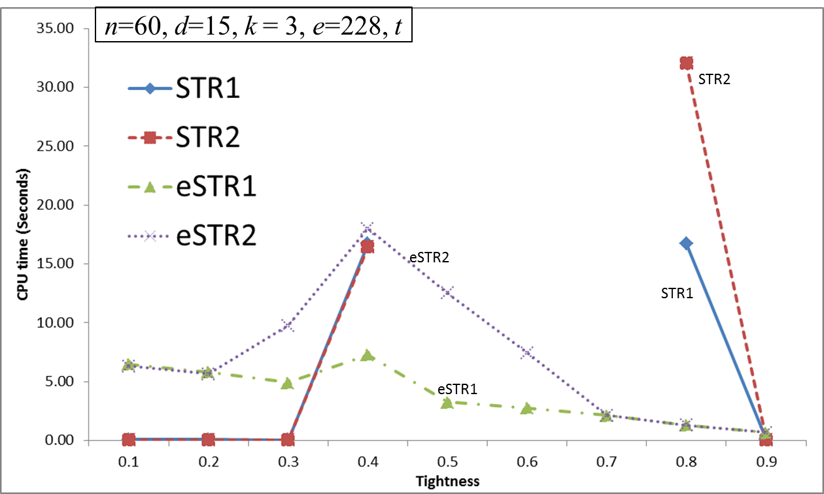
Comparing eSTR1 and eSTR2 against STR1 and STR2
Notes:
Very large problems. Search space 15^60. GAC is not high enough consistency. WE really need higher level consistency to handle such large problems. STR* do not even complete within 2 hours

Slide 25
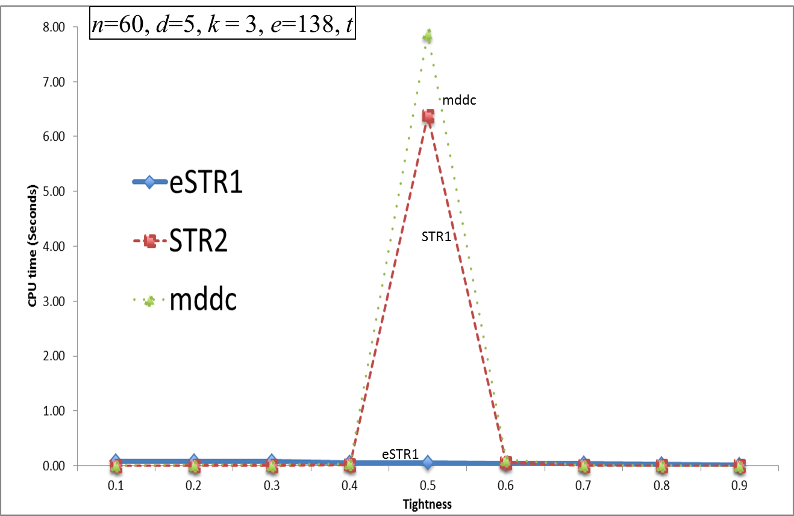
Comparing mddc against STR2 and eSTR1
STR2

Slide 26
Benchmark Problems
Number of instances tested: 2875
  Binary: 1915
  Non-binary: 960
Algorithm ranking
  Kaplan-Meier method, a non-parametric test
  Computes the survival time of each algorithm
Discuss three representative benchmarks
  Detailed results are in Appendix B

Slide 27
Qualitative analysis (1)
Statistical analysis on CP benchmarks
Time: Censored data calculated mean
#F: Number of instances fastest
[⋅]_{CPU}: Equivalence classes based on CPU
#C: Number of instances completed
#BT-free: # instances solved backtrack free
Algorithm | Time | #F | [⋅]_{CPU} | #C | #BT-free | #NV
lexVg: 63(2) instances
GAC2001 | 38,838.41 | 28 | A | 63 | 26 | 18.00
STR1 | 10,414.50 | 20 | A | 60 | 26 | 18.00
STR2 | 5,490.16 | 60 | A | 61 | 26 | 18.00
STR3 | 120,270.34 | 0 | B | 58 | 26 | 18.00
eSTR1 | 5,074.00 | 3 | A | 55 | 26 | 18.00
eSTR2 | 10,202.50 | 23 | A | 60 | 26 | 18.00
STR-Ni | 25,370.00 | 0 | B | 2 | 2 | 18.00
STR-h | 136,883.33 | 0 | B | 6 | 2 | 18.00
mddc | 214,408.41 | 0 | B | 44 | 26 | 18.00

Slide 28
Qualitative analysis (2)
Statistical analysis on CP benchmarks
Time: Censored data calculated mean
#F: Number of instances fastest
[⋅]_{CPU}: Equivalence classes based on CPU
#C: Number of instances completed
#BT-free: # instances solved backtrack free
Algorithm | Time | #F | [⋅]_{CPU} | #C | #BT-free |  | #NV
dag-rand: 25 instances
GAC2001 | 2,934,000.00 | 0 | B | 25 | 0
STR1 | 1,348,394.00 | 0 | B | 25 | 0
STR2 | 1,331,438.00 | 0 | B | 25 | 0
STR3 | - | - | - | 0 | -
eSTR1 | 108,003.20 | 0 | A | 25 | 25
eSTR2 | 101,985.20 | 25 | A | 25 | 25
STR-Ni | - | - | - | 0 | -
STR-h | - | - | - | 0 | -
mddc | - | - | - | 0 | -

Slide 29
Qualitative analysis (3)
Statistical analysis on CP benchmarks
Time: Censored data calculated mean
#F: Number of instances fastest
[⋅]_{CPU}: Equivalence classes based on CPU
#C: Number of instances completed
#BT-free: # instances solved backtrack free
Algorithm | Time | #F | [⋅]_{CPU} | #C | #BT-free | #NV
travellingSalesman-20: 15 instances
GAC2001 | 67,176.67 | 10 | A | 15 | 1
STR1 | 13,179.17 | 1 | A | 12 | 1
STR2 | 13,635.83 | 3 | A | 12 | 1
STR3 | 7,440.00 | 0 | B | 1 | 1
eSTR1 | 19,076.67 | 0 | A | 12 | 1
eSTR2 | 13,820.83 | 0 | A | 12 | 1
STR-Ni | - | - | - | 0 | -
STR-h | 15,281.67 | 0 | A | 12 | 1
mddc | 989,813.33 | 0 | B | 3 | 1

Slide 30
Outline
Background
Overview of GAC algorithms
  GAC2001
  Simple Tabular Reduction: STR1, STR2, STR3, STR-Ni, eSTR1, eSTR2
  Multi-valued decision diagrams: mddc
Our contribution
  STR-h combines STR1 and STR-Ni
Evaluation and comparison of GAC algorithms
  Randomly generated CSPs
  Benchmark problems
Conclusions and future work

Slide 31
Conclusions (I)
GAC2001
  Easy to implement
  Particularly effective on binary but occasionally on non-binary CSPs
  Effective for ‘shorter’ tables
STR1 and STR2
  STR2 has (too?) complex data structures
  Effective on many binary and non-binary CSPs
  Especially when the positive tables are smaller than the negative tables (i.e., tight constraints)
STR3
  Heavy on (bookkeeping) data structures
  Requires more memory than all other algorithms we tested
  Our implementation fails to show the promised improvements ☹

Slide 32
Conclusions (II)
STR-Ni
  Lightweight data structures
  Effective when the negative tables are smaller than the positive tables
STR-h
  Combines STR1 and STR-Ni
  Does not perform worse than the worse of STR1 and STR-Ni
  Effective when a CSP has a mixture of tight and loose constraints
eSTR*
  Enforces both GAC and PWC
  Very effective on non-binary CSPs, especially on ‘difficult’ problems
mddc
  Advantageous when constraints can be represented compactly as an MDD (e.g., pseudo-Boolean CSPs)
  Our implementation fails to show promised improvements ☹
Notes:
Difficult, means problems that require higher level consistency

Slide 33
Future Work
Performance of our STR3 and mddc is a major concern
  It requires a more careful examination than allowed in the time frame
  of this thesis
New developments reported in the literature
  Target STR and MDD-represented constraints
Extend our idea of a hybrid algorithm
  Use the most appropriate representation for each individual constraint
  Apply the GAC algorithm most adapted to constraint’s representation
  Challenge: data structures for transparent and efficient interoperability of the various algorithms

Slide 34
Thank you
Ready for your questions

Slide 35
Contributions
Study of various generic GAC algorithms
  Basic (1)
  Simple Tabular Reduction (STR) (6)
  For constraints as multi-valued decision diagrams (1)
New hybrid algorithm
  STR for positive and negative table constraints
Empirical evaluation of all algorithms
  Randomly generated problems
  Benchmark problems

